Slide 1



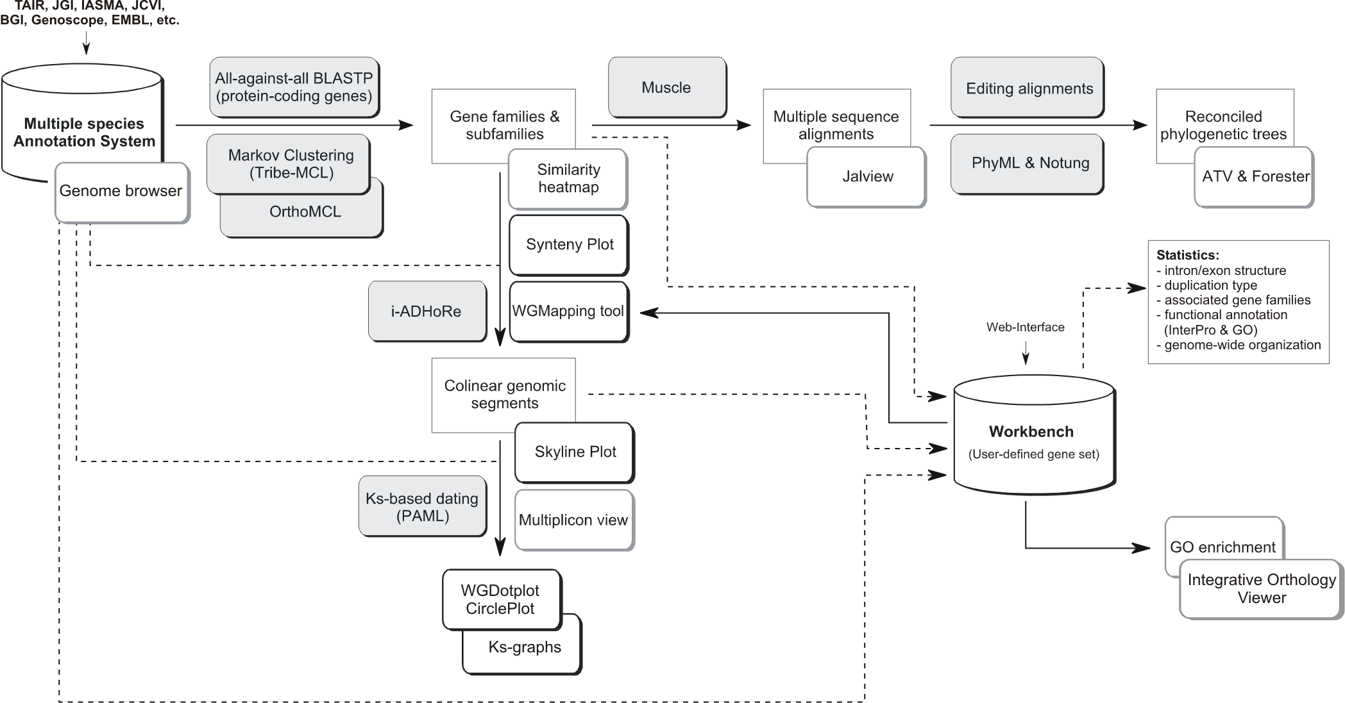
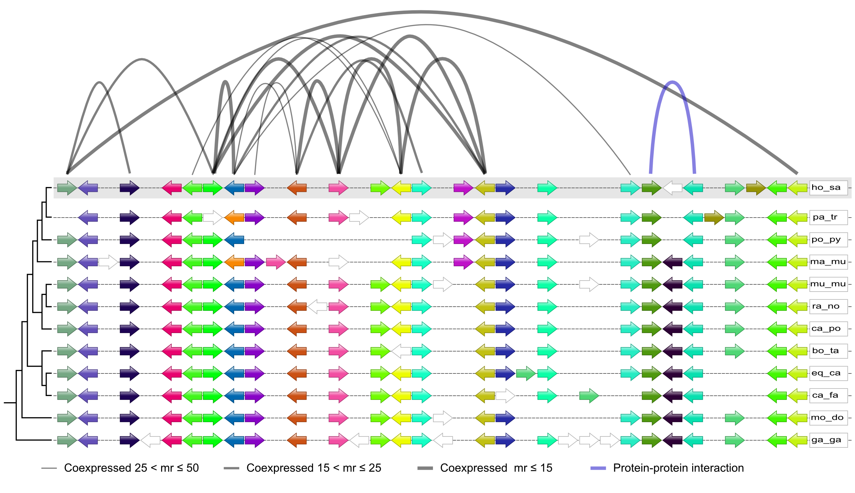
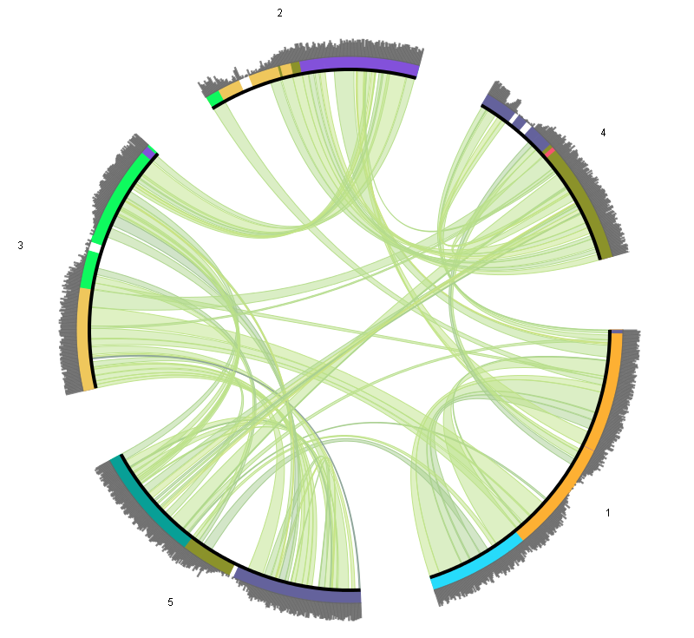
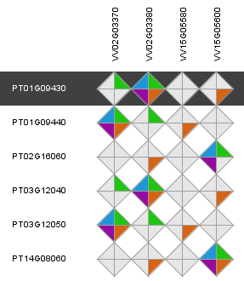
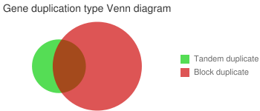
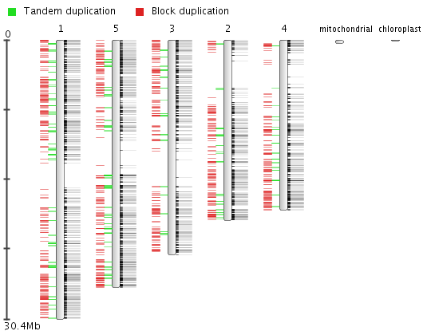
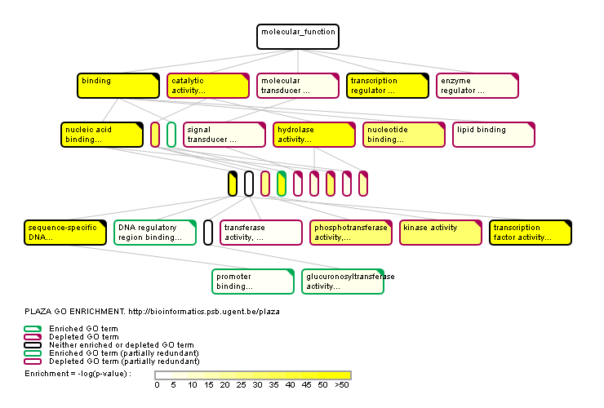

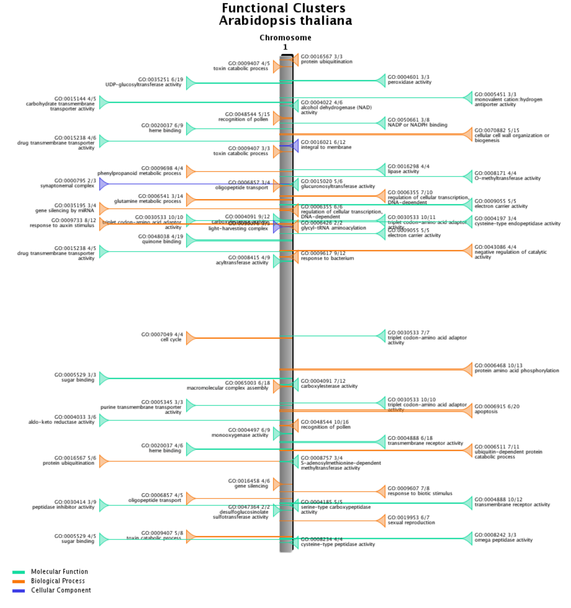








sebastian.proost@psb.vib-ugent.be
Dissecting plant genomes using PLAZA 2.5
Michiel Van Bel^{1,2+}, Sebastian Proost^{1,2+}, Elisabeth Wischnitzki^{1,2}, Sara Mohavedi^{1,2}, Christopher Scheerlinck³, Yves Van de Peer^{1,2} and Klaas Vandepoele^{1,2} (+contributed equally)
1 Department of Plant Systems Biology, Bioinformatics and Systems Biology Division, VIB, Technologiepark 927, 9052 Ghent, Belgium
2 Department of Plant Biotechnology and Genetics, Ghent University, Technologiepark 927, 9052 Ghent, Belgium
3 Department Industrial Sciences BME-CTL, Hogeschool Gent, B-9000 Ghent, Belgium
http://bioinformatics.psb.ugent.be/plaza
Introduction
Detection of Genomic Homology Using i-ADHoRe 3.0
To study genome evolution it is imperative to know which regions are derived from a common ancestor. This way remnants of whole genome duplications in a single species and rearrangements between species can be mapped. To deal with the vast amount of data in this new release of PLAZA, i-ADHoRe, the tool to detect genomic homology has been significantly improved. The implemenation of a new gene order alignment algorithm (Fostier J. et al., 2011) enables an accurate and sensitive detection in large datasets, while the implementation of support for modern hardware (like multi–core cpu’s and computer cluters) and under-the-hood optimizations keep runtimes acceptable even on extremely large datasets.
The on-line comparative genomics platform PLAZA (Proost S. et al., 2009) was designed to offer comprehensive data to non-bioinformaticians in a user-friendly way.
However, since the release of the first version of PLAZA the number of available plant genomes has more than doubled. Hence an update of the species became necessary, along with under-the-hood improvements to allow this increase in data and the inclusion of several new tools. Here we present the novel version of PLAZA that now contains 25 plant species and, along with the tools present in previous versions, comes with a new sets of tools to dissect the evolution of these plant genomes.
Data included since the first version
  Structural and functional annotation
  Gene families and sub-families
  Multiple sequence alignment
  Reconciled phylogenetic trees
  Genomic homology with Ks/4dtv dating
  Tools and viewers associated with all types
  of data
  Workbench for analysis of custom gene sets
  New features
  Interactive visualizations
  Orthology Viewer
  Functional clustering
  Improved detection of genomic homology
  Extra features in workbench
(A)
(B)
Figure 1. Steps and tools required to build PLAZA, and various viewers to browse the generated data.
Figure 4. (A) gene order alignment of an conserved region in vertebrates, arced lines connect co-expressed genes (black) and genes that code for interacting proteins (blue). (B) Integration of i-ADHoRe data in PLAZA 2.5, the circleplot shows the 5 chromosomes of Arabidopsis thaliana with regions duplicated during the last whole genome duplication connected using green lines, homologous regions in A. lyrata are indicated by different colors, for different chromosomes. The most outward ring shows coding gene densitiy, low densitiy can be observed in centromeric regions.
Orthology Viewer: a quick way to find functionally related genes
A major advantage of comparative genomics is that it allows the transfer of knowledge from one species, most likely a model-organism, to other less studied species. Orthologous genes are of crucial importance for this, since they are derived from a common ancestor, separated by speciation events, they are likely to have a similar function. However, in case of species specific duplications, one gene might have multiple co-orthologs in the other species. Additionally each method to detect orthologs comes with a unique set of advantages and disadvantages. Therefore information from several sources was integrated in the Orthology Viewer, to allow users to make more informed decisions to find functional orthologs.
Workbench: allowing users to study their favorite genes
Through the normal web platform studying a mid- to large-scale set of genes becomes a tedious, repetitive, time-consuming task. To allow users to retrieve data for a set of genes faster , without hassle the workbench was created. After creating an account user can quickly create private experiments containing sets of genes. Using the import through BLAST , protein or cDNA/EST sequences from species not included in PLAZA can be mapped onto a close relative.
Within such an experiment users can quickly compare intron-exon structure, interpro domains, the mode of duplication, functional enrichment, … Like in the main platform, each datatype is associated with viewers that make interpretation of the results easy and efficient.
In PLAZA there are four different ways to detect orthologous genes have been integrated, using Reciprocal Best Hits (RBH, BLAST based), OrthoMCL, by reconciliation of phylogenetic trees and positional orthologs. Using a interactive apple orthologs for a specific gene in other organisms can be found in an intuitive way. The different colors in the diamonds show the various types of evidence.
(A)
(C)
(D)
Figure 2. The selected poplar gene PT01G09430 has 4 homologs (genes derived from a common ancestor) in grape, while various genes are considered orthologs, only one gene (VV02G03380) is a confirmed ortholog using all methods. (RBH, purple; Tree based, blue; orthoMCL, green; anchorpoint, orange)
Functional Clustering
(B)
From literature it is known that functionally related genes can be present in close proximity to each other, this has several distinct advantages, they have a low linkage distance and can be co-regulated in additional ways (eg. chromatin modification). In this new version of PLAZA such functional cluster have been detected and an new viewer for this novel datatype is implemented.
Figure 5. (A) Venn diagram of the mode of duplication of the genes in the set. (B) Easy side-by-side comparison of intron-exon structure. (C) Distribution of transcription factors in the Arabidopsis thaliana chromosome 1 and 5. (D) GO-graph with enriched labels indicated.
Conclusion
Here we present an significant update of both the raw data as the features of the PLAZA comparative genomics platform. By including novel species researchers working on any of the new species can directly benefit from this update. While others still have the option to quickly map genes to a related included species using the workbench’s BLAST interface. The new tools enable additional analyses, that were not possible using previous versions.
This new update ensures PLAZA, that currently is visited by dozens of scientist each day, will stay a powerful tool for plant researchers worldwide.
References
Figure 3. Functionally enriched gene clusters on a part of Arabidopsis thaliana chromosome 1.
S. Proost*, M. Van Bel*, L. Sterck, K. Billiau, T. Van Parys, Y. Van de Peer, and K. Vandepoele. Plaza: a comparative genomics resource to study gene and genome evolution in plants. Plant Cell, 21(12):3718-31, 2009 (* contributed equally)
J. Fostier*, S. Proost*, B. Dhoedt, Y. Saeys, P. Demeester, Y. Van de Peer, and K. Vandepoele. A greedy, graph-based algorithm for the alignment of multiple homologous gene lists. Bioinformatics, 27(6):749-756, 2011 (* contributed equally)

