Slide 1



PLAZA 2.5 – a resource for plant comparative genomics
Michiel Van Bel
Bioinformatics & Evolutionary Genomics group
Comparative & Integrative Genomics group
VIB – Ghent University, Belgium
SPICY workshop 08/03/0212
Wageningen, Netherlands
plaza@psb.vib-ugent.be
Notes:
The Motivation for this talk is two-fold: the first objective is to introduce the update of the PLAZA platfrom and discuss new #species as well as new or improved tools. Secondly, I will present the application of complementary data types to infer gene orthology between different plants and comment on some associated pitfalls.

Slide 2
Publicly available plant genomes
Today: >20 published plant genomes
Number of available transcriptomes is a multitude of this
Notes:
22 published plant genomes

Slide 3
Exploiting cross-species genome information
Centralized infrastructure
Detailed gene catalog per species
  Structural annotation (gene models, UTRs)
  Functional annotation (experimental, sequence-based)
Intuitive & advanced data mining tools for non-expert users
    Gene function
    Genome organization
    Gene families
    Pathway evolution
    Data manipulation

Slide 4
What can we learn from Comparative Genomics?
Conservation
  transfer knowledge gained from model organisms to non-model organisms
Variation
  understand how genomes change over time in order to identify evolutionary processes and constraints
Evolutionary constraint & detection of functional elements
  coding elements (e.g. exons)
  conserved non-coding sequences (e.g. regulatory elements)
Notes:
Because all modern genomes have arisen from common ancestral genomes, the relationships between genomes can be studies with this fact in mind. This commonality means that information gained in one organism can have application in other even distantly related organisms.
Comparative genomics enables the application of information gained from facile model systems to agricultural and medical problems. The nature and significance of differences between genomes also provides a powerful tool for determining the relationship between genotype and phenotype through comparative genomics and morphological and physiological studies.

Slide 5

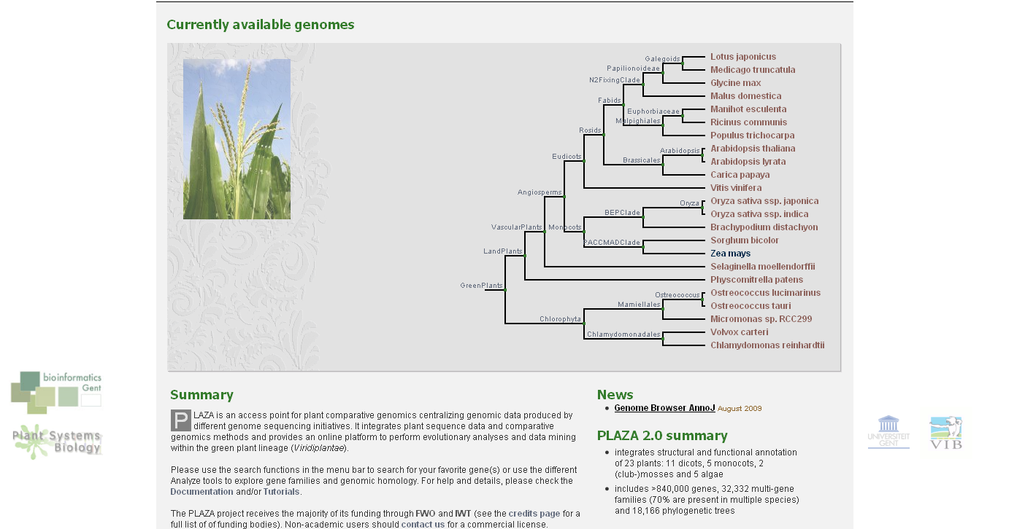
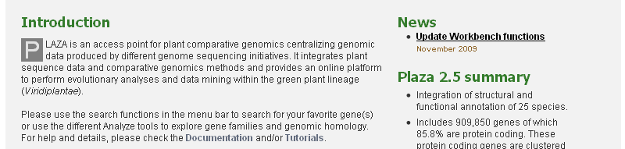
PLAZA, a resource for plant comparative genomics
http://bioinformatics.psb.ugent.be/plaza/

Slide 6
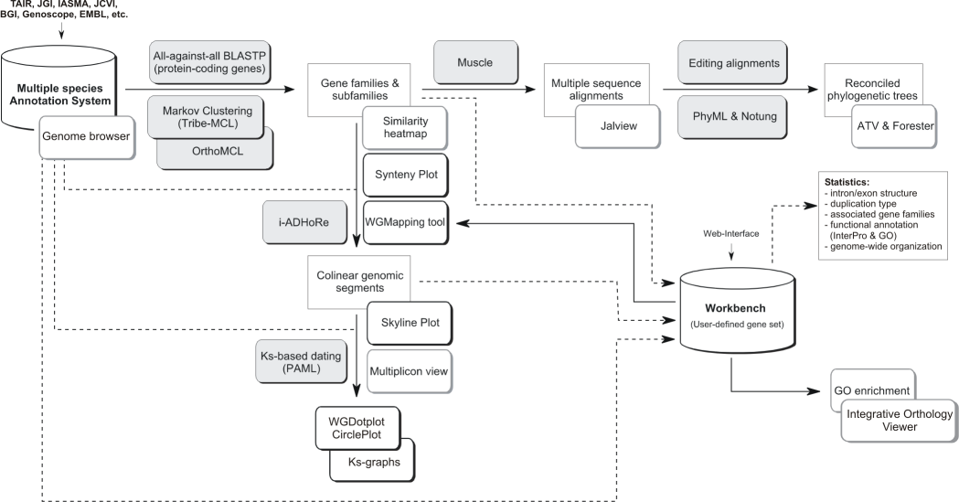
Gene family analysis
Genome analysis
More information? Check Help – Documentation
Data content & Construction
Tools
Tutorial
Proost et al., 2009

Slide 7
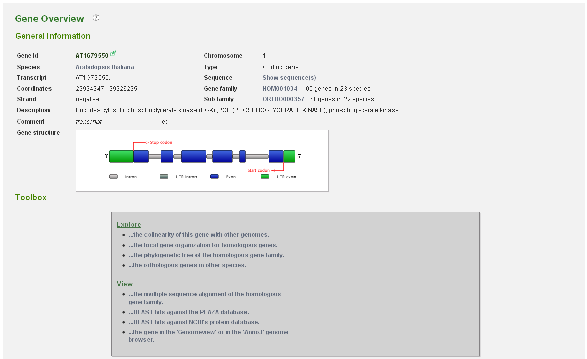
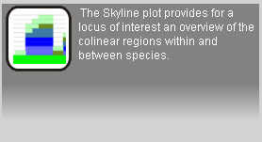
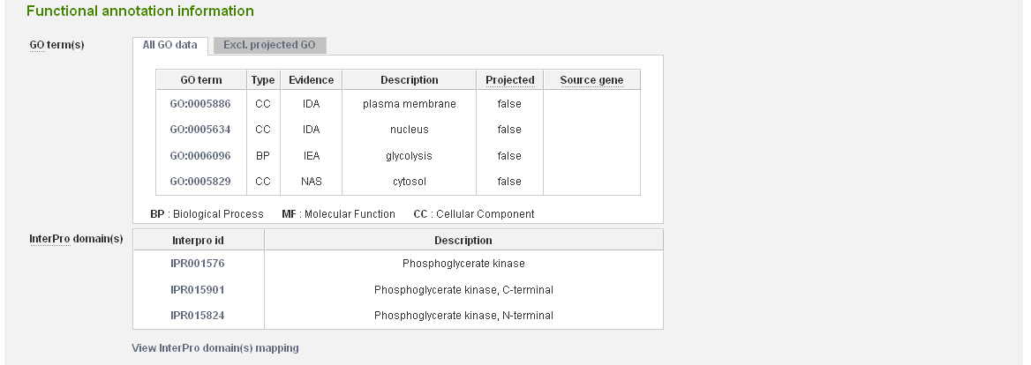

Slide 8
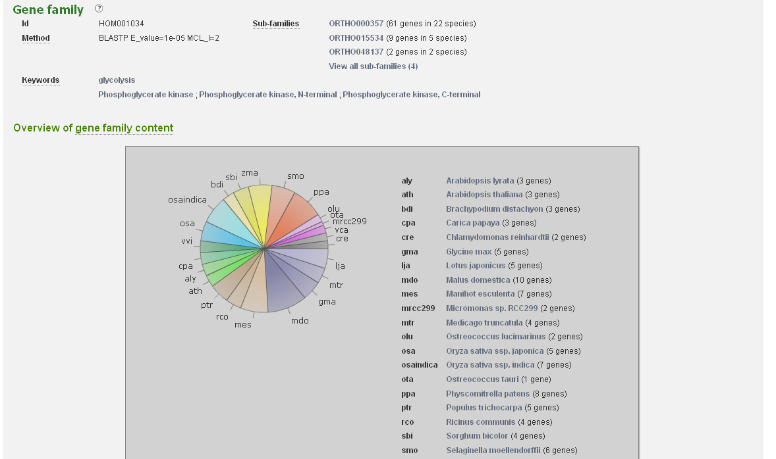
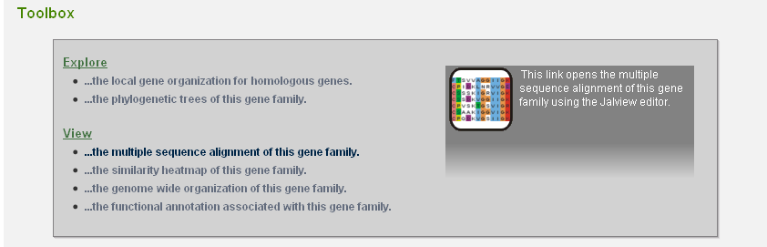
Gene family page
Notes:
Gene families based on sequence similarity, but this does not strictu sensu means homology

Slide 9
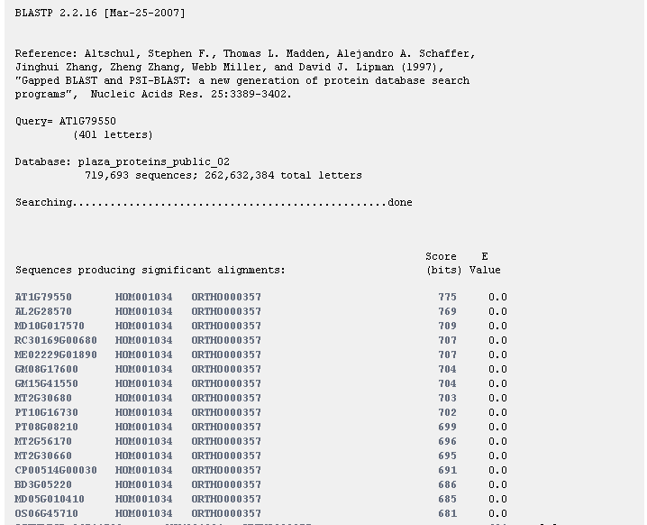
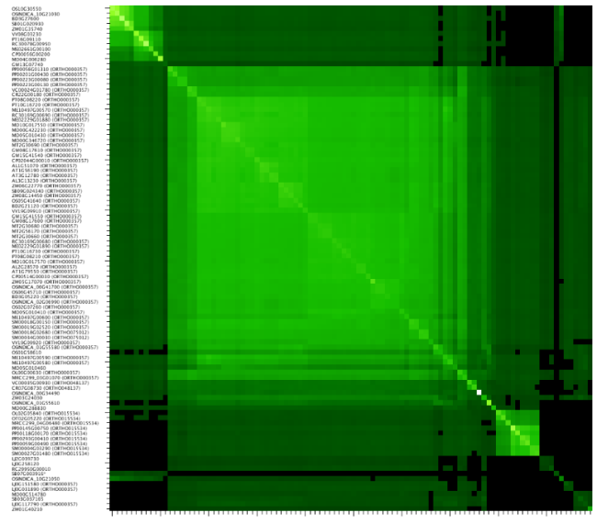
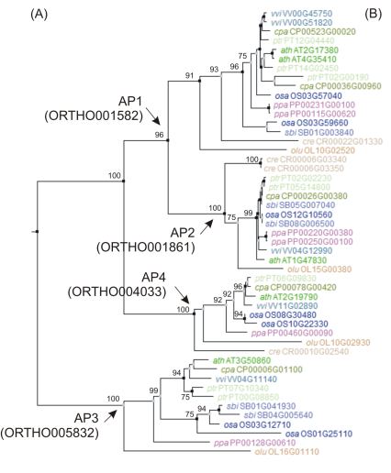
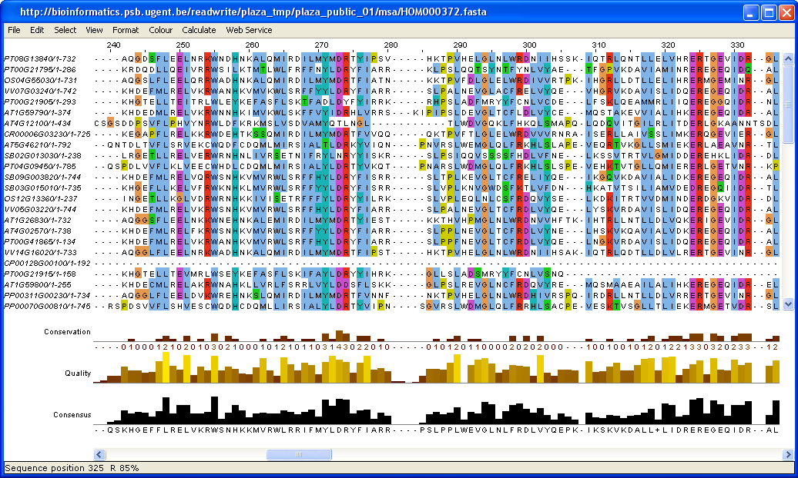
Gene family similarity heat map, multiple sequence alignment & phylogenetic trees

Slide 10
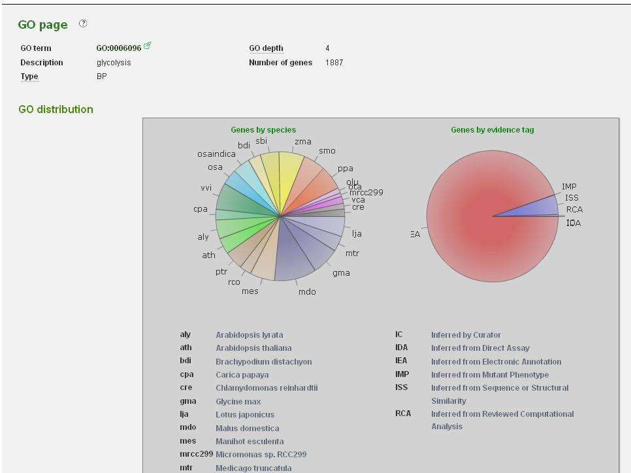
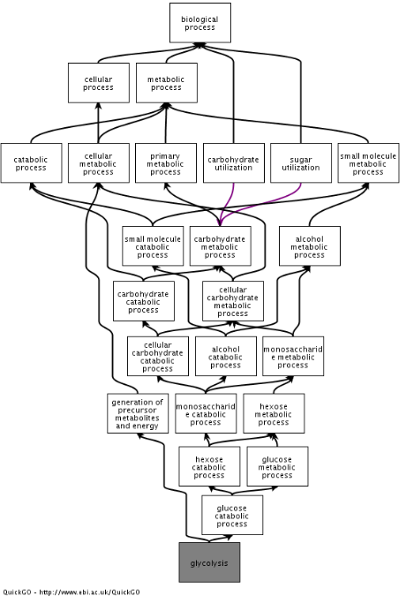

Gene Ontology annotation

Slide 11
Gene family analysis
Genome analysis

Slide 12
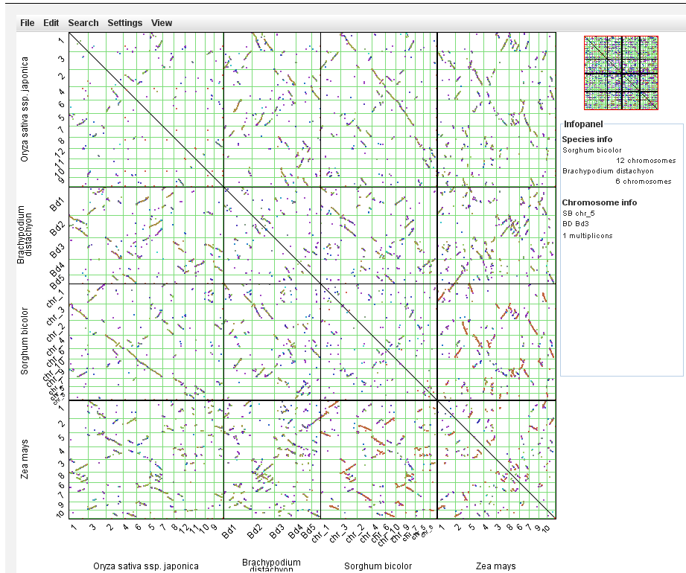
WGDotplot applet

Slide 13
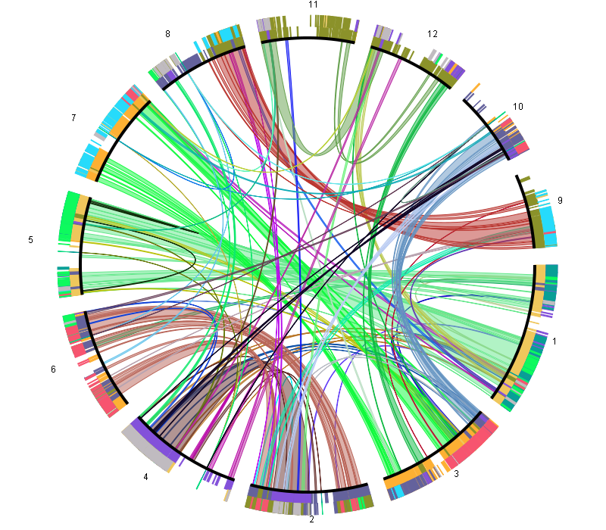
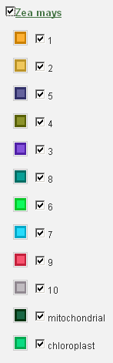
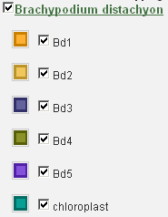
Whole-genome Circular Dotplot
Reference: O. sativa
Inner circle: duplicated regions
Outer circle: inter-species colinear regions

Slide 14
Gene family analysis
Genome analysis

Slide 15
Workbench data import
Create a custom gene set (~experiment) using gene identifiers or BLAST
  External/internal gene IDs (e.g. AN3, AT5G28640, GRMZM2G180246_T01)
  BLAST interface can be used to map sequence data from a non-model species to a reference species present in PLAZA
A toolbox is available to analyze user-defined gene sets
Microarray transcript profiling
Mapping
Gene Families
PLAZA
Workbench
EST sequencing
Functional
annotations
GO enrichment
Sequence
retrieval
Tandem/block
duplicates
Genes reported in Suppl. data
Orthologs
Export data…

Slide 16
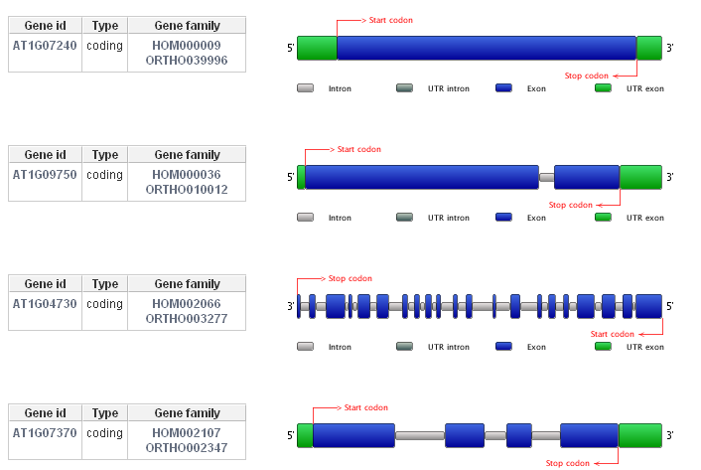
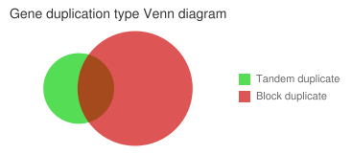
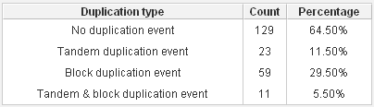
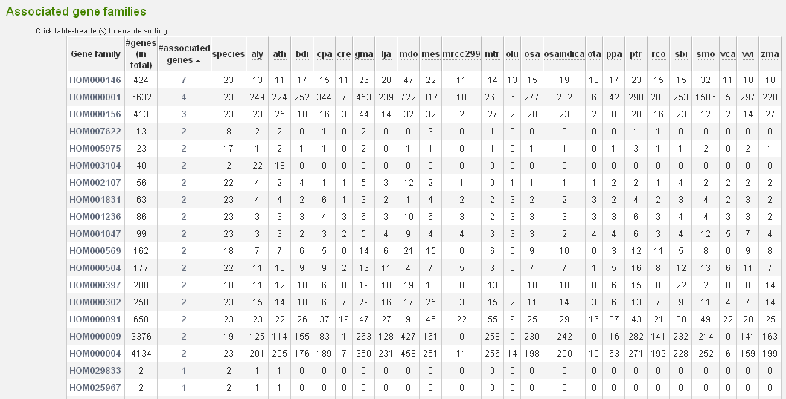
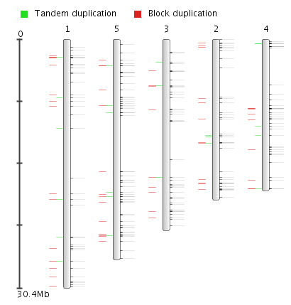

Slide 17
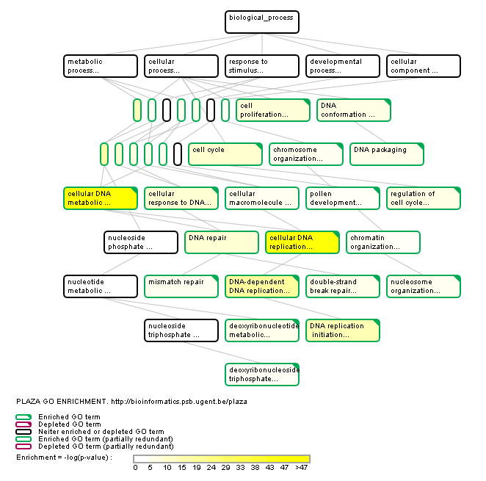
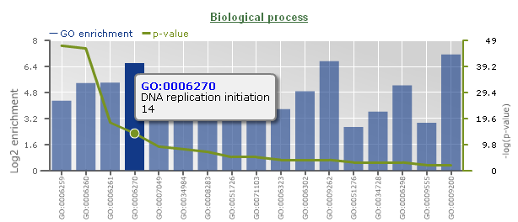
GO enrichment analysis for all 25 species!

Slide 18
Detection of orthologous plant genes
Meaning…
  Orthology = genes derived from a common ancestor in different species
  Functional homologs = genes in different species having similar functions
Functional homologs in different species share …
  similar expression?
  regulation?
  protein-protein interactions?

Slide 19
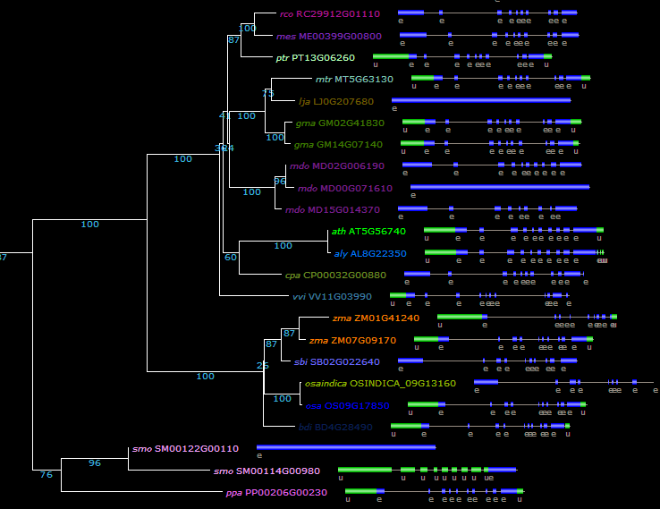
How do we measure orthology?
Phylogenetic inference (TROG)
dicots
1-many orthology
1-1 orthology
monocots

Slide 20
BLAST-based approaches
Reciprocal Best Hit (RBH)
  Genes being mutual best hits using BLAST are considered orthologs
RBH Orthologs:
  Arabidopsis – O. sativa:
    AT5G56740 – OS09G17850
  Arabidopsis – G. max:
    AT5G56740 – GM14G07140 (not GM02G41830!)
Simple measure but not robust to species-specific evolution
AL8G22350
AT5G56740
OS09G17850
GM14G07140
GM02G41830

Slide 21
Protein clustering
OrthoMCL (ORTHO)
  Graph-based clustering algorithm modeling orthology using RBHs as well as in-paralogy (within-species best hits)
Best-hit Inparalog Families (BHIF)
  BLAST-based approach retrieving for each species the best hit including in-paralogs
AL8G22350
AT5G56740
OS09G17850
GM14G07140
GM02G41830

Slide 22
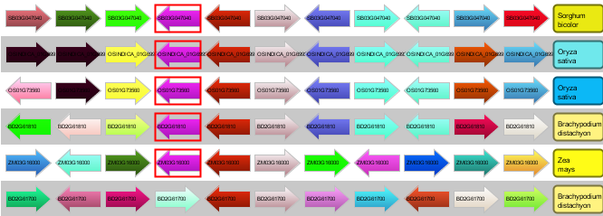
Genome conservation
Orthologous genes showing conserved genome organization are called ‘positional orthologs’
Gene colinearity can be used as a proxy for genome stability
Synteny Plot

Slide 23
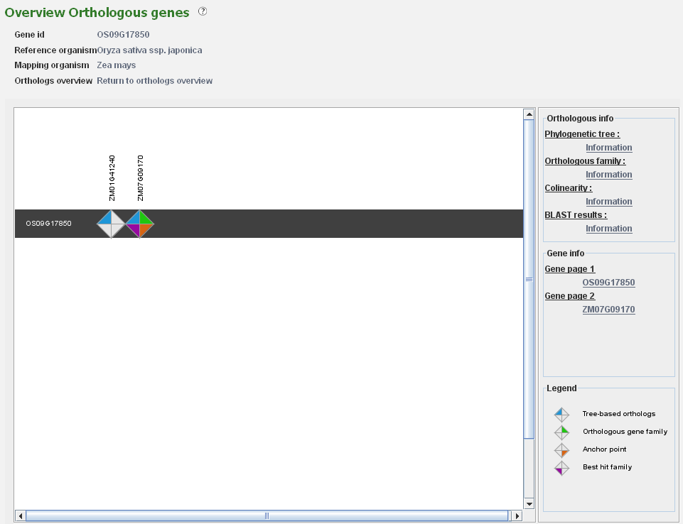
Integration of 4 orthologous data types
Tree-based orthologs (TROG) inferred using tree reconciliation
Orthologous gene families (ORTHO) inferred using OrthoMCL
Anchor points refer to gene-based colinearity between species
Best hit families (BHIF) inferred from Blast hits against including inparalogs

Slide 24
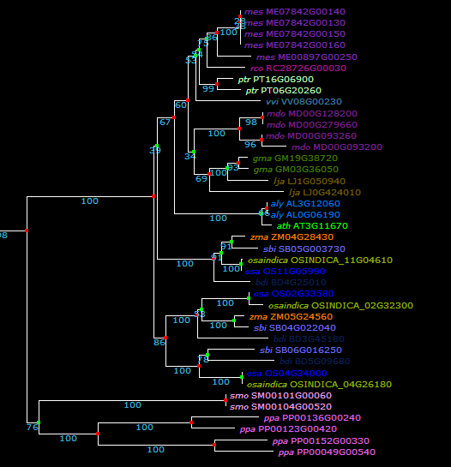
AT3G11670 - DGD1 (DIGALACTOSYL DIACYLGLYCEROL DEFICIENT 1)
dicots
monocots
monocots

Slide 25
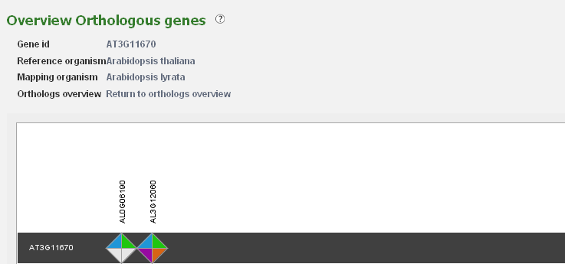
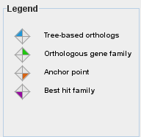
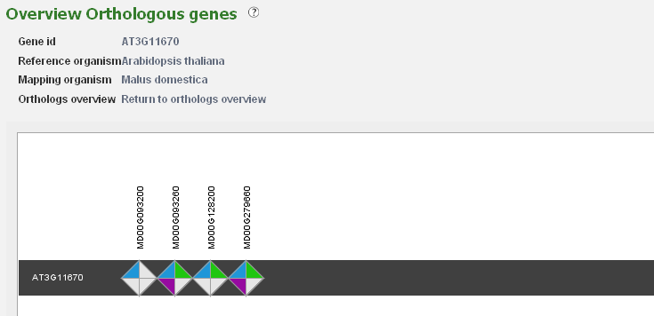
1-many orthology

Slide 26
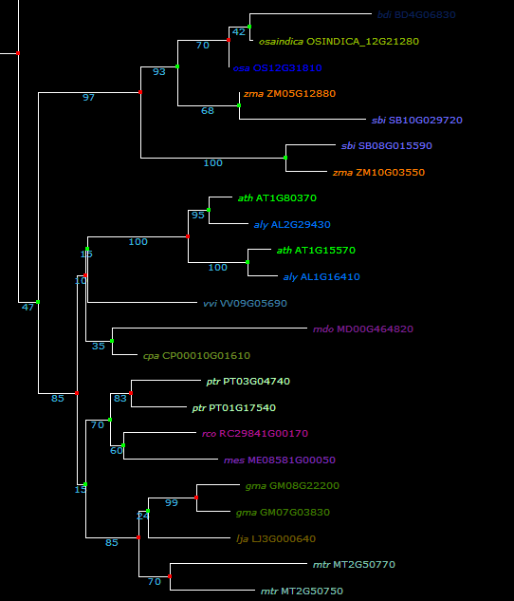
AT1G15570 – CYCA3;2
monocots
dicots

Slide 27
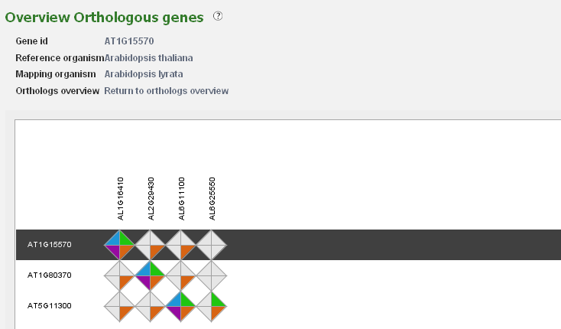
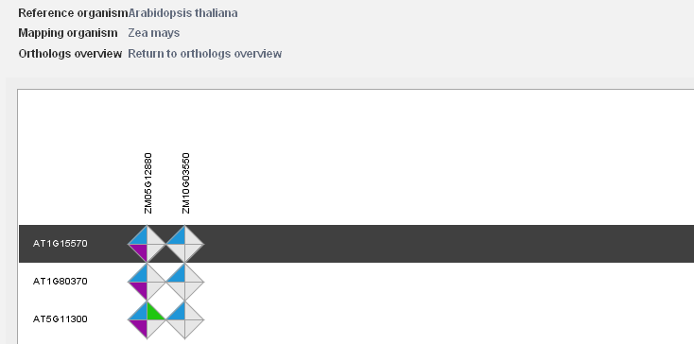
many-many orthology
Notes:
The Workbench includes a tool to explore orthologous genes in other species for multiple genes in batch-mode.

Slide 28
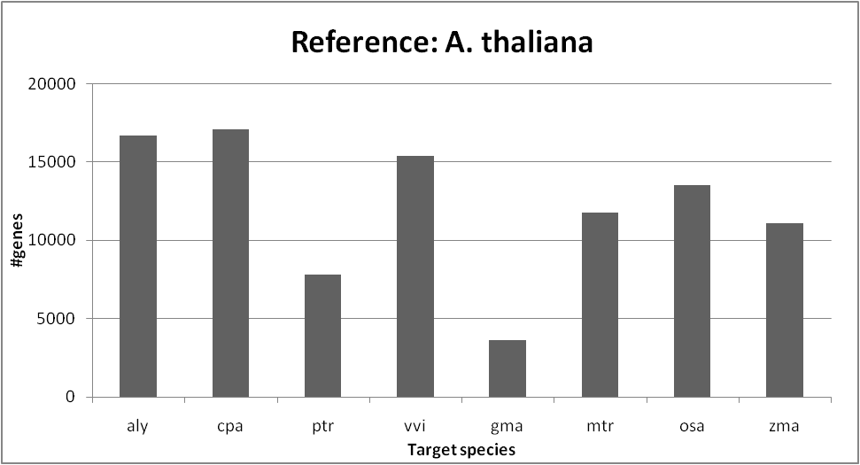
The quest for single-copy orthologs…
45%
66%
60%
52%
46%
43%
30%
14%
WGD
WGD
Both species divergence and different modes of genome evolution interfere with the efficient and unambiguous detection of orthologous genes in plants
Notes:
25879 Ath genes with homologs in other species

Slide 29
Conclusions
PLAZA provides an integrated and intuitive framework that can function as
  a data warehouse for plant genomes
  a comparative research environment for genomic data mining
  an easy access point for non-expert users to explore orthologous genes

Slide 30





Acknowledgments
  Prof. Dr. Klaas Vandepoele
  Sebastian Proost
  Prof. Dr. Yves Van de Peer
http://bioinformatics.psb.ugent.be/plaza/

Slide 31
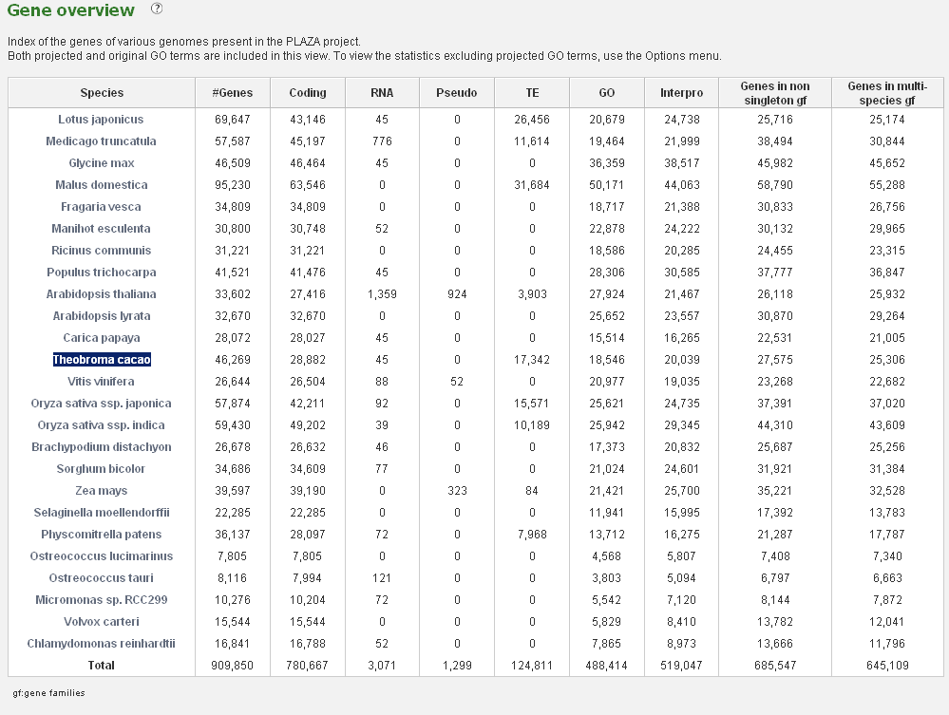
PLAZA 2.5 gene content

Slide 32
Sequencing in progress
Eucalyptus grandis | JGI
Arabidopsis arenosa | JGI
Gossypium (cotton) genome Phase II | JGI
Gossypium raimondii | JGI
Brassica rapa B3 | JGI
Zea mays ssp. mays Mo17 | JGI
Salix purpurea L | JGI
Arabidposis halleri | JGI
Capsella rubella | JGI
Boechera holboellii Panther | JGI
Miscanthus giganteus Sequencing Pilot Project | JGI
Manihot esculenta CV AM560-2 | JGI
Setaria italica Yugu1 | JGI
Aquilegia coerulea Goldsmith | JGI
Brassica ? | MGBP
Lycopersicum esculentum | ITGSP
Solanum tuberosum | PGSC
Musa acuminata | GMGC
Mimulus guttatus | JGI
Triphysaria versicolor | JGI

Slide 33
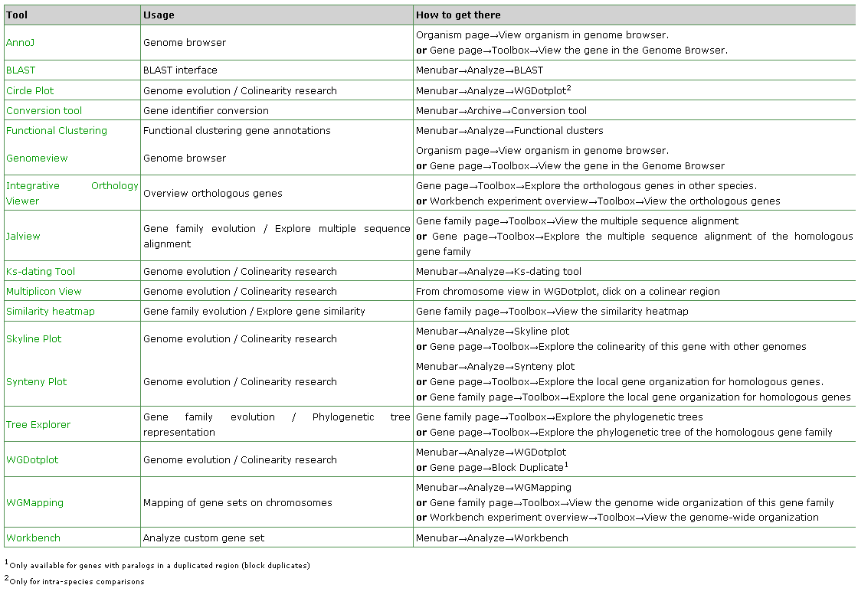
Tool navigation table

