Slide 1
Solutions for the PLAZA genomics part of the SPICY workshop on genomics
Website: http://bioinformatics.psb.ugent.be/plaza/
More information:
plaza@psb.vib-ugent.be

Slide 2
Part 1.
Starting from a gene page

Slide 3
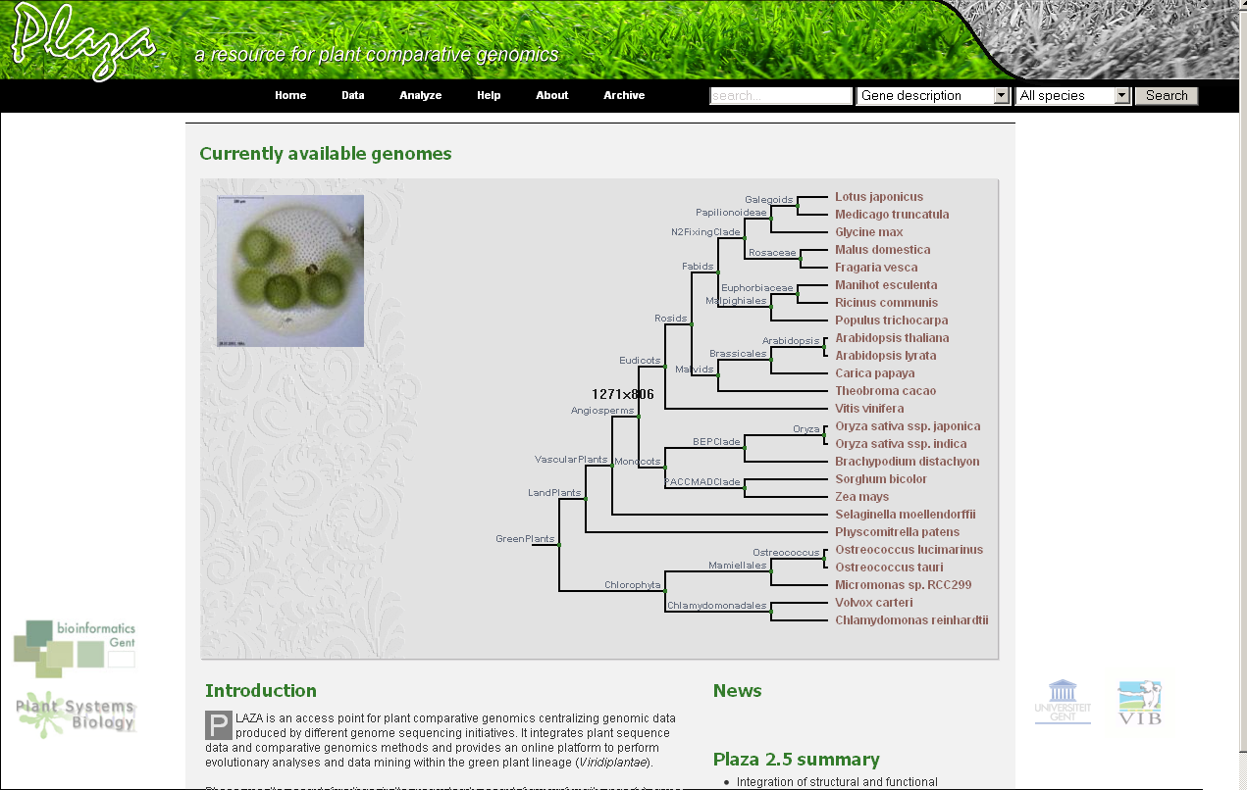
1.1) Go to gene page of Arabidopsis thaliana gene AT2G41430
Solution: a) Go to http://bioinformatics.psb.ugent.be/plaza/
b) Enter AT2G41430 in the search-box

Slide 4
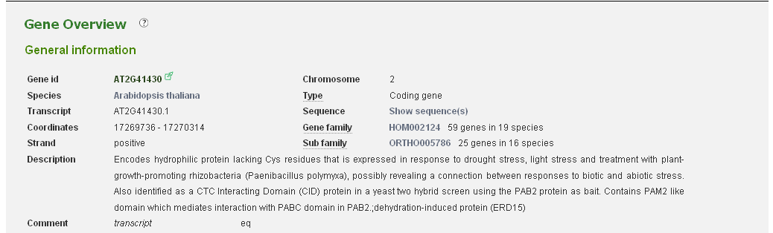
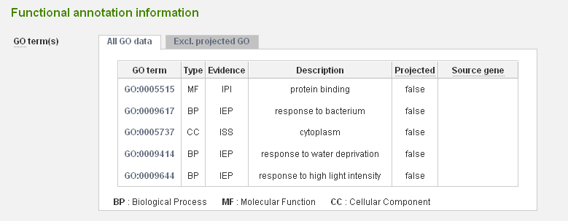
1.2) What is the function of this gene? Does the description of the gene match the
associated functional annotation?
Solution: a) Gene page: http://bioinformatics.psb.ugent.be/plaza/genes/view/AT2G41430
b) Compare description at top of page with functional annotation at bottom

Slide 5
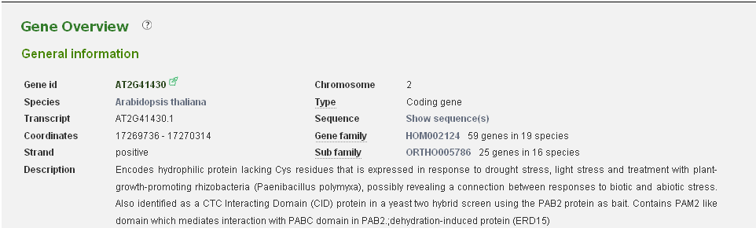
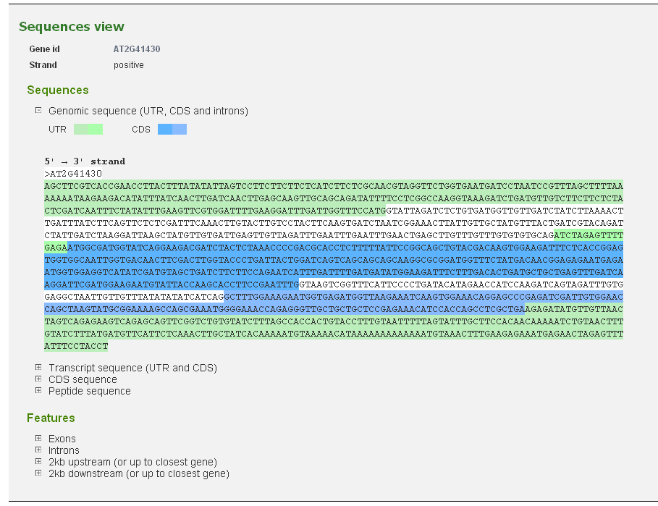
1.3) What kinds of sequences are available for this gene?
Solution: a) Go to sequences page of a gene

Slide 6
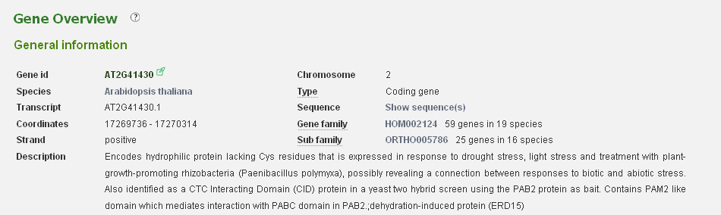
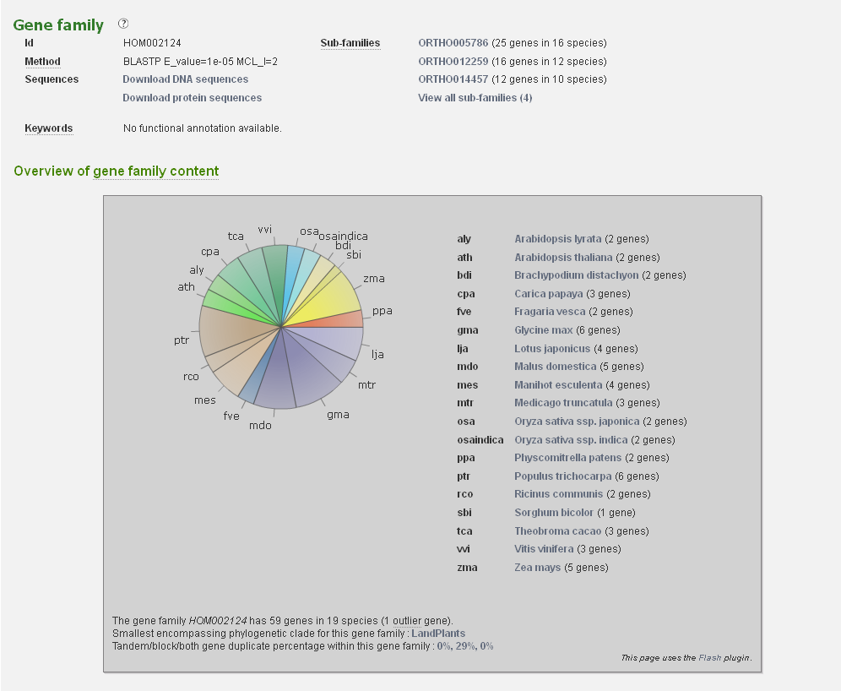
1.4) What is the associated gene family for the Arabidopsis thaliana gene?
Solution: a) Go to gene family page, associated with that gene
(http://bioinformatics.psb.ugent.be/plaza/gene_families/view/HOM002124)

Slide 7
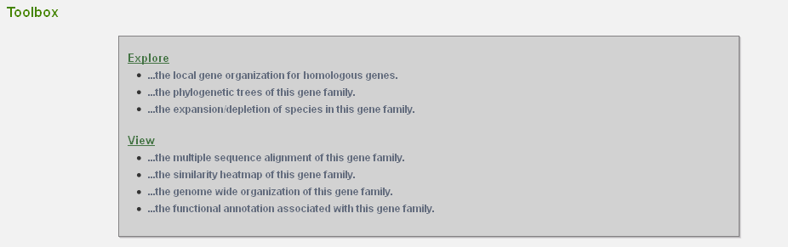
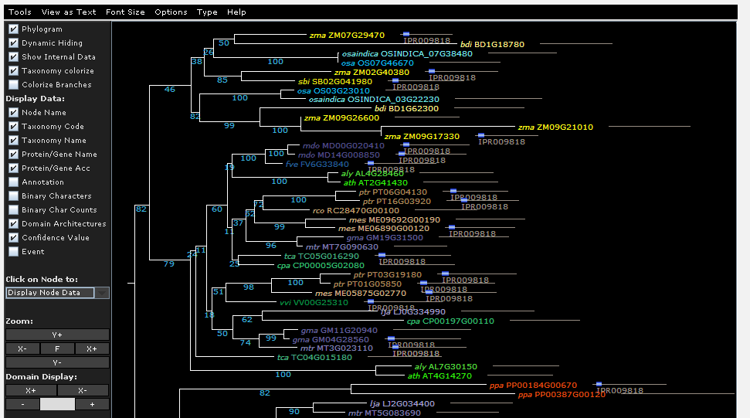
1.5) Are the Arabidopsis thaliana and lyrata genes adjacent in the phylogenetic tree associated
with this gene family?
Solution: a) Go to the phylogenetic tree page, using the toolbox on the gene family page
(http://bioinformatics.psb.ugent.be/plaza/gene_families/explore_trees/HOM002124)
b) Investigate the phylogenetic tree

Slide 8
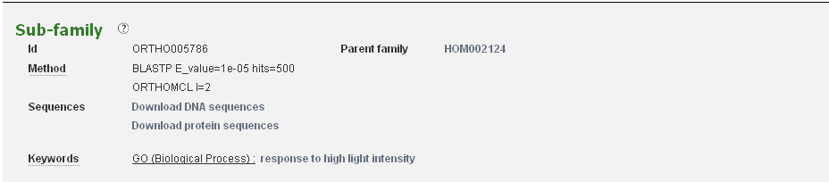
1.6) In what sub family is the gene present? What is the function of the sub family?
Solution: a) Go to the gene page (AT2G41430, see 1.1 and 1.2)
b) Go the the sub-family page (ORTHO005786)
c) Look at the associated functional annotation (keywords)

Slide 9


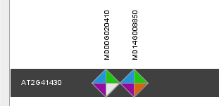
1.7) Find the orthologs of this gene in apple and maize, using the Integrative Orthology method.
Solution: a) Go to the gene page (AT2G41430, see 1.1 and 1.2)
b) Go to the Integrative Orthology page, using the toolbox on the gene page
c) Select the correct species, and view the Java applet
Apple

Slide 10
Part 2.
Starting from a GO page

Slide 11
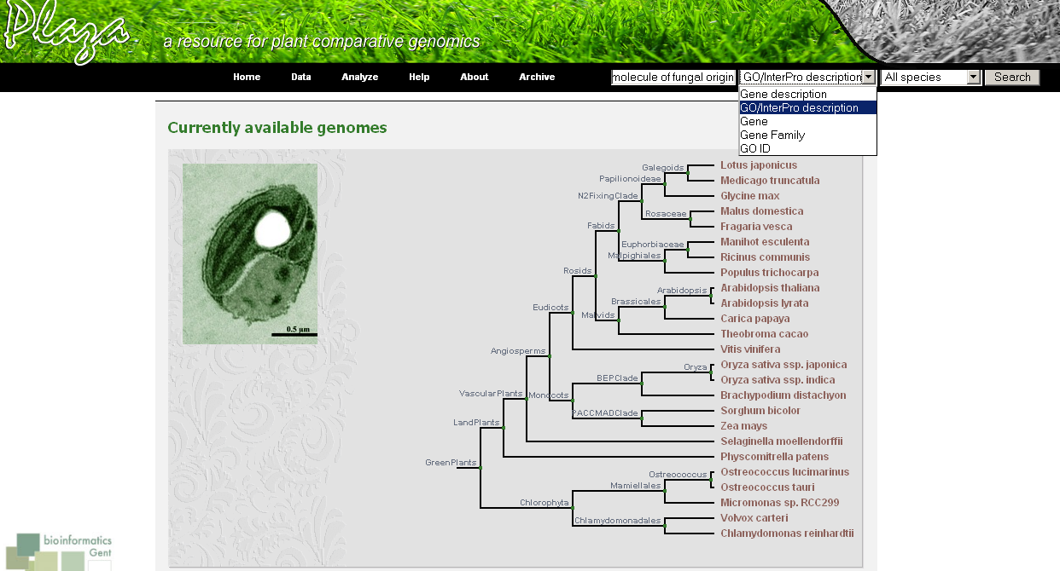
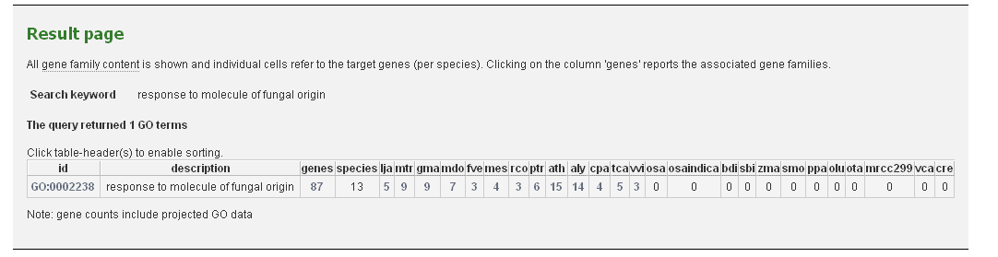
2.1) Search the GO term with description “response to molecule of fungal origin”
Solution: a) Enter description in search box, use correct search target
b) Select correct GO term from list
Phylogenetic profile

Slide 12

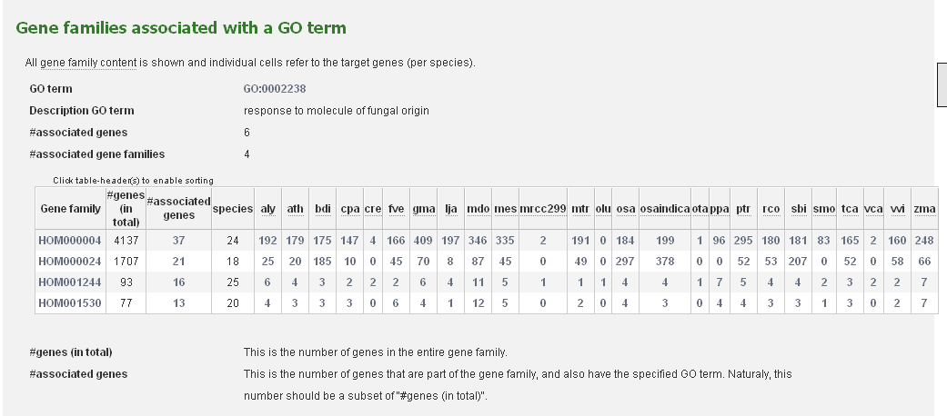
2.2) What are the associated gene families with this GO term?
Solution: a) Start from the correct GO page
(http://bioinformatics.psb.ugent.be/plaza/go/view/GO-0002238)
b)Select “View associated gene families” from toolbox

Slide 13
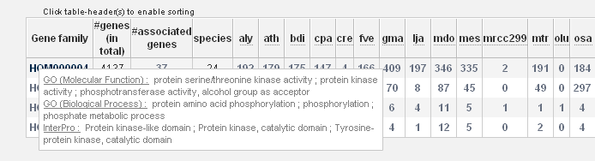
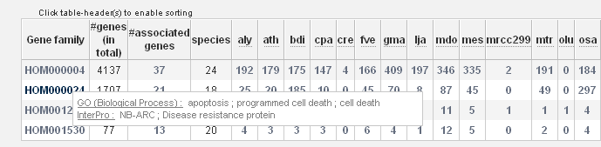
2.3) What are the general InterPro domains associated with these gene families?
Solution: a) Start from the associated gene family page (see 2.1)
(http://bioinformatics.psb.ugent.be/plaza/go/view_gene_gf/GO-0002238 )
b) Hover over each gene family identifier, and learn the keywords

Slide 14
Part 3.
Starting from a set of genes

Slide 15
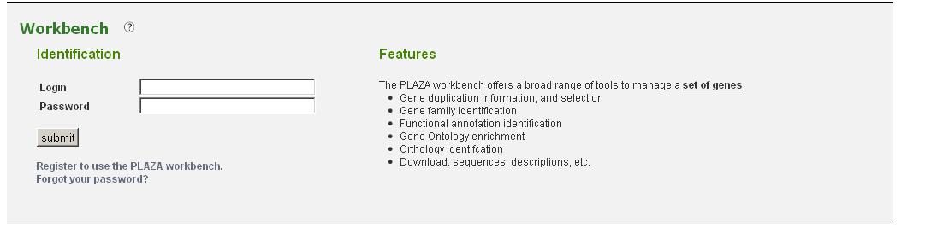
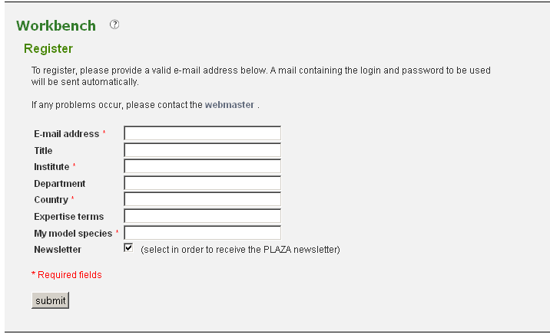
3.1) Create workbench account.
Solution: a) Use toolbar: Analyze->Workbench
b) Register to use the PLAZA workbench

Slide 16
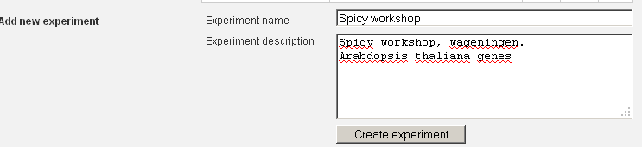
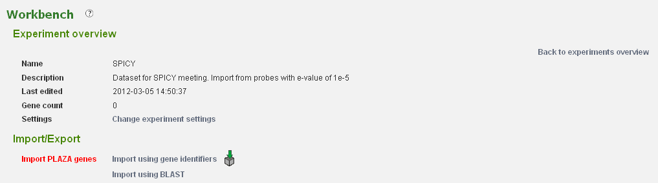
3.2) Load data set of Arabidopsis thaliana genes
Solution: a) Login into the workbench, using credentials send by email
b) Create new experiment
c) Go to experiment page
d) Go to the “Import using gene identifiers” page

Slide 17
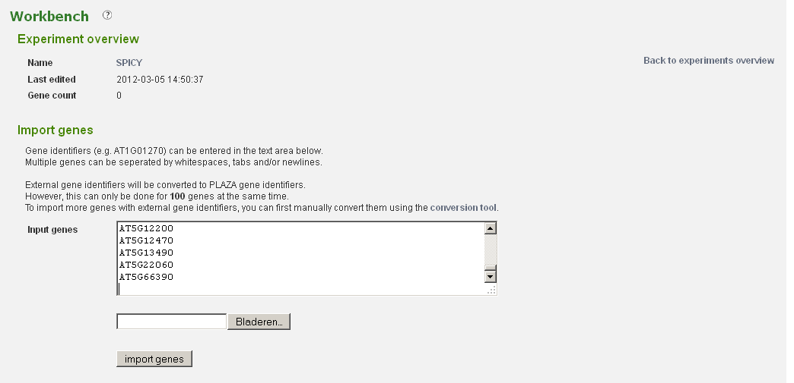
3.2) Load data set of Arabidopsis thaliana genes
Solution: e) Download the file with Arabidopsis thaliana genes:
+ - either go through PLAZA toolbar->Data->download-> FTP dir (bottom)
- or go directly to ftp://ftp.psb.ugent.be/pub/plaza/
+ Go to subfolder “workshop”, and download file SPICY_ath.txt f) Use content of file to load gene identifiers into workbench

Slide 18
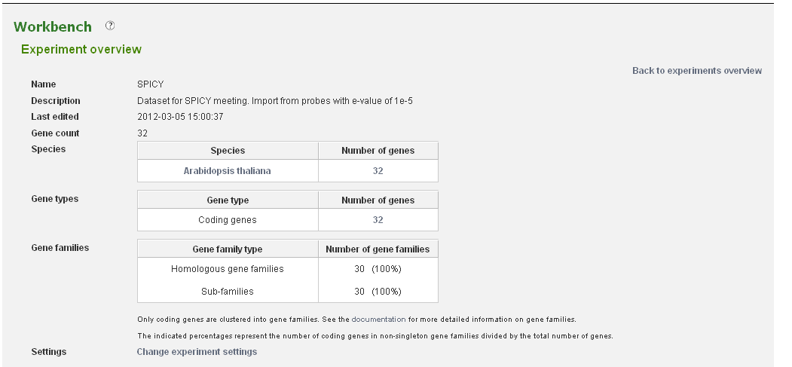
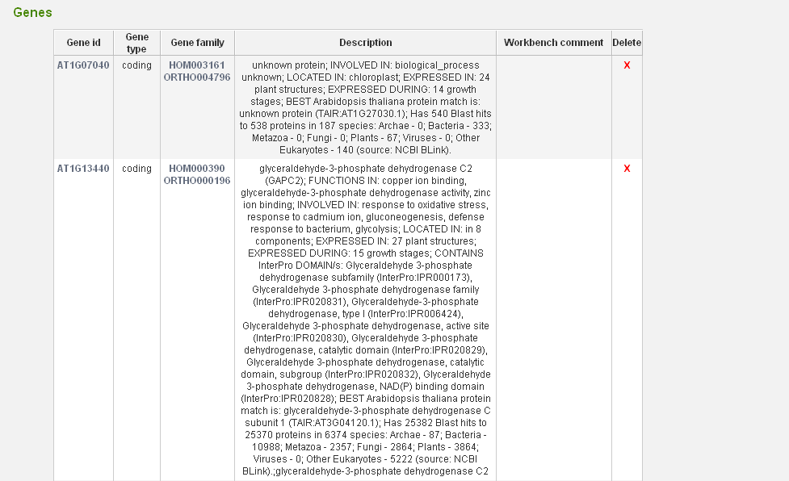
3.2) Load data set of Arabidopsis thaliana genes : result

Slide 19
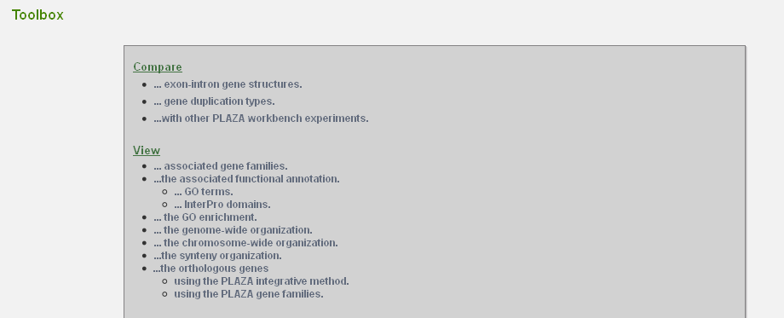
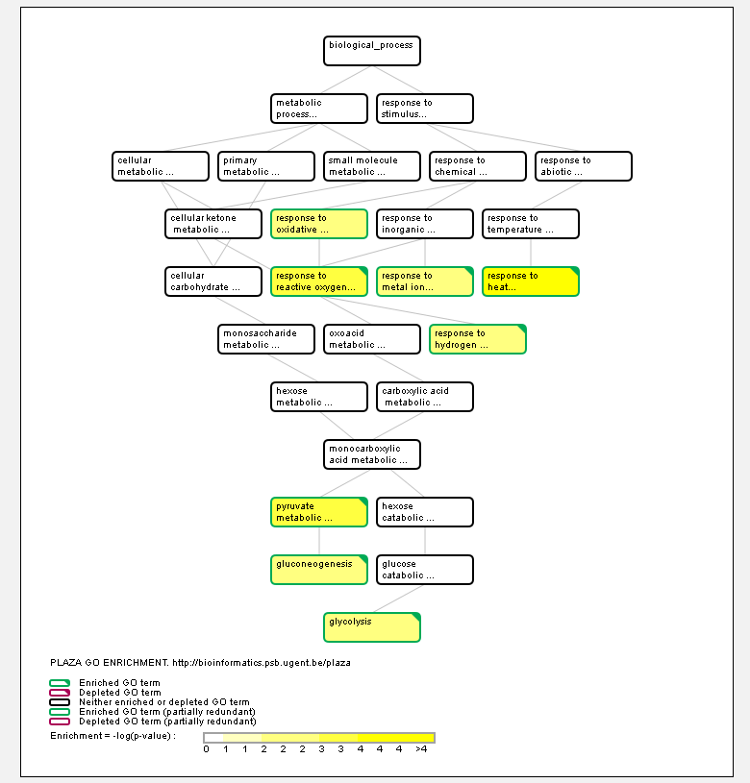
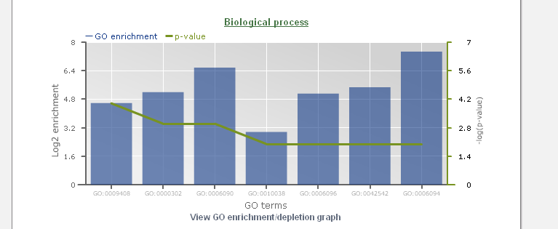
3.3) Is the data-set enriched for a certain GO-term?
Solution: a) Go to the experiment page on the workbench
b) Select “View the GO enrichment” from the toolbox

Slide 20
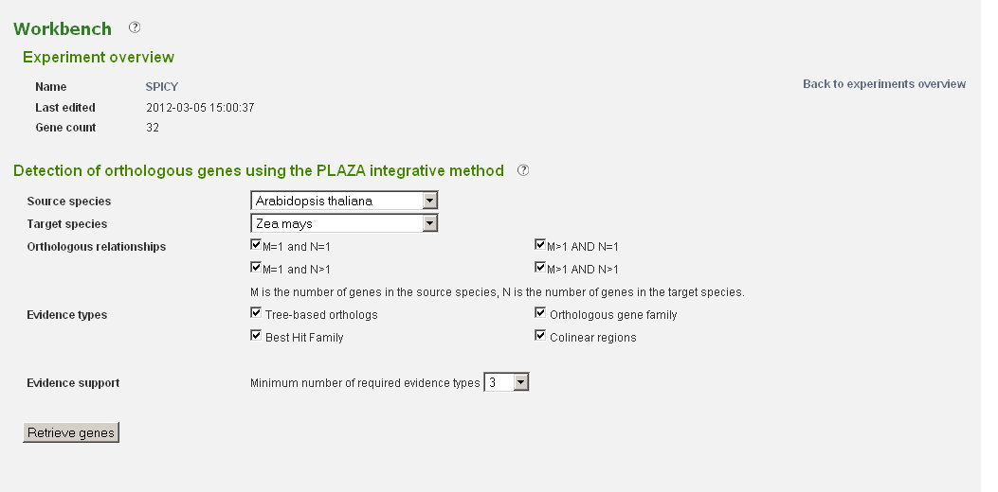
3.4) Locate the orthologous genes for this data-set (using at least 3 types of evidence of the PLAZA integrative method) in Zea Mays.
Solution: a) Go to the experiment page on the workbench
b) Select “View the Orthologous genes using the PLAZA Integrative Method” from the toolbox

Slide 21
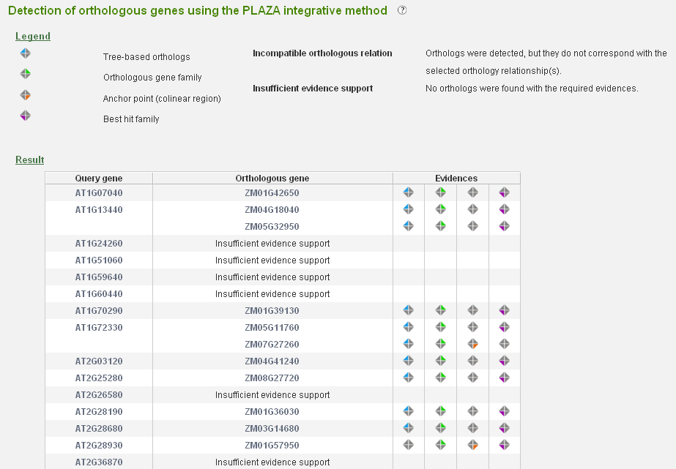
3.4) Locate the orthologous genes for this data-set (using at least 3 types of evidence of the PLAZA integrative method) in Zea Mays : result

