Slide 1
Network construction and exploration using CORNET and Cytoscape
SPICY WORKSHOP
Wageningen, March 8th 2012
Stefanie De Bodt

Slide 2
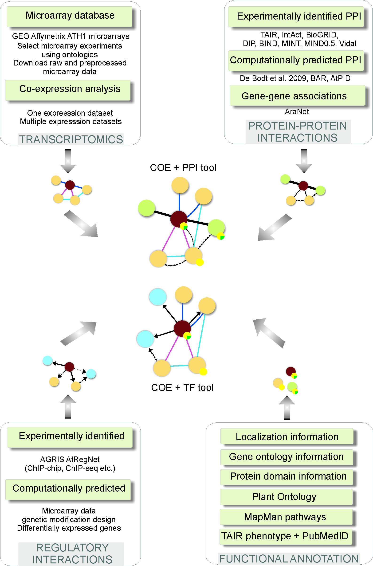

Slide 3
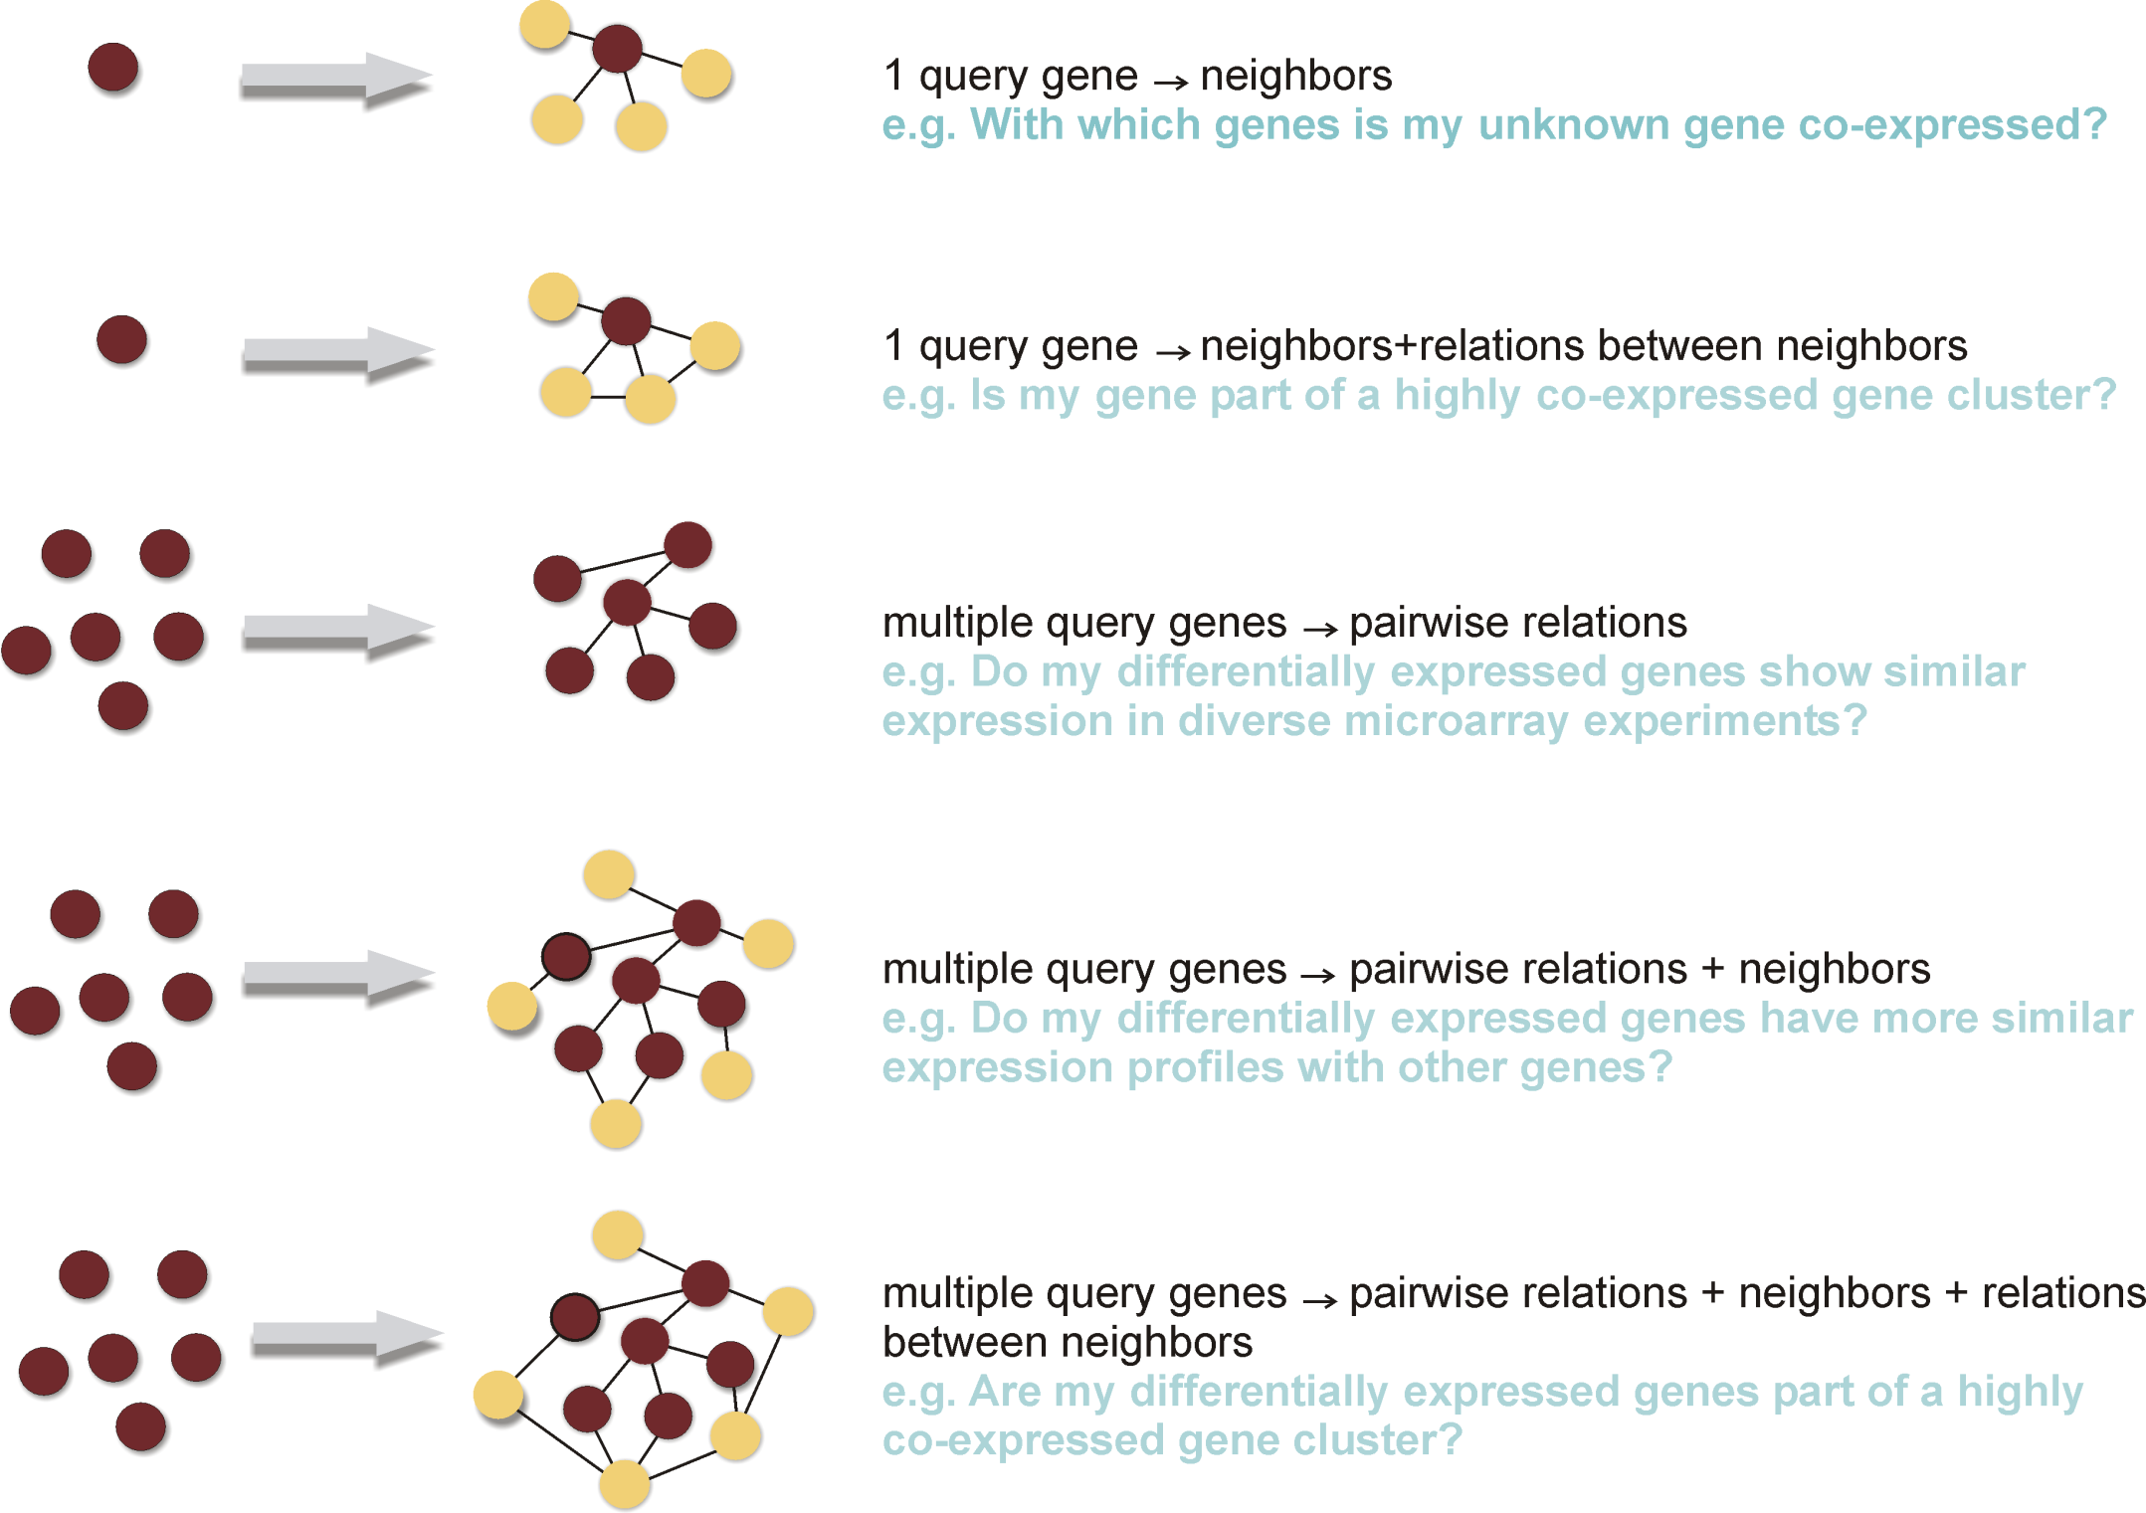

Slide 4
Need for co-expression studies
Measure of expression similarity
Guilt-by-association: similarity in regulation, function
When and where are genes expressed?
Which genes show similar expression?
Which known genes co-express with unknown genes?
Spatial and temporal behavior of networks
Dynamics of protein-protein interactions

Slide 5
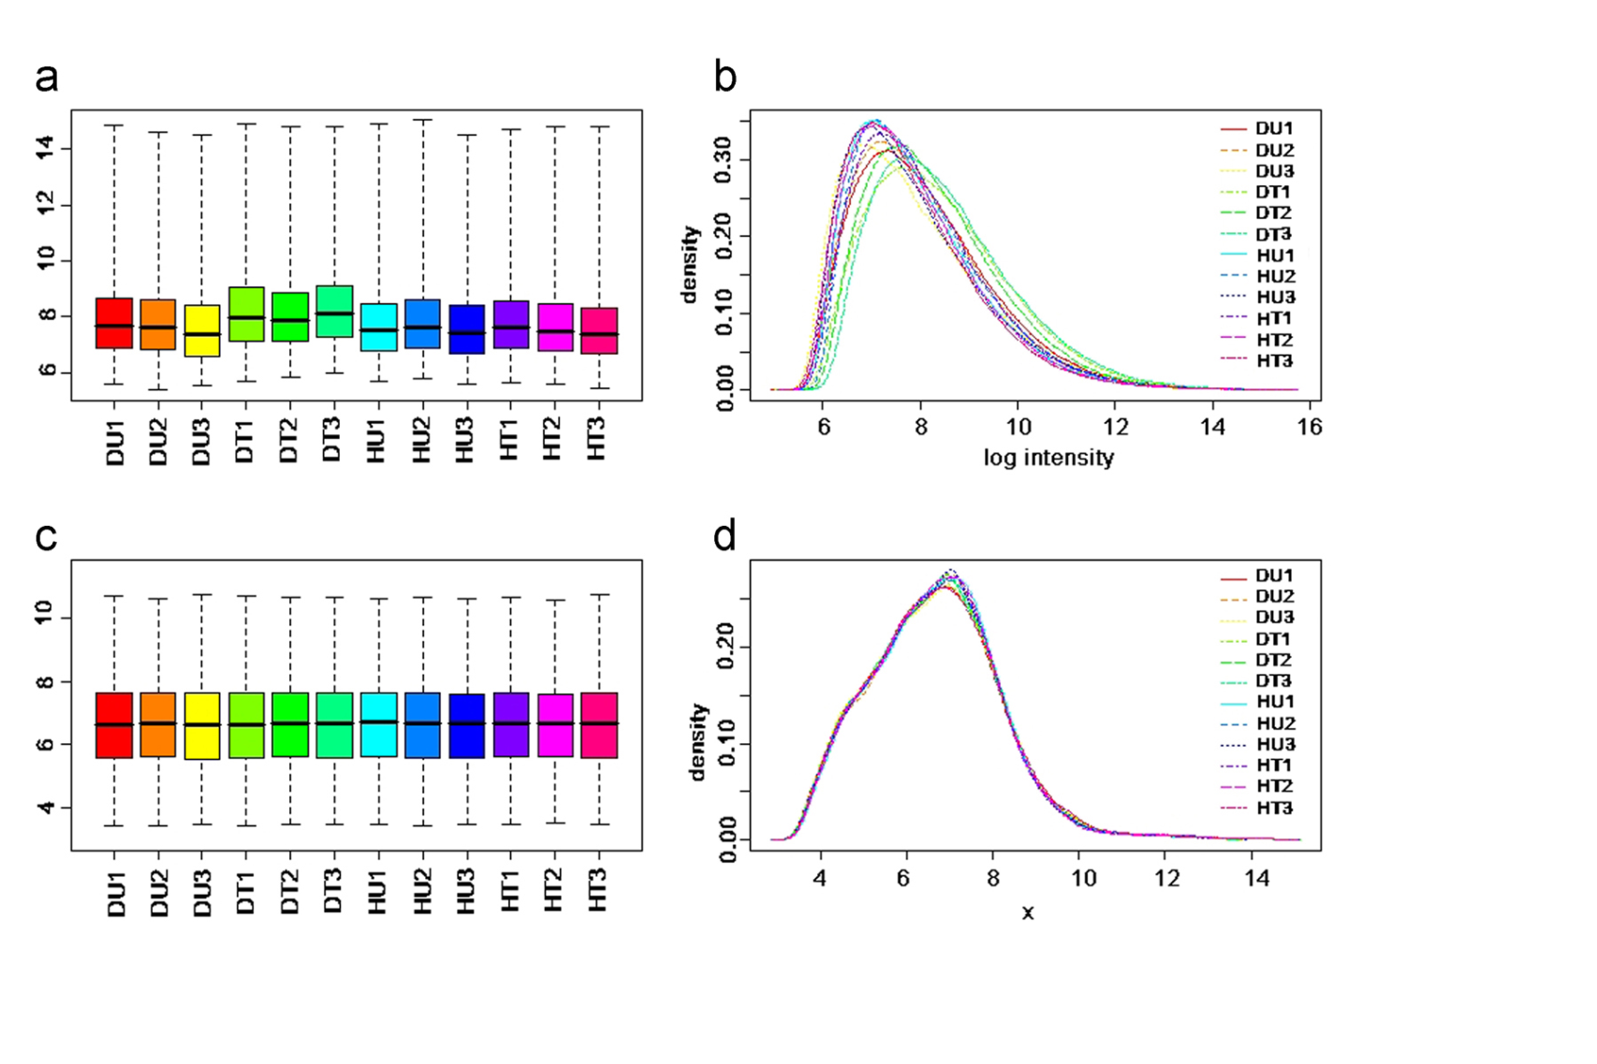
Preprocessing of microarray data
Raw microarray data
Background correction
Normalization
PREPROCESSING
Summarization
Log2 absolute expression values
Notes:
MAS5
RMA
gcRMA

Slide 6
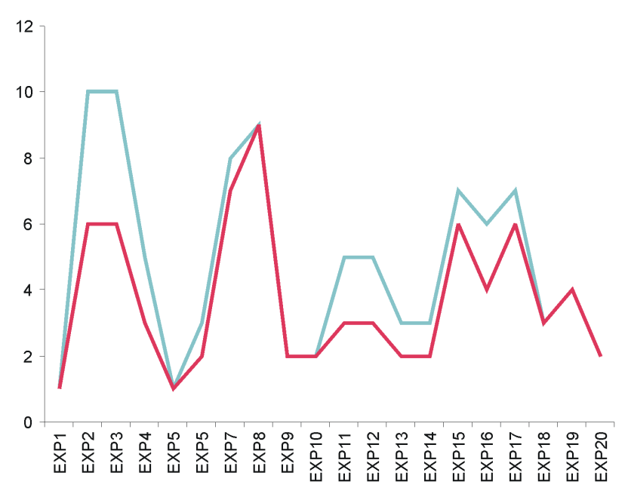
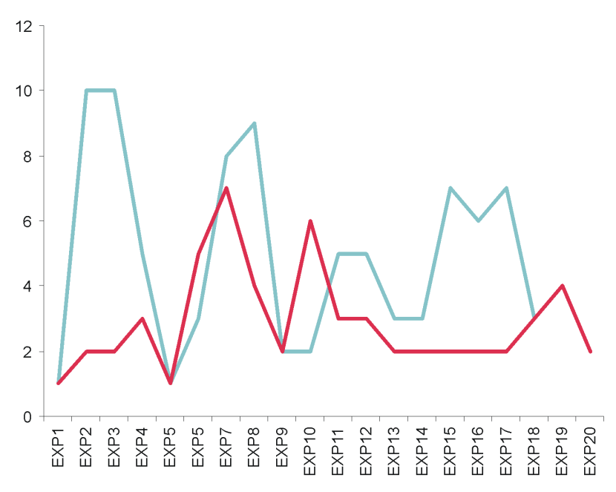
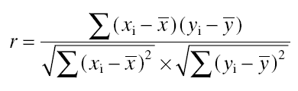
Co-expression
Gene A
Gene B
Gene A
Gene C
Expression value
High correlation coefficient
Low correlation coefficient
Pearson correlation coefficient:
(range: -1,0,1)
Notes:
SSC is more robust to outliers

Slide 7
Predefined microarray expression compendia
Compendium 1 (bias towards cell cycle, growth, development)
Compendium 2 (no bias, no redundancy in experiments)
AtGenExpress
Abiotic stress
Biotic stress
Stress (abiotic + biotic)
Hormone treatment
Genetic modification
Development
Flower
Leaf
Root
Seed
Whole plant
User-defined microarray expression compendia
Compilation of public microarrays
Compilation of private microarrays
Compilation of public and private microarrays
Multiple microarray expression compendia simultaneously

Slide 8
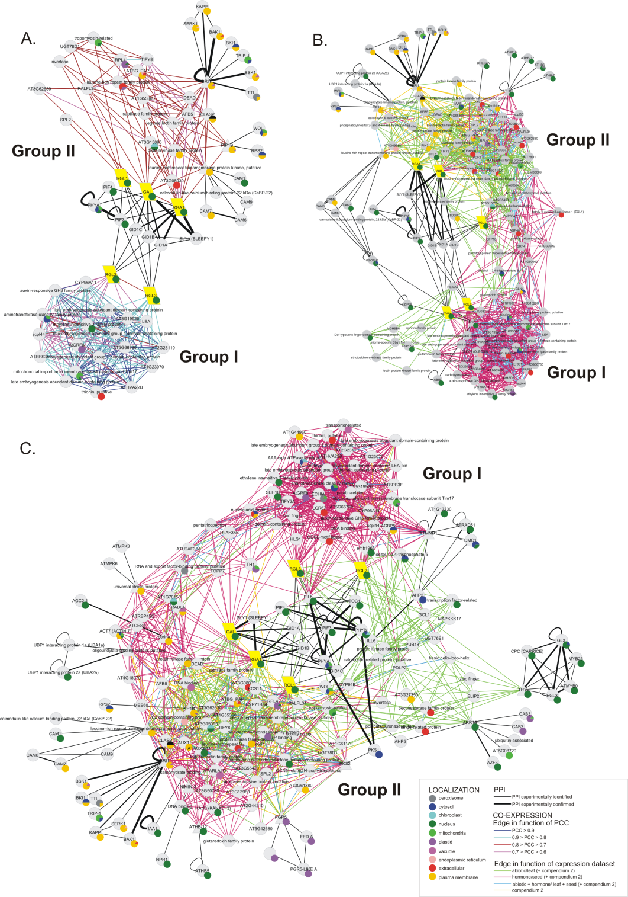
  Co-expression in multiple datasets is important
Expression compendia
Leaf compendium
Seed compendium
Abiotic stress compendium
Hormone compendium

Slide 9
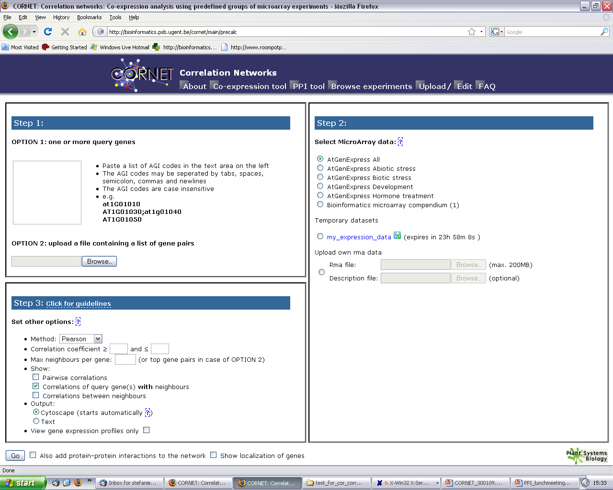
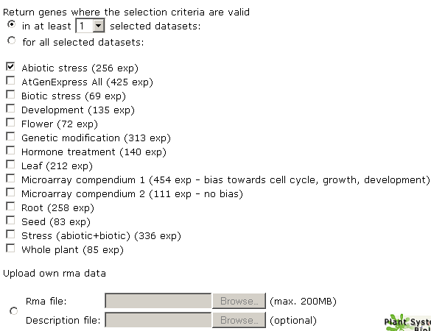
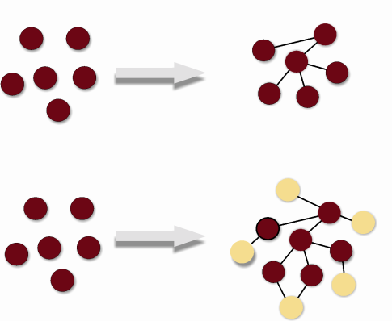

1
3
3
1
2
1
1
2
3

Slide 10
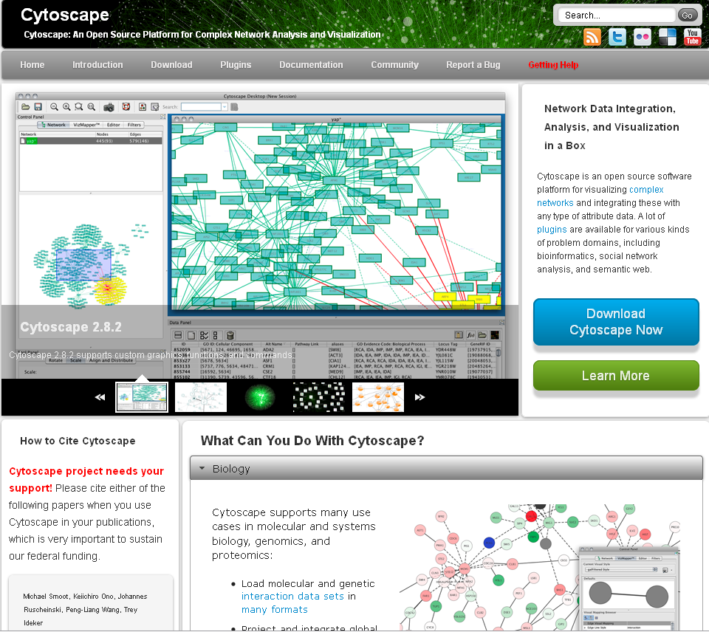

Slide 11
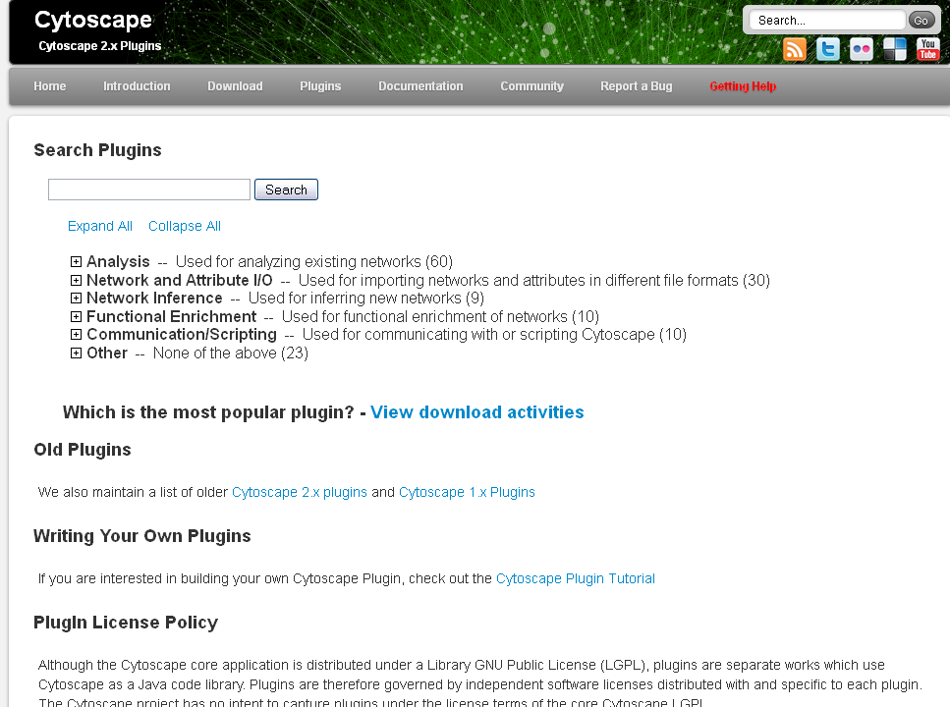

Slide 12
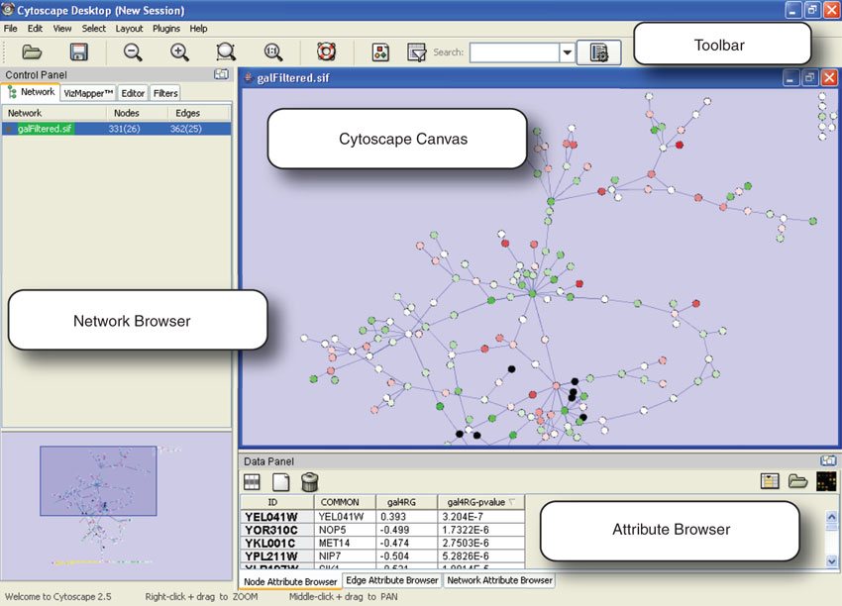

Slide 13
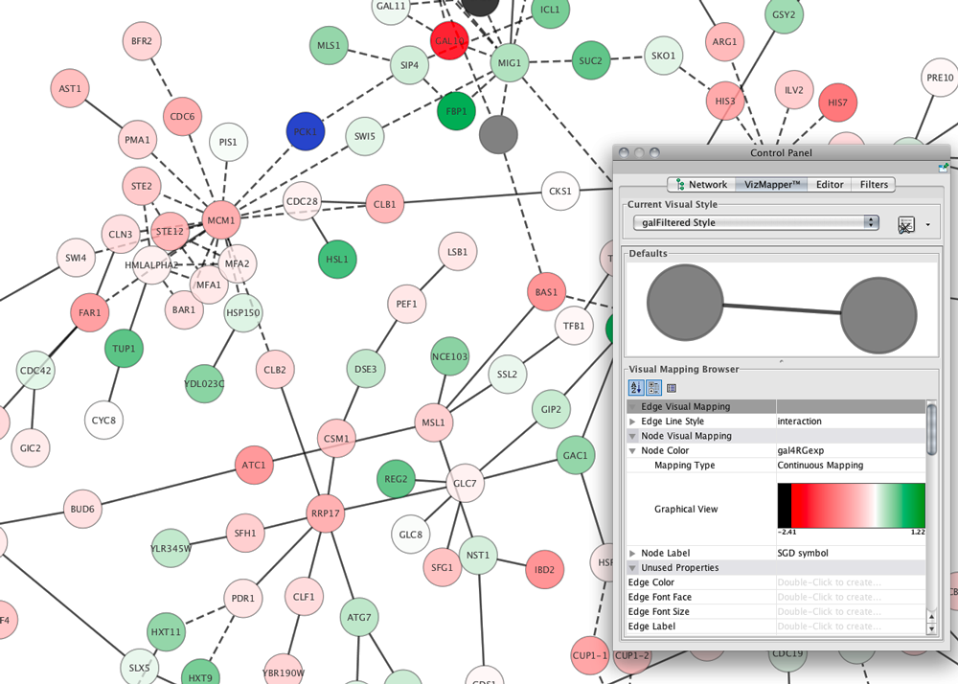

Slide 14
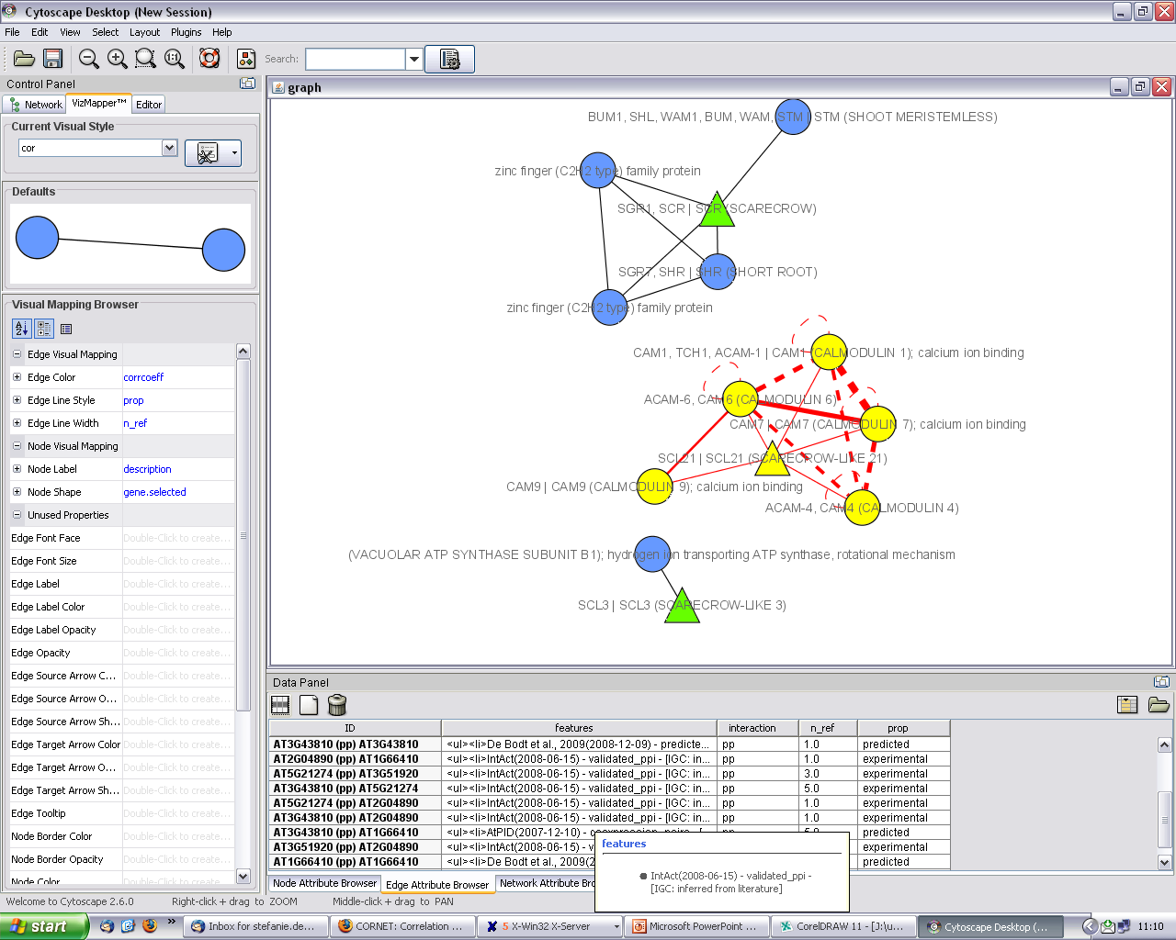

Slide 15
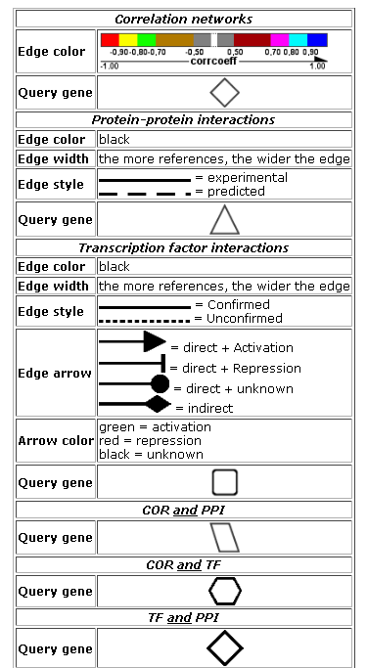
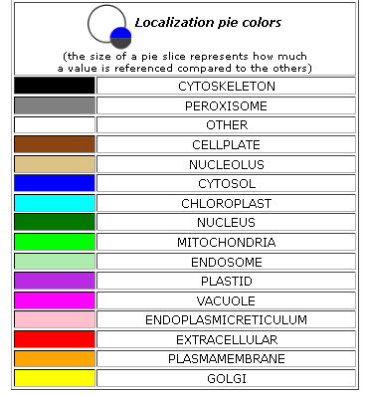
Network exploration in Cytoscape
Node and edge attribute browser
Cytoscape LinkOut
VizMapper

Slide 16
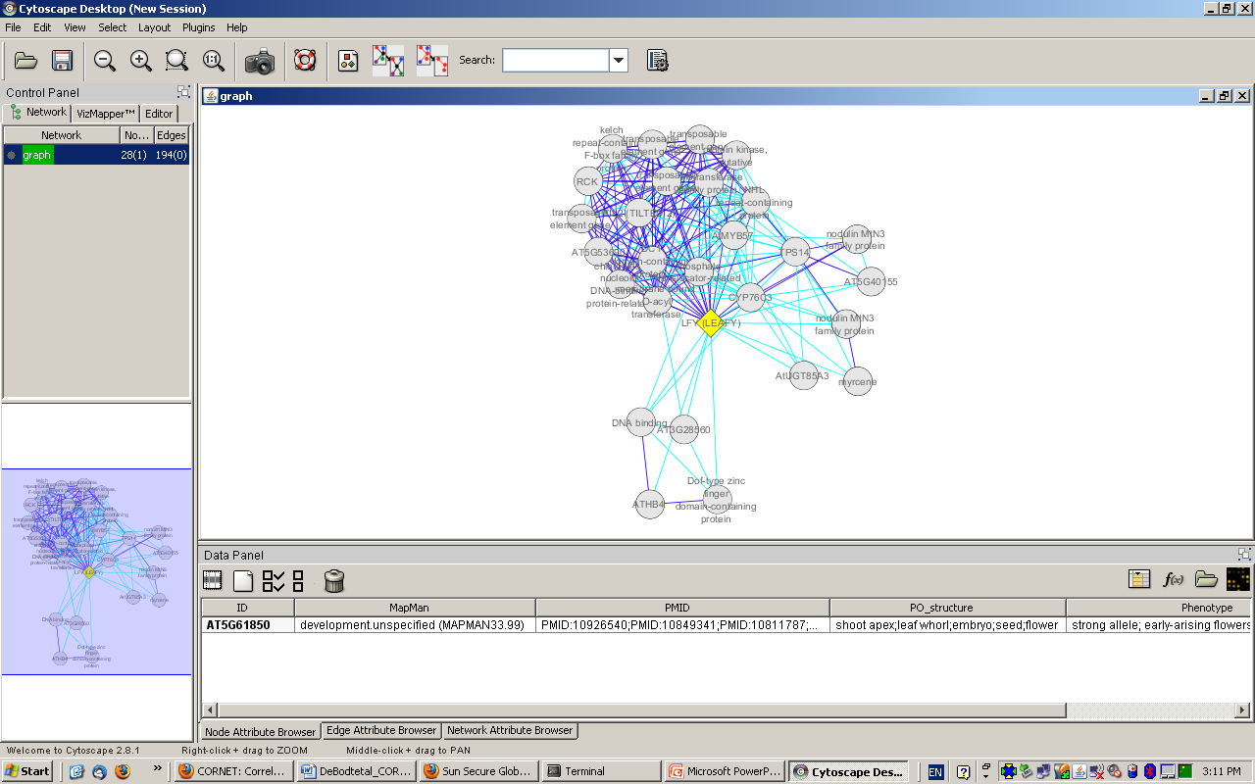
NODE ATTRIBUTES

Slide 17
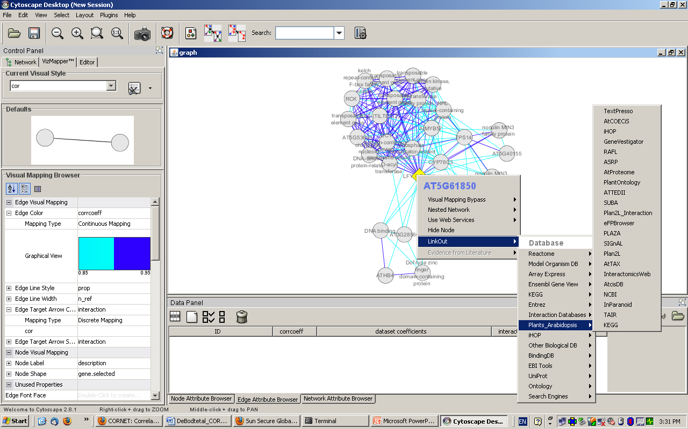
LinkOut

Slide 18
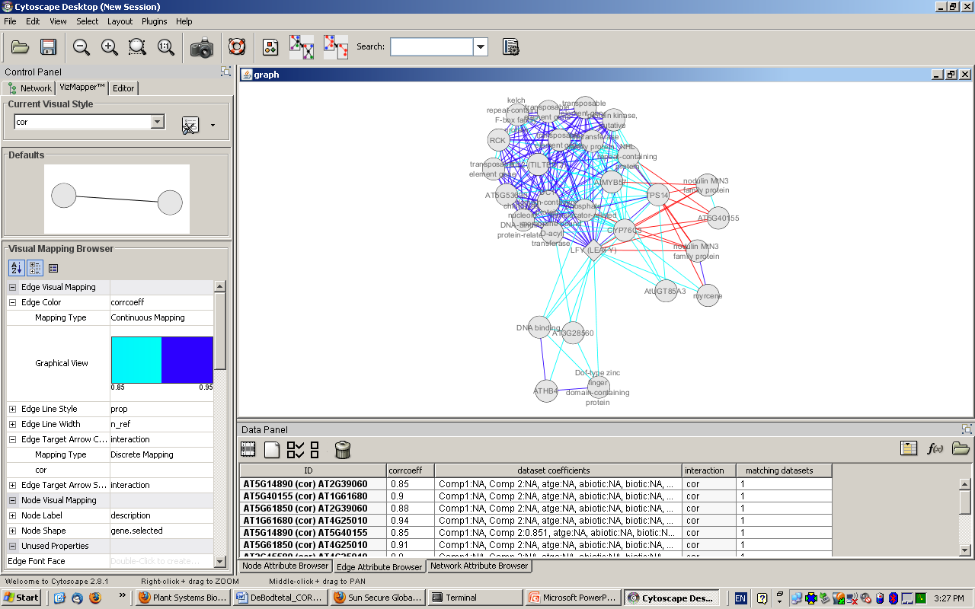
CO-EXPRESSION
EDGE ATTRIBUTES

Slide 19
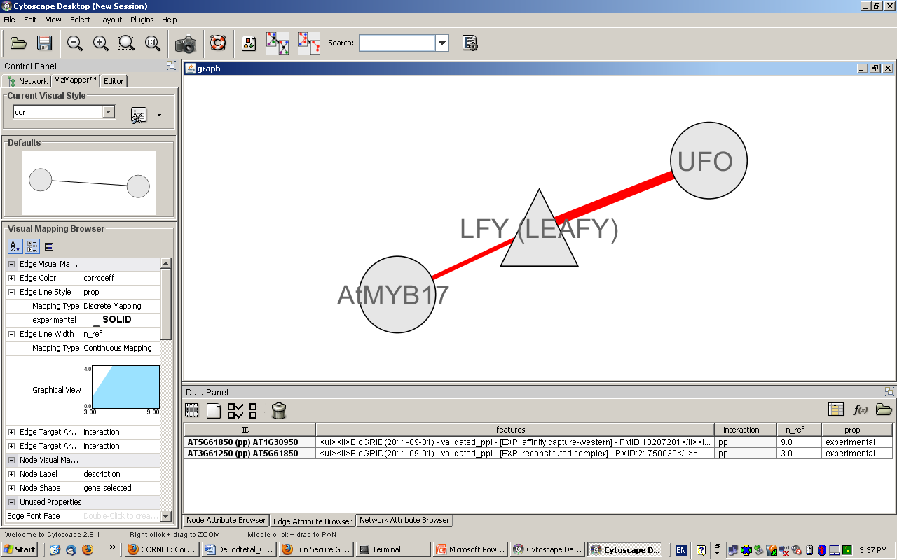
PPI EDGE ATTRIBUTES

Slide 20
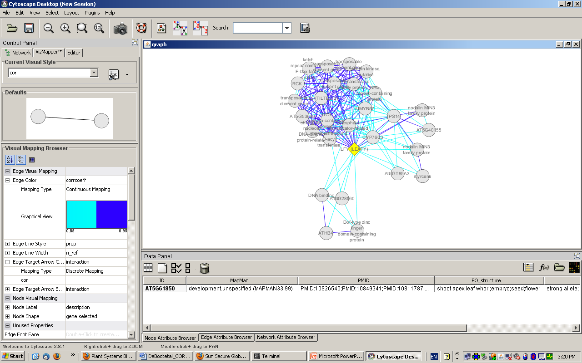
VIZMAPPER

Slide 21




Acknowledgements
Stefanie De Bodt
Jens Hollunder
Nick Meulemeester
Hilde Nelissen
Thomas Van Parys
Michiel Van Bel
Klaas Vandepoele
Yves Van de Peer
Dirk Inzé
Published version: http://bioinformatics.psb.ugent.be/cornet
De Bodt, S., Carvajal, D., Hollunder, J., Van den Cruyce, J., Movahedi, S., Inzé, D. (2010) CORNET: a user-friendly tool for data mining and integration. Plant Physiology

Slide 22
CORNET statistics
Microarray | CORNET 1.0 | CORNET 2.0
Number of arrays | 3055 | 3055
Number of experiments | 1209 | 1209
Number of series | 200 | 200
Number of experiments with 2 replicates | 634 | 634
Number of experiments with more than 2 replicates | 575 | 575
Protein-protein interactions
Vidal - Number of experimentally identified PPIs | - | 6205
MIND0.5 – Number of experimentally identified PPIs | - | 17856
Other – Number of experimentally identified PPIs | - | 10353
Number of experimentally identified PPIs | 4302 | 34269
Number of computationally predicted PPIs | 89181 | 88642
Total number of PPIs | 93109 | 121999
Regulatory interactions
Number of confirmed AGRIS interactions | - | 574
Number of unconfirmed AGRIS interactions | - | 12464
Number of gene-target relations (genetic_modification) | - | 156563
Total number of regulatory interactions | - | 168651
Gene-gene associations
AraNet – Total number of associations | - | 1062222

