Slide 1
Network construction and exploration using CORNET and Cytoscape - Excercises
SPICY WORKSHOP
Wageningen, March 8th 2012
Stefanie De Bodt

Slide 2
CORNET
https://bioinformatics.psb.ugent.be/cornet
Use Firefox
Accept certificate
Allow popups

Slide 3
Excercise 1a: Pairwise co-expression using CORNET
32 Arabidopsis input genes
all expression datasets
no PCC threshold
(returns PCC > 0.6 and PCC < -0.6 when selecting
multiple expression datasets)

Slide 4
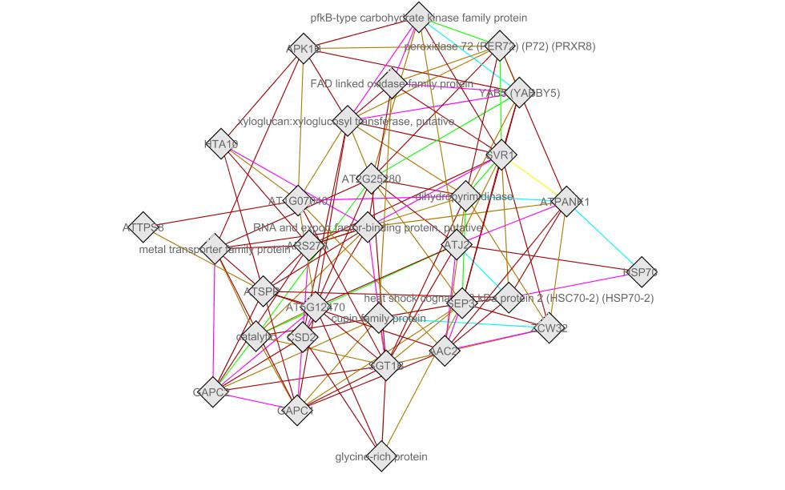
Solution Excercise 1a
31 nodes
131 edges

Slide 5
Excercise 1b: Pairwise co-expression using CORNET
Integration of homology links to pepper genes
Import Network in Cytoscape
File > Import > Network from Table (Text/MS-Excel)
Wizard > Text file import options > Network import options: interaction “homolog”

Slide 6
Excercise 1b: Pairwise co-expression using CORNET
Merge networks in Cytoscape
Plugins > Merge networks > Union
Color edges according to “interaction” to distinguish co-expression and homology links - Vizmapper: edge color, discrete mapping

Slide 7
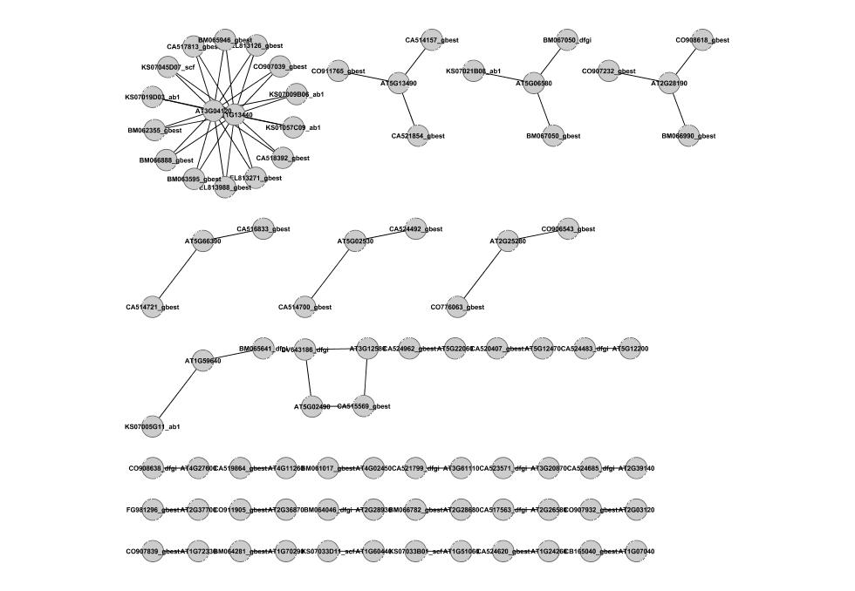
Solution Excercise 1b
86 nodes
70 edges

Slide 8
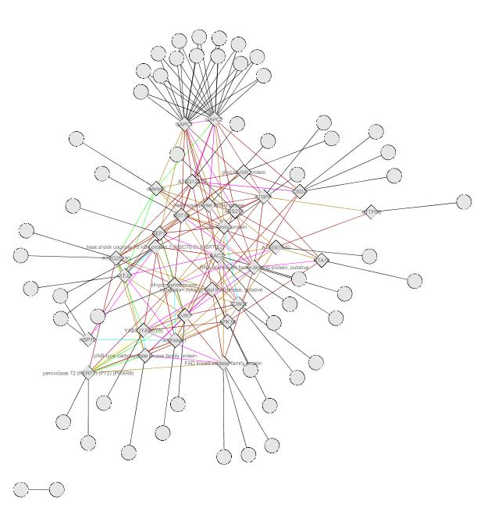
Solution Excercise 1b
86 nodes
201 edges

Slide 9
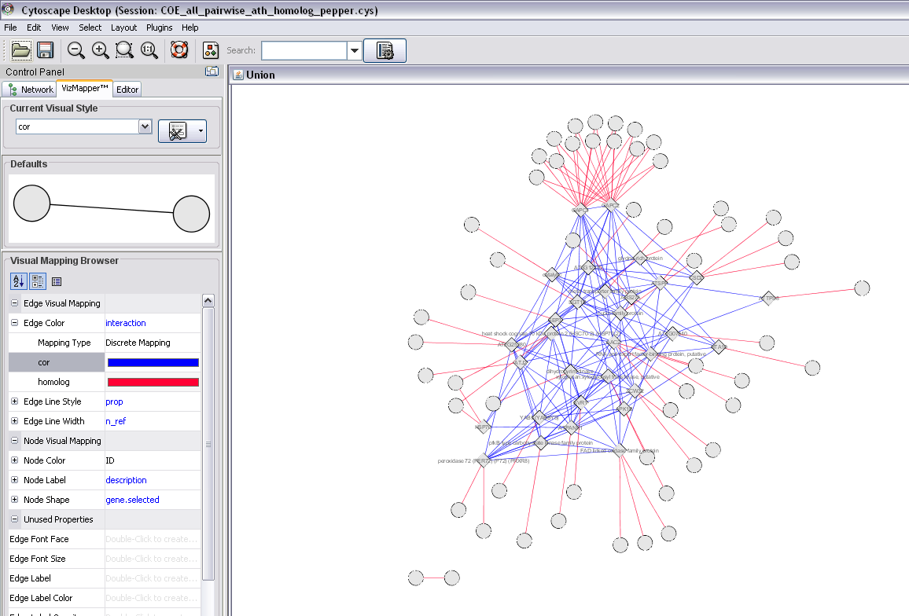
Solution Excercise 1b

Slide 10
Excercise 2a: Co-expression neighborhood using CORNET
32 Arabidopsis input genes
all expression datasets
PCC > 0.85, 5 neighbors

Slide 11
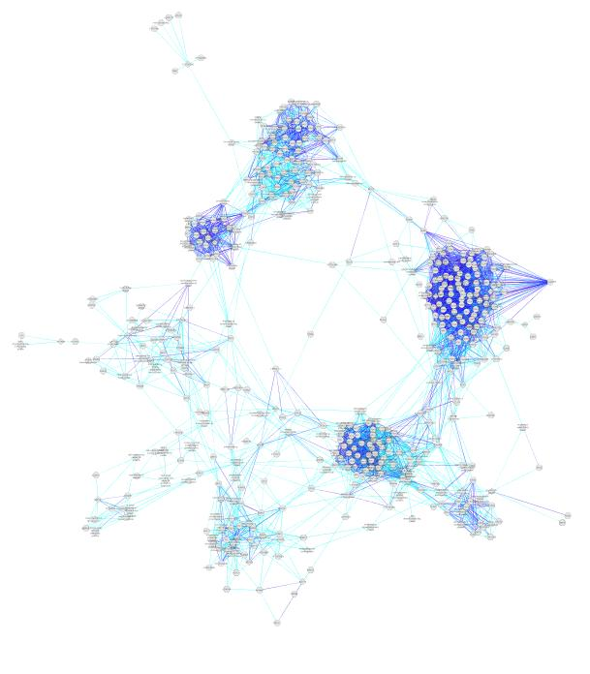
Solution Excercise 2a
482 nodes
496 edges

Slide 12
Excercise 2b: Clustering co-expression network using Cytoscape
MCODE plugin (using Fluff option)
Can you identifiy subnetworks or clusters of tightly co-expressed genes in the network?
http://baderlab.org/Software/MCODE/UsersManual

Slide 13
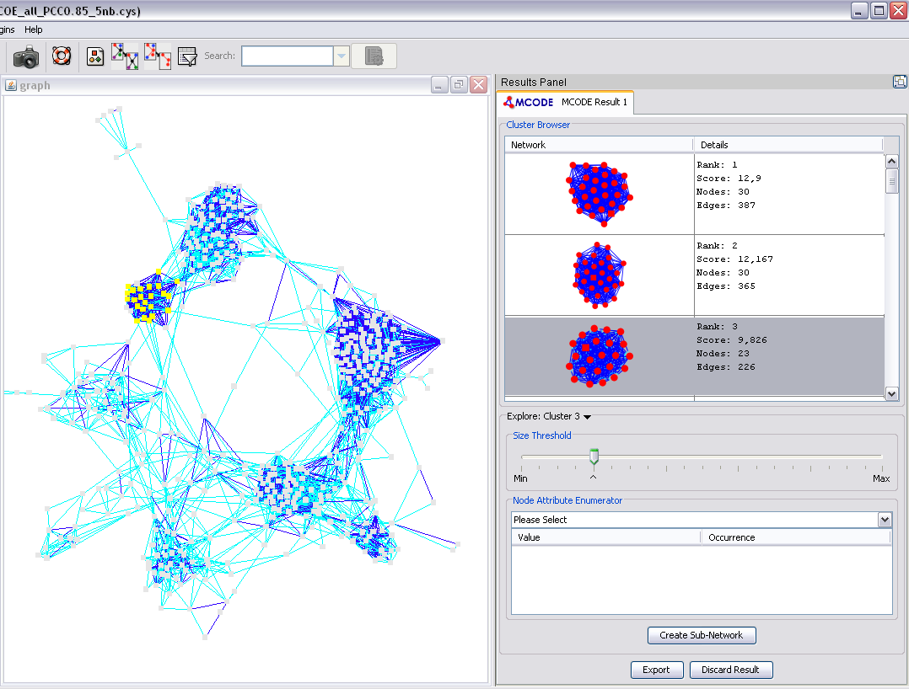
Solution Excercise 2b

Slide 14
Excercise 2c: Functional annotation of co-expression network using CORNET and Cytoscape
Node attributes (Gene Ontology, Plant Ontology, protein domain, localization)
BinGO plugin – GO overrepresentation analysis
Which functional classes are enriched?
Do you find the same functional classes when using the complete network or using subnetworks?

Slide 15
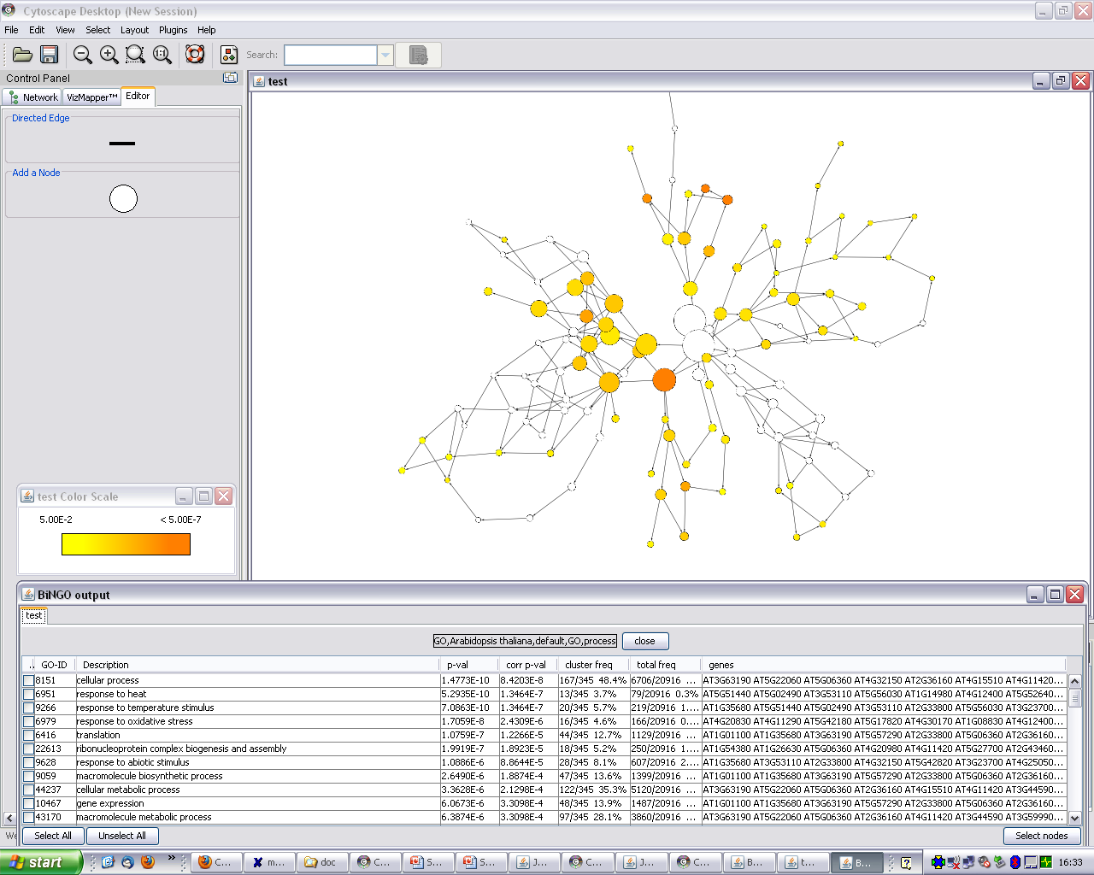
Solution Excercise 2c

Slide 16
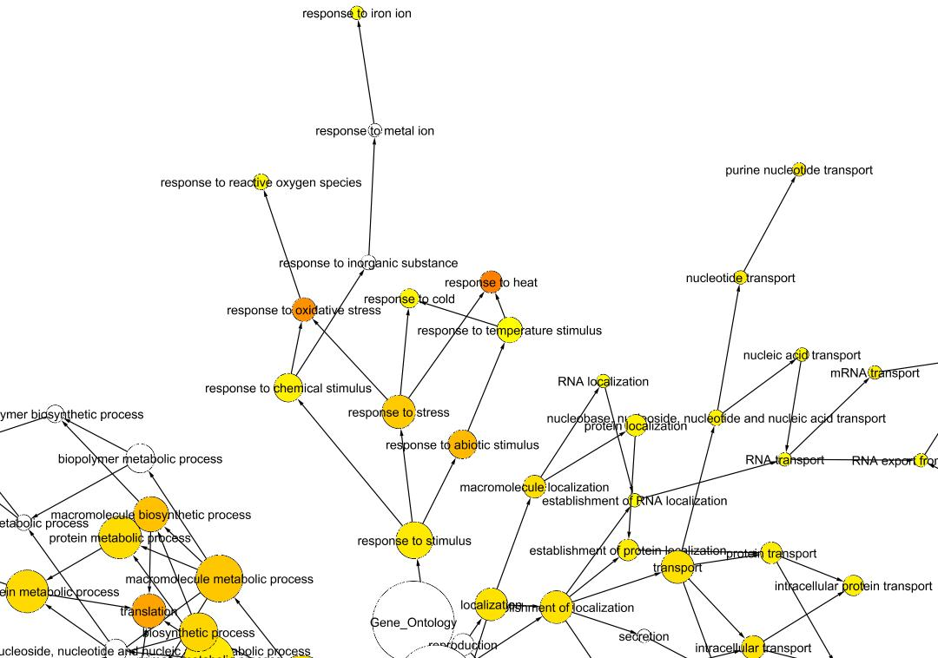
Solution Excercise 2c

Slide 17
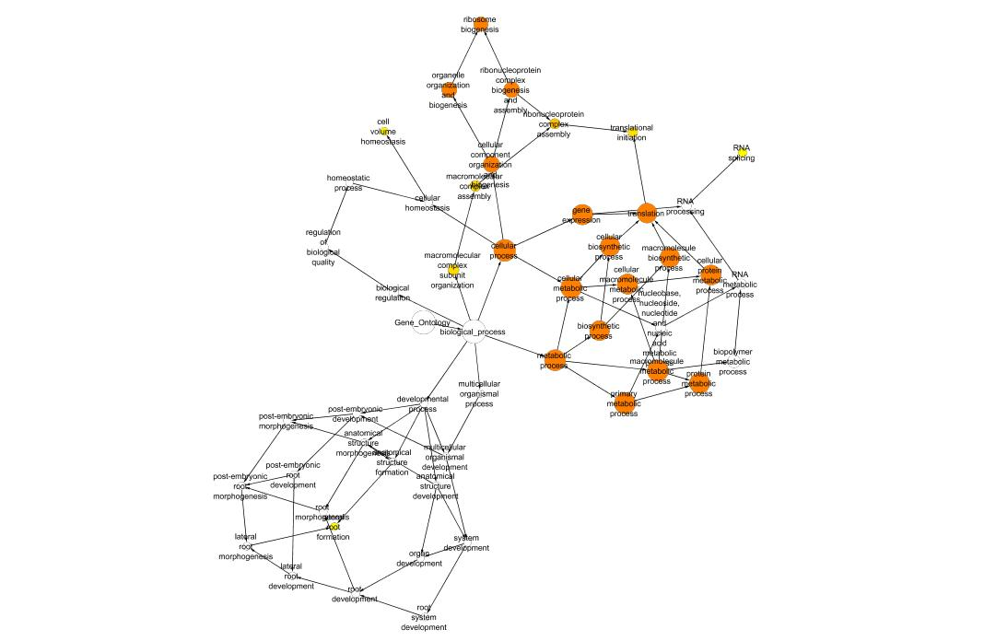
Solution Excercise 2c

