Slide 1
Functional Plant Bioinformatics
Orthologs, paralogs & phylogenetic trees
14-15 September, 2017
Klaas Vandepoele

Slide 2
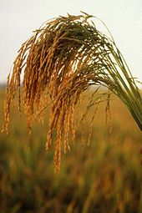
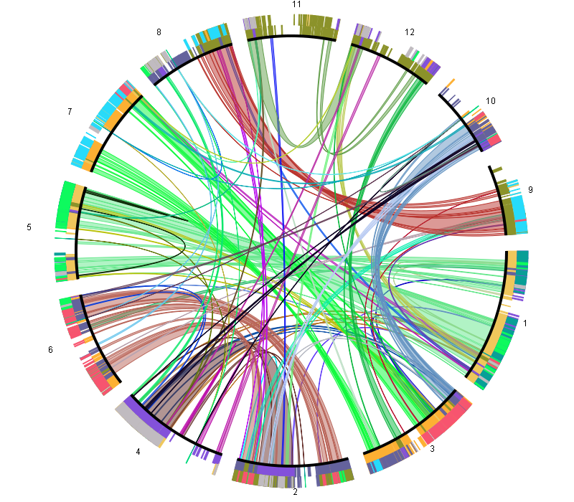
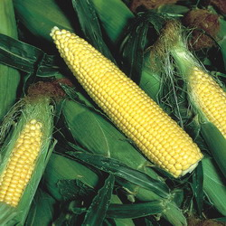
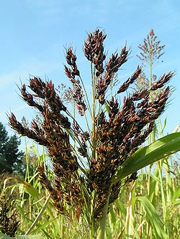
Orthology and paralogy
A major goal of sequence analysis is evolutionary reconstruction. It is critical to distinguish between two principal types of homologous relationships, which differ in their evolutionary history and functional implications.
Orthologs, defined as homologous genes evolved through speciation (~evolutionary counterparts derived from a single ancestral gene in the last common ancestor of the given two species)
Paralogs, which are homologous genes evolved through duplication within the same (perhaps ancestral) genome.
These definitions were first introduced by Fitch (1970)
Notes:
Comparative genomics can be performed at different levels: genome level to study chromosome biology, at the gene level to study pathways or GFs, but also at the DNA level to for example identify CVs, SNPS. In all these cases, setting up CG workflows is not easy, as you need to handle a lot of data, combine several tools and also make sure the performance of your methods scales well with for example extra genomes.

Slide 3
Different types of paralogs
Organism phylogeny
(species tree)
Gene phylogenies
gene duplication
a1
A
b1
B
a1
c1
b)
a2
a2
C
b2
b1
c2
a)
b2
speciation
Outparalogs
Inparalogs
c1

Slide 4
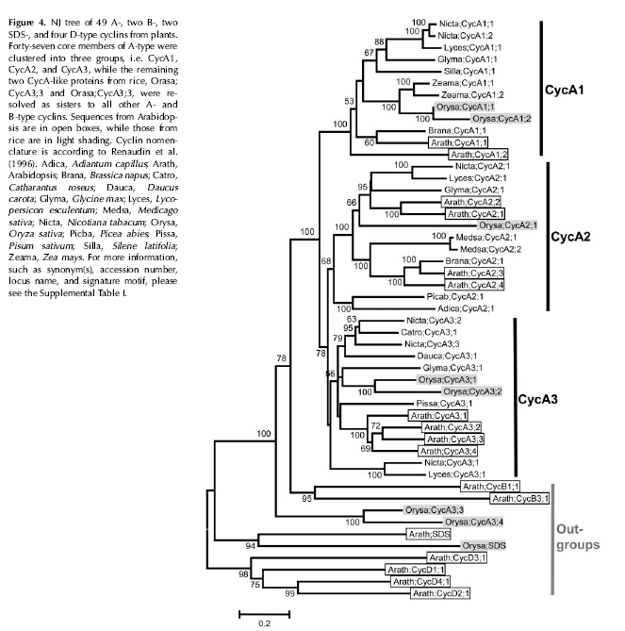
Outparalogs can be considered as sub-types

Slide 5
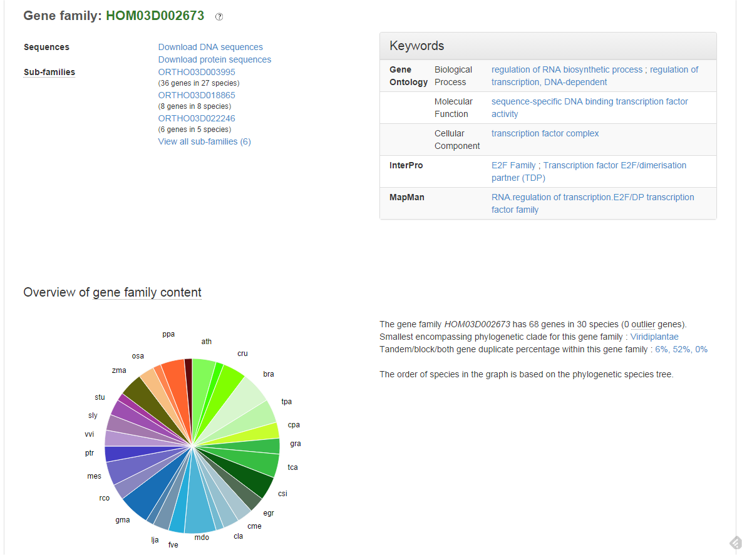
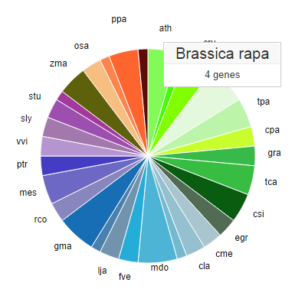
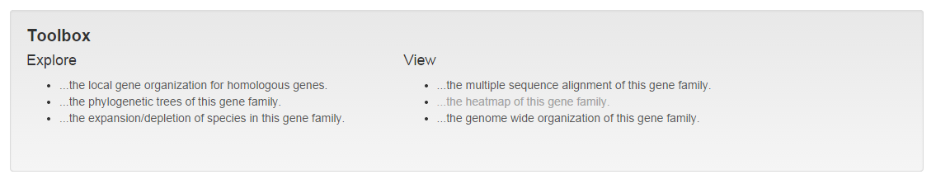
Gene family page

Slide 6
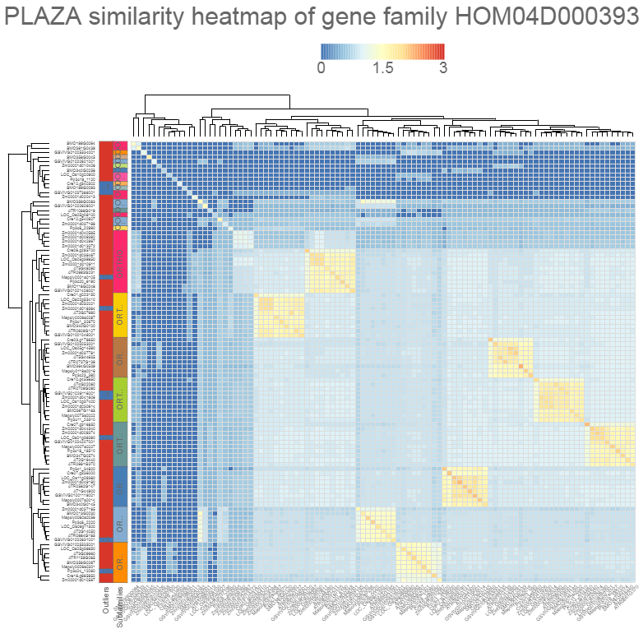
Gene family similarity heatmap
Mini-chromosome maintenance (MCM) protein

Slide 7
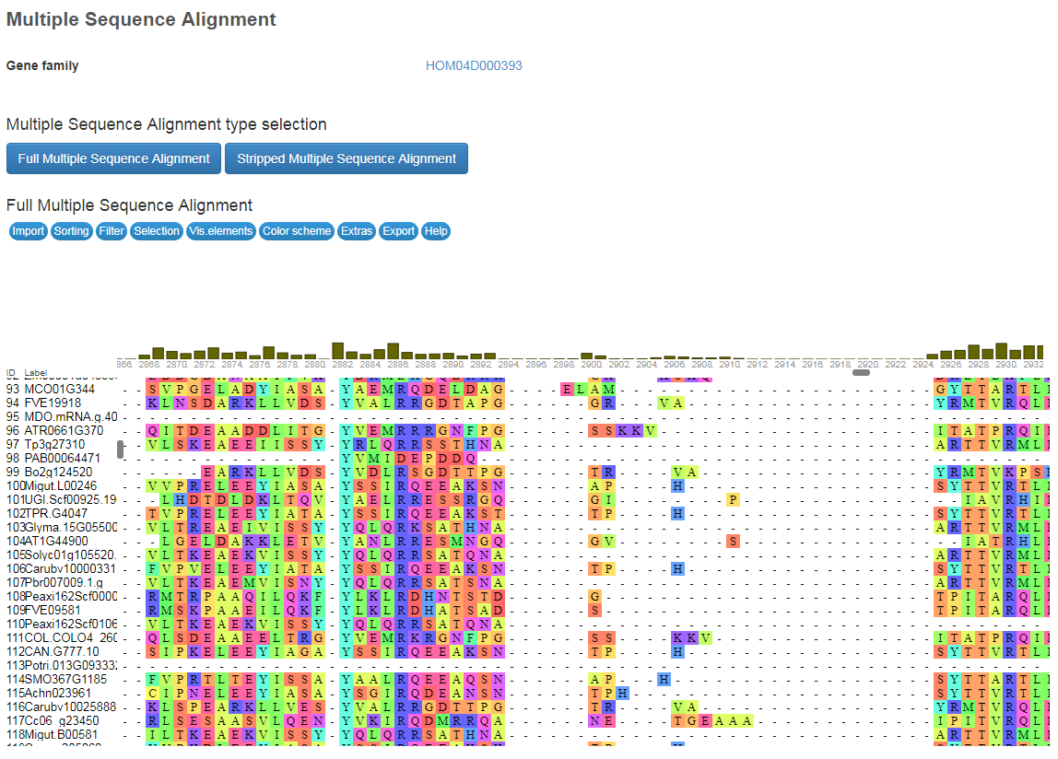
Multiple sequence alignment

Slide 8
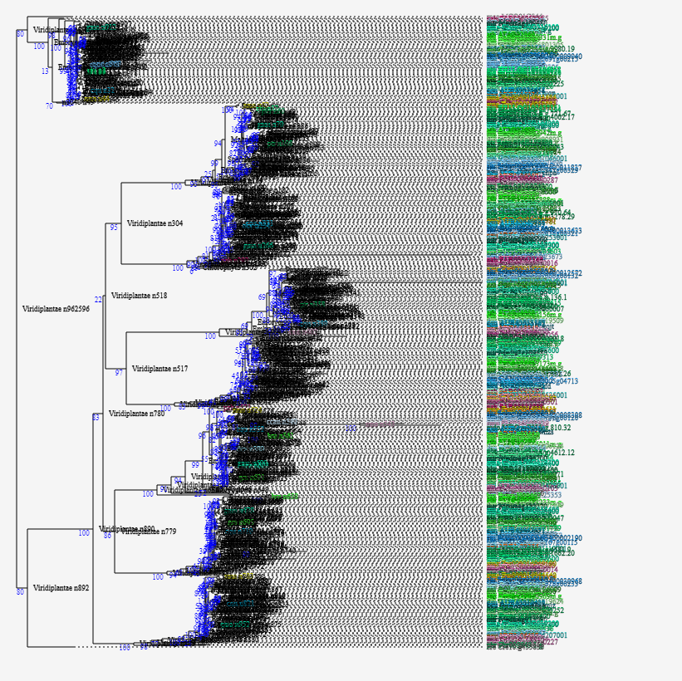
Phylogenetic trees
MCM family

Slide 9
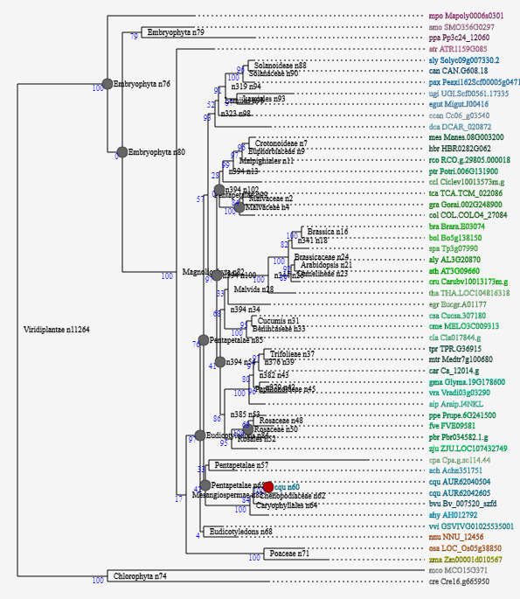
Phylogenetic trees
MCM8 sub-family

Slide 10
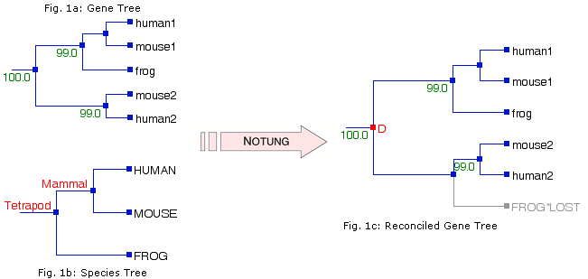
Tree reconciliation
The automatic detection of speciation and duplication events using a species tree and gene family tree

Slide 11
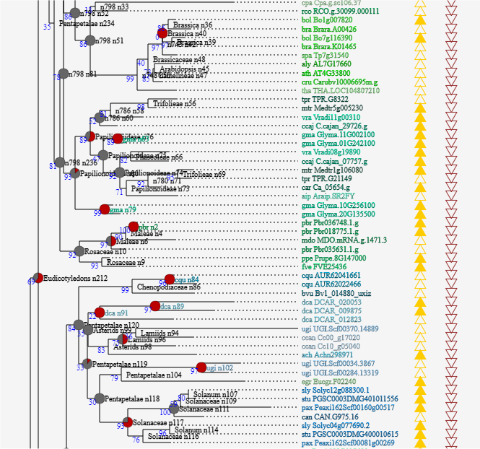
Phylogenetic trees
Notes:
Chenopodium quinoa

Slide 12
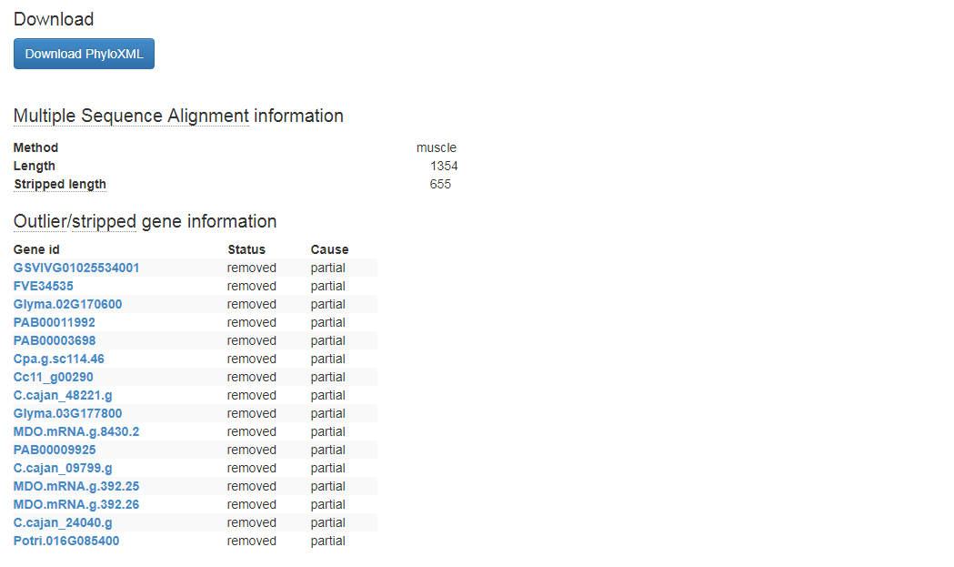
Detailed information tree construction procedure

Slide 13
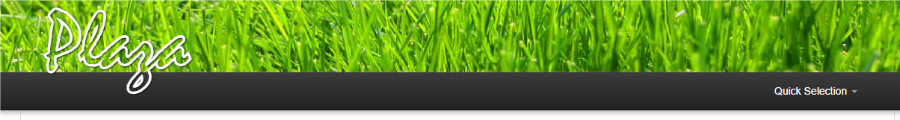
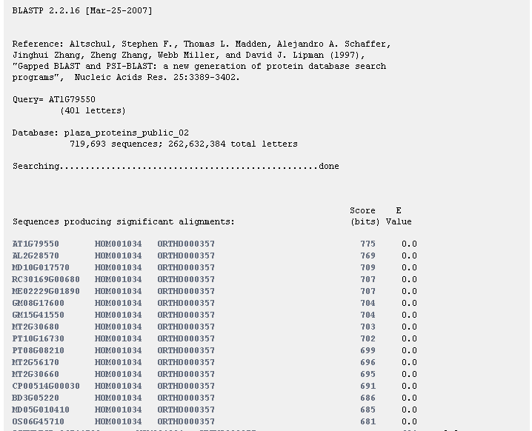
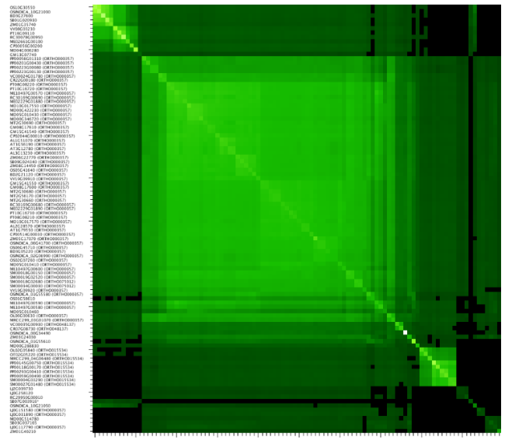
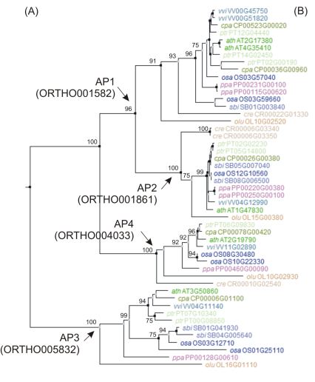
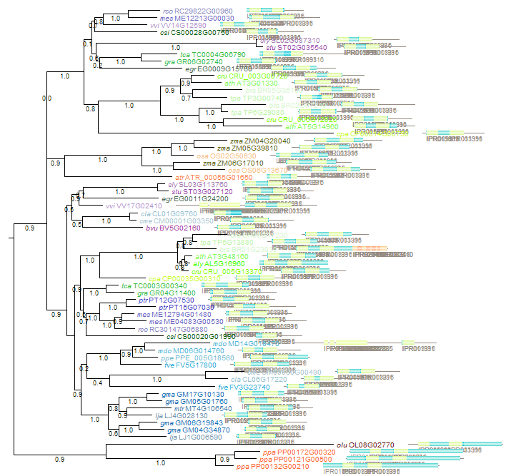
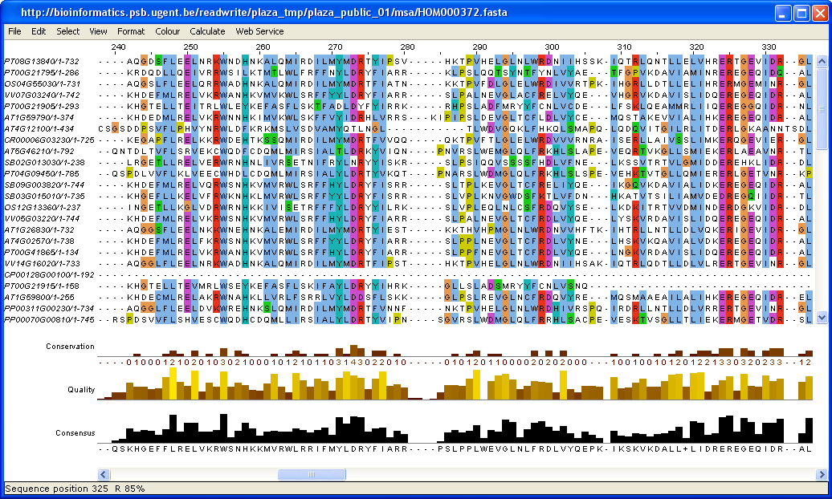
http://bioinformatics.psb.ugent.be/plaza/
>1.8M proteins from 55 species
38K multi-gene families
24K trees incl. >800K annotated tree nodes
Notes:
PLAZA starts from plant genomes, or better structural and functional annotations, produced by a variety of data providers. It focusses on gene-based comp. sequence analysis, with an emphasis on gene families, pathways and genome organization.
Scalable: version1: 9 genomes 250K proteins, now integrate genomes of >50 species, >1M proteins

Slide 14
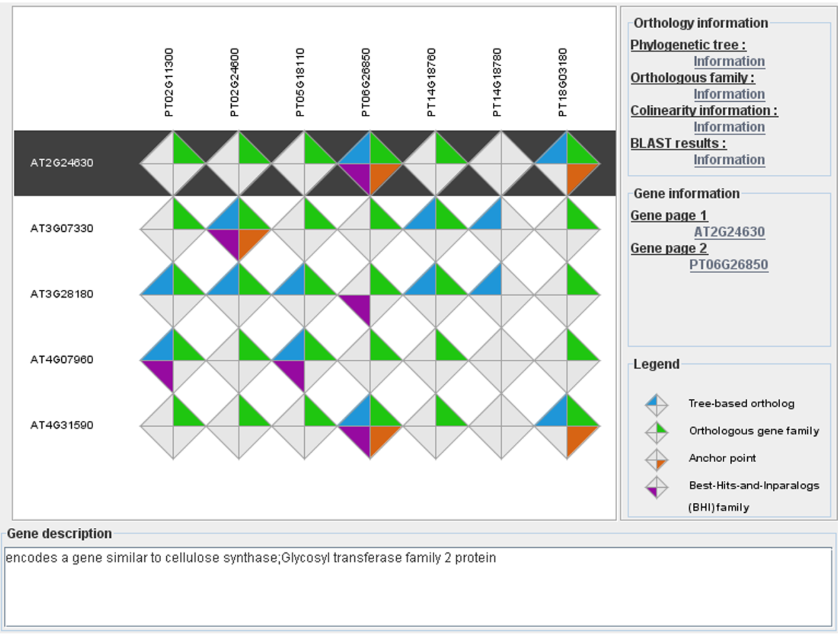
Integrative Orthology
Tree-based orthologs (TROG) inferred using tree reconciliation
Orthologous gene families (ORTHO) inferred using OrthoFinder
Anchor points refer to gene-based colinearity between species
Best hit families (BHIF) inferred from Blast hits including inparalogs
Notes:
Caution with big gene families – rapid sequence evolution!

Slide 15
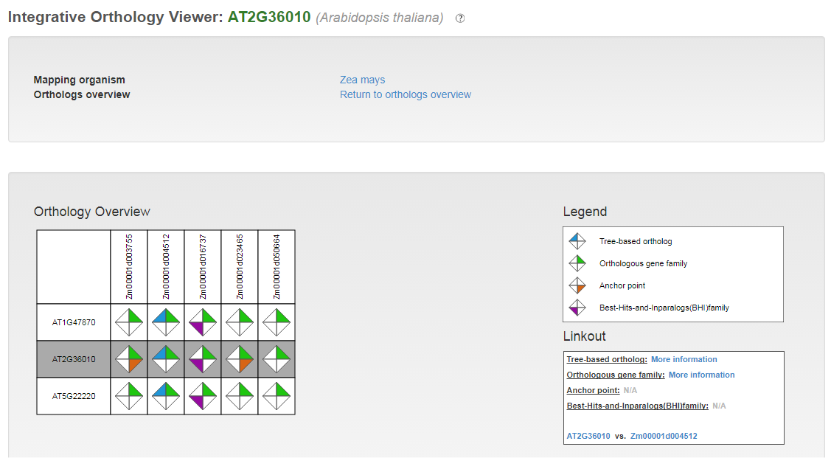
Integrative Orthology: ATE2FA orthologs in maize
Notes:
Caution with big gene families – rapid sequence evolution!

Slide 16
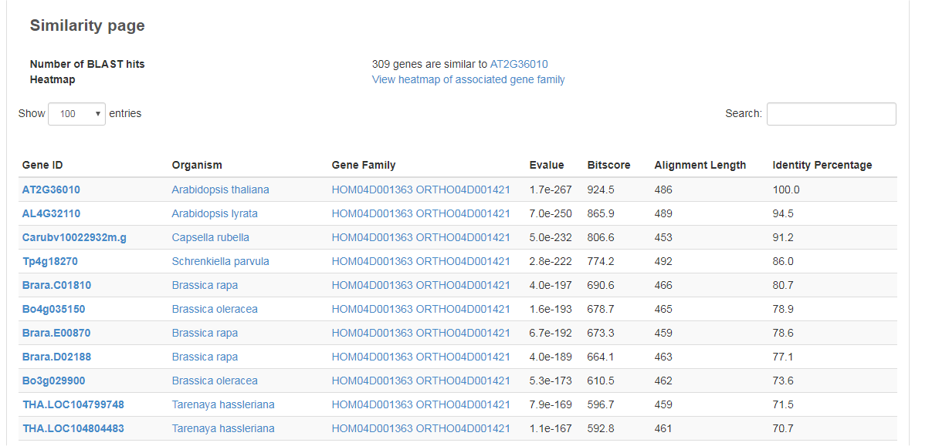
Best hit families (BHIF) inferred from Blast hits including inparalogs

Slide 17
Interactive Phylogenetics Module
DEMO
Generate the phylogenetic tree of user-selected sequences.
Selection of sequences to be analyzed based on
  BLAST hits of the query gene
  Species of interest present in corresponding gene family
More extensive options available related to
  Multiple sequence alignment (MUSCLE or MAFFT)
  Editing alignment
  Phylogenetic tree construction (PhyML, RaXML, or IQ-TREE incl. model test)
PhyD3 is used to visualize the generated phylogenetic tree
All intermediate and final files can be downloaded from the Files tab.

