Slide 1
Functional Plant Bioinformatics
Functional annotation + concept GO projection
14-15 September, 2017
Klaas Vandepoele

Slide 2
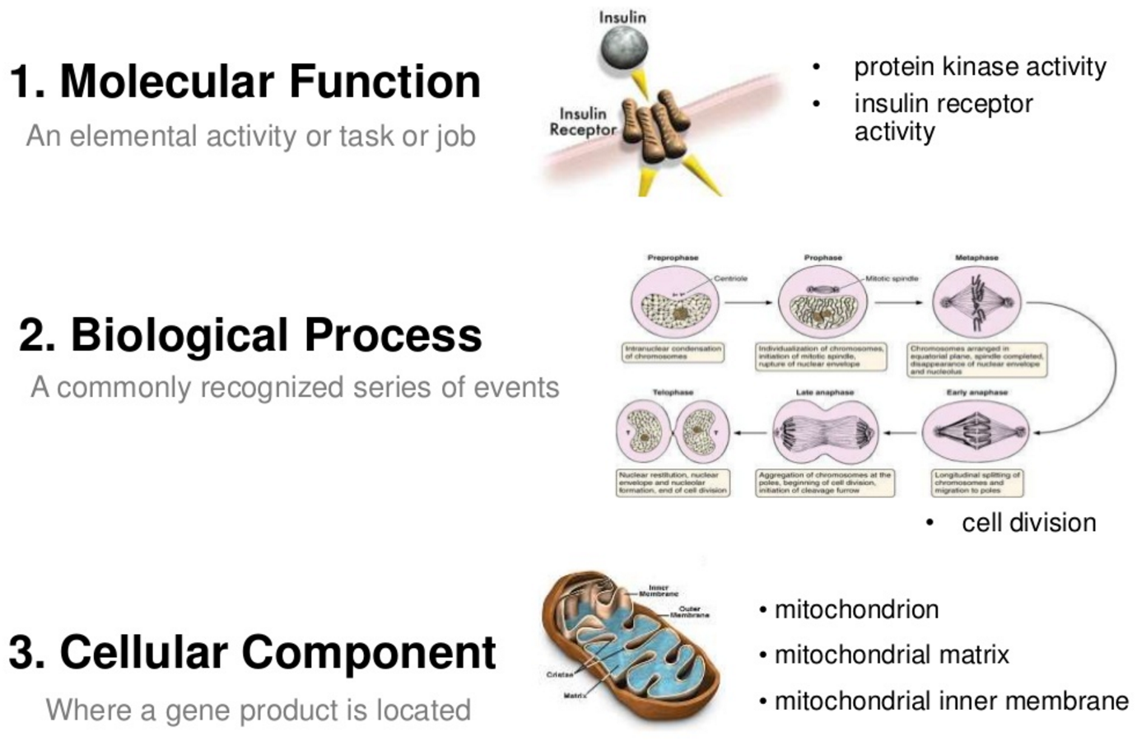
Gene Ontology (GO)
a collaborative effort to address the need for consistent descriptions of gene products across databases
The GO project has developed three structured ontologies that describe gene products in a species-independent manner
An ontology is a formal representation of a body of knowledge, within a given domain. Ontologies usually consist of a set of classes or terms with relations that operate between them.

Slide 3
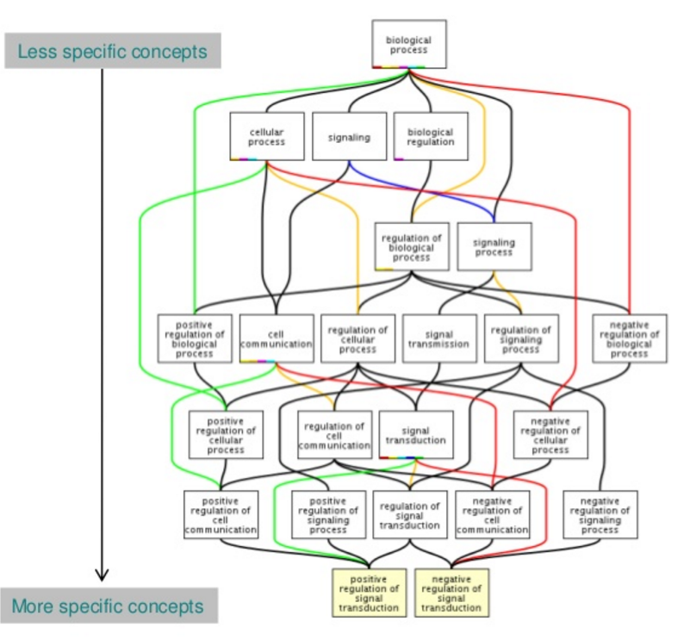
Sample GO term
id: GO:0016049
name: cell growth
namespace: biological_process
def: "The process in which a cell irreversibly increases in size over time by accretion and biosynthetic production of matter similar to that already present." [GOC:ai]
subset: goslim_generic
subset: goslim_plant
subset: gosubset_prok
synonym: "cell expansion" RELATED []
synonym: "cellular growth" EXACT []
synonym: "growth of cell" EXACT []
is_a: GO:0009987 ! cellular process
is_a: GO:0040007 ! growth
relationship: part_of GO:0008361 ! regulation of cell size
GO annotation is the process of assigning GO terms to gene products.

Slide 4
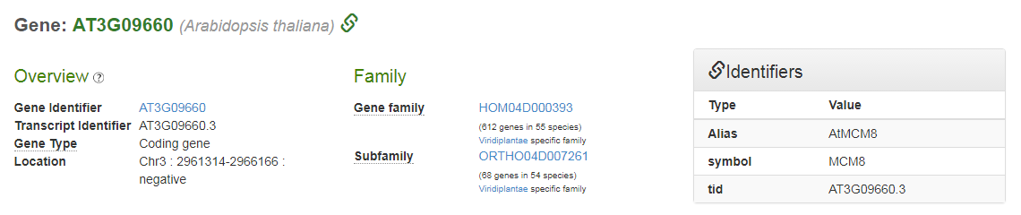
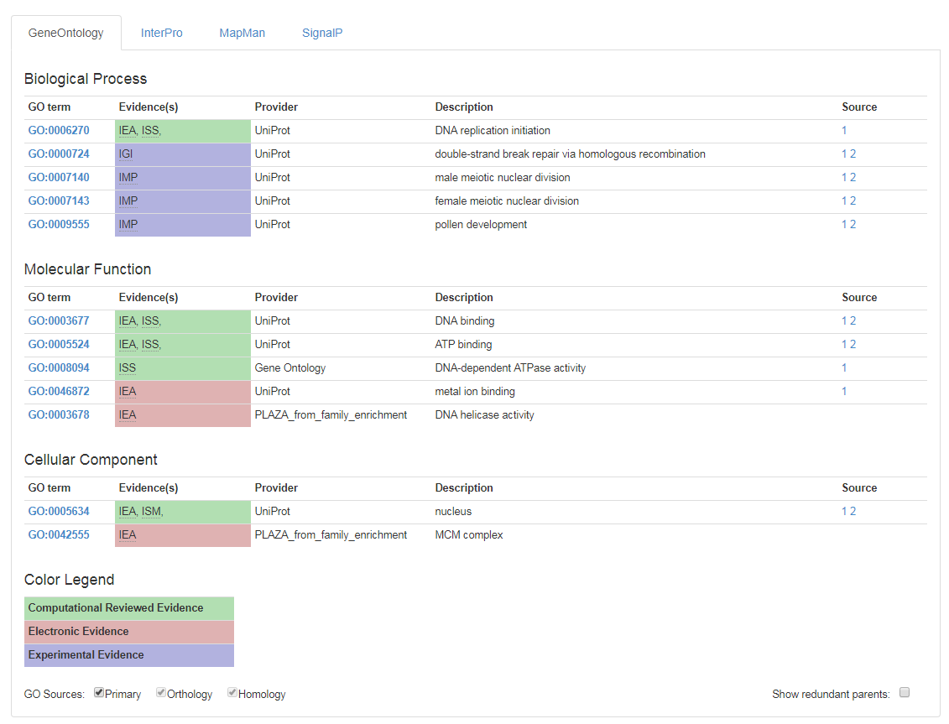
Gene Page: functional GO information

Slide 5
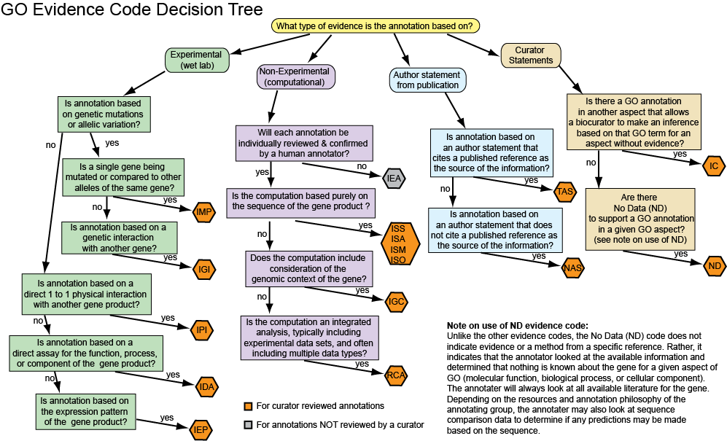
GO evidence codes

Slide 6
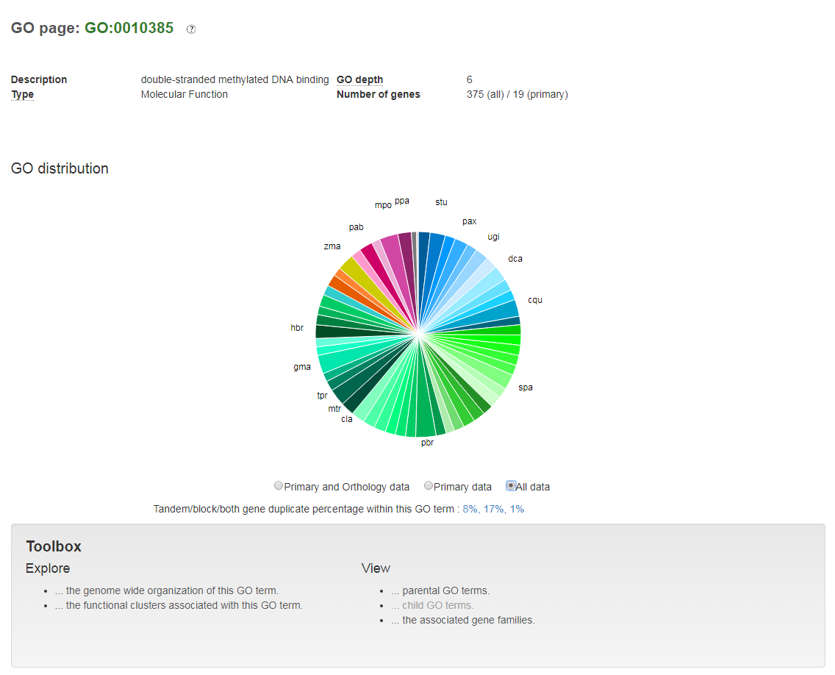
GO page

Slide 7
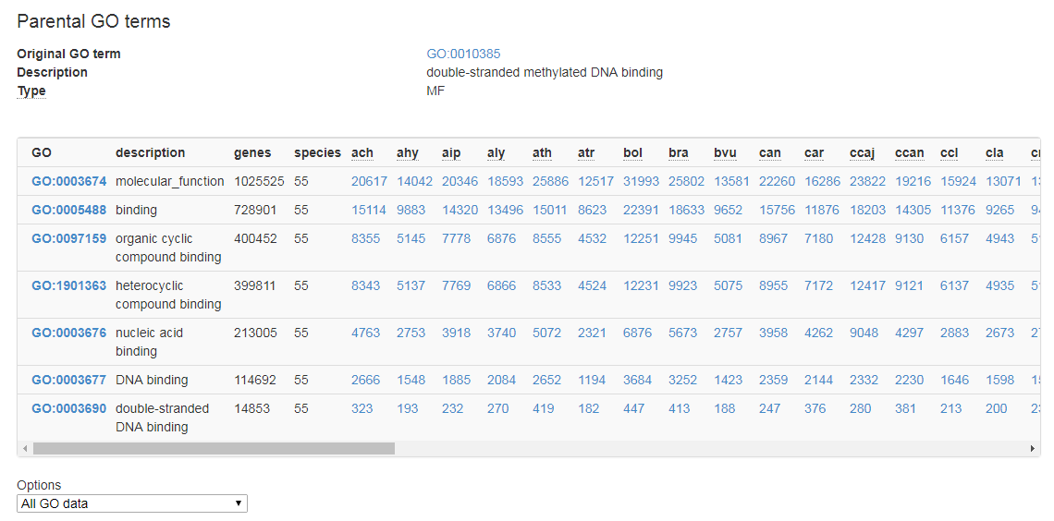
Navigating parental/child GO terms

Slide 8
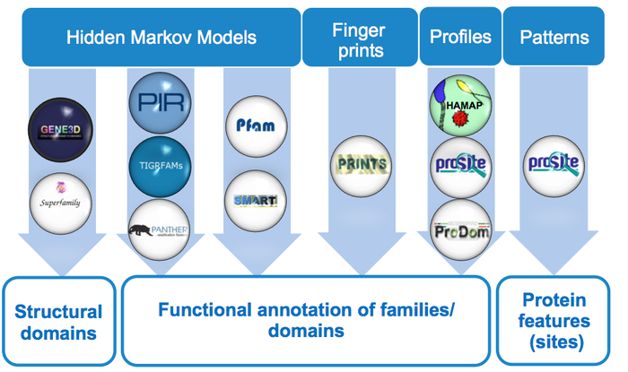
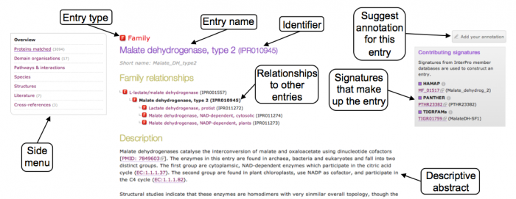
InterPro: protein sequence analysis & classification
Provides functional analysis of protein sequences by classifying them into families and predicting the presence of domains and important sites.
To classify proteins in this way, InterPro uses predictive
models, known as signatures, provided by several
different databases

Slide 9
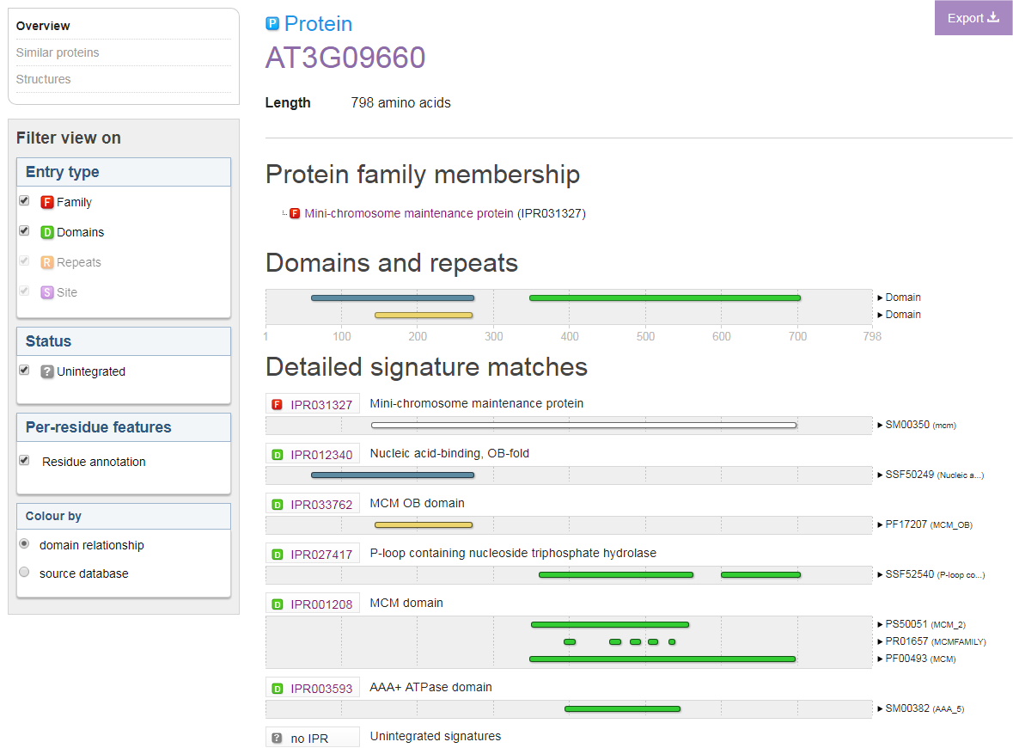
InterProScan sequence search
The InterPro protein view provides a graphical representation of the signatures that match a particular protein, with information about protein family membership, sequence features, structural features, and structural predictions for that protein.

Slide 10
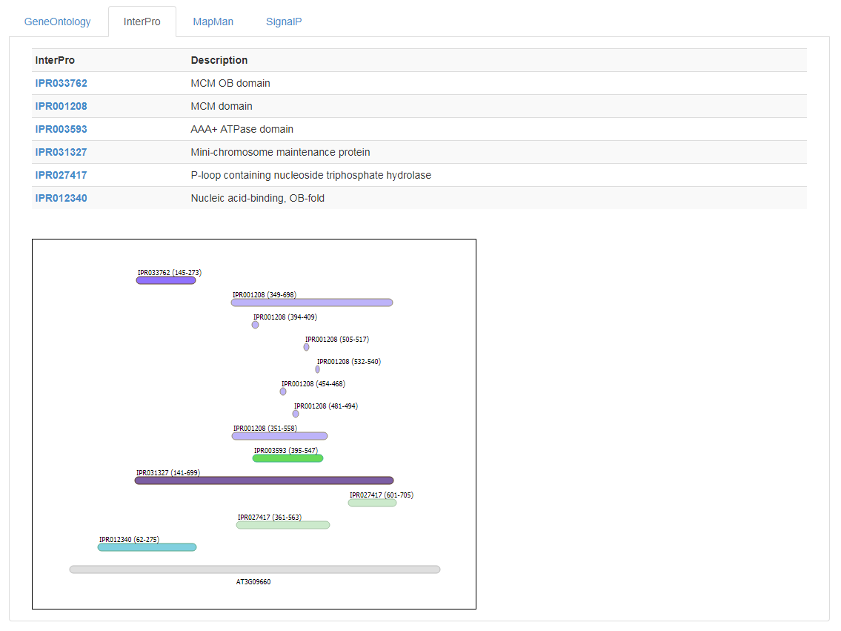
Gene Page: functional InterPro information

Slide 11
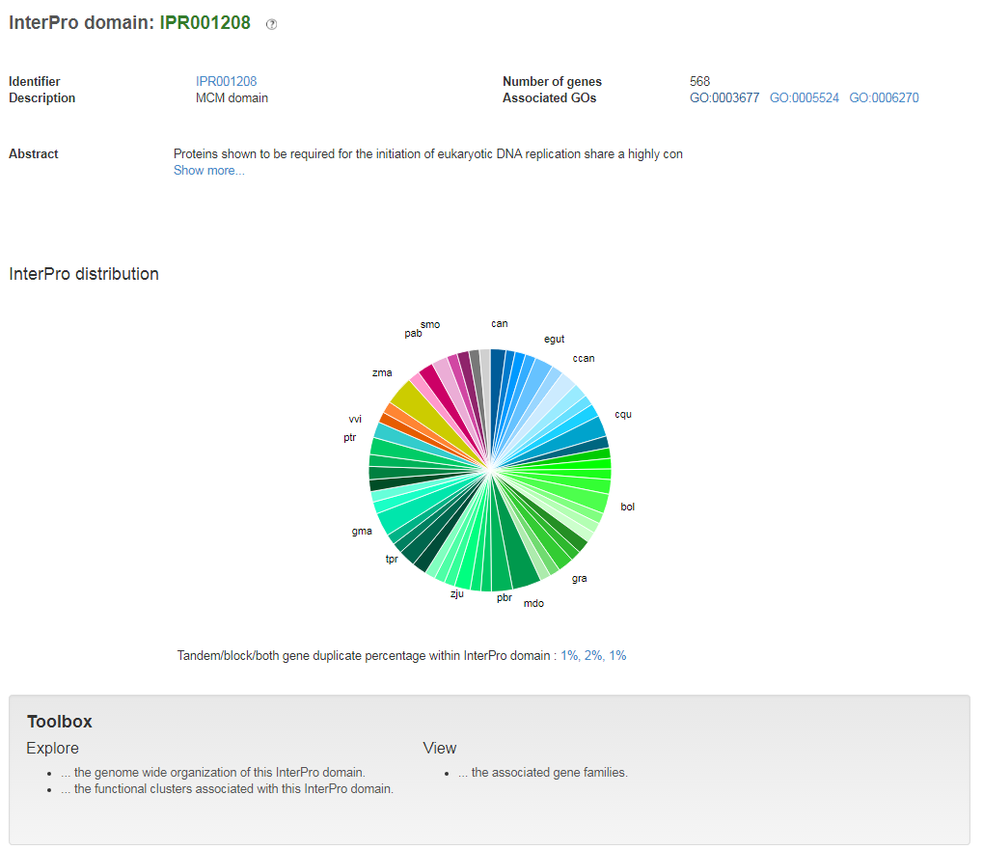
InterPro page

Slide 12
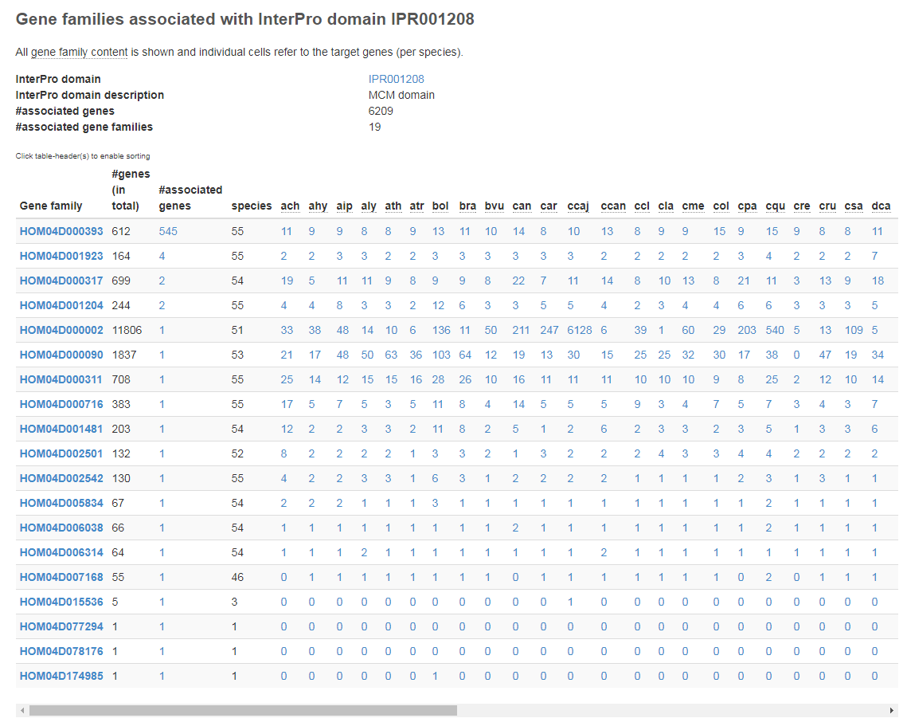
InterPro page: View the associated gene families

Slide 13
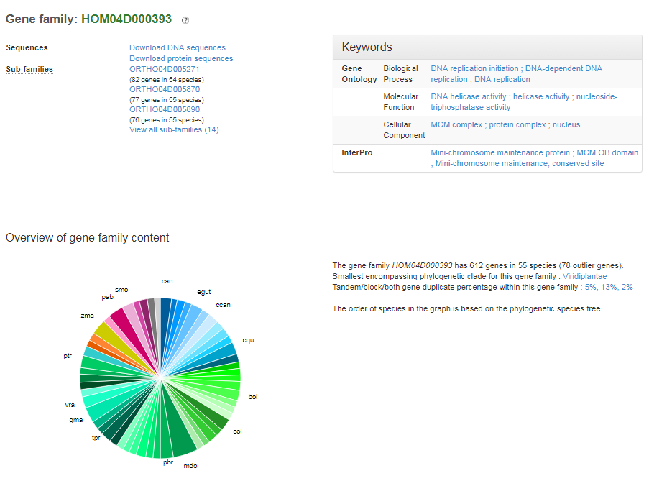
Gene family page

Slide 14
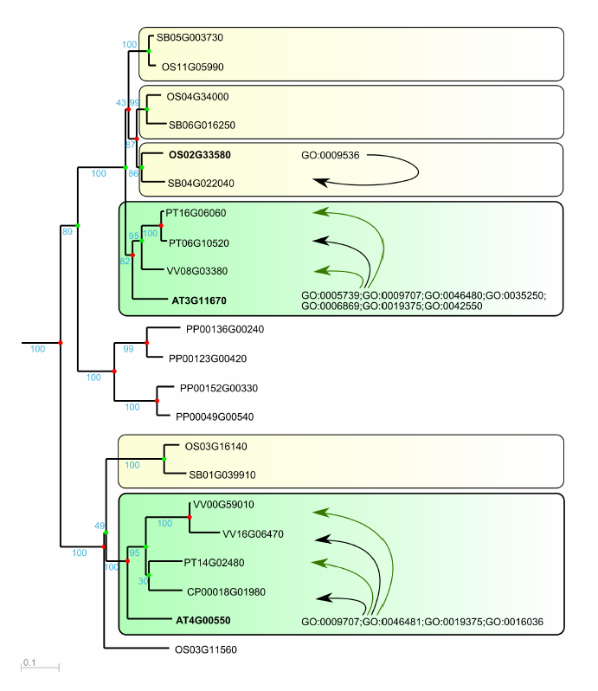
Functional annotation through GO projection
Orthology-based
Homology-based
Transfer of experimentally confirmed GO information to orthologs and homologs

Slide 15
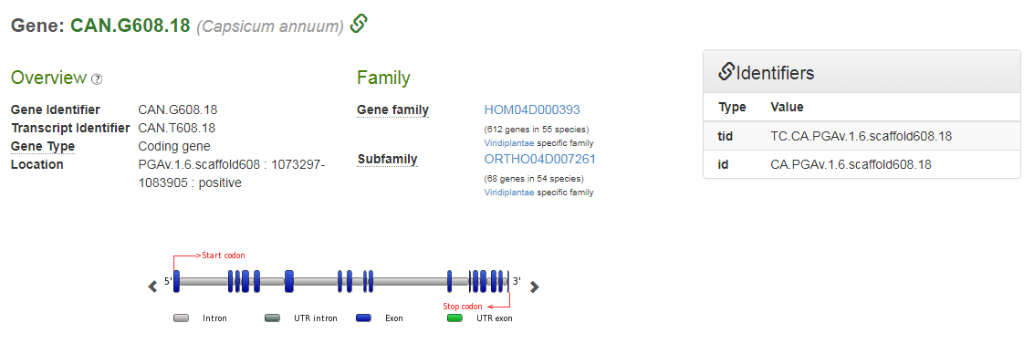
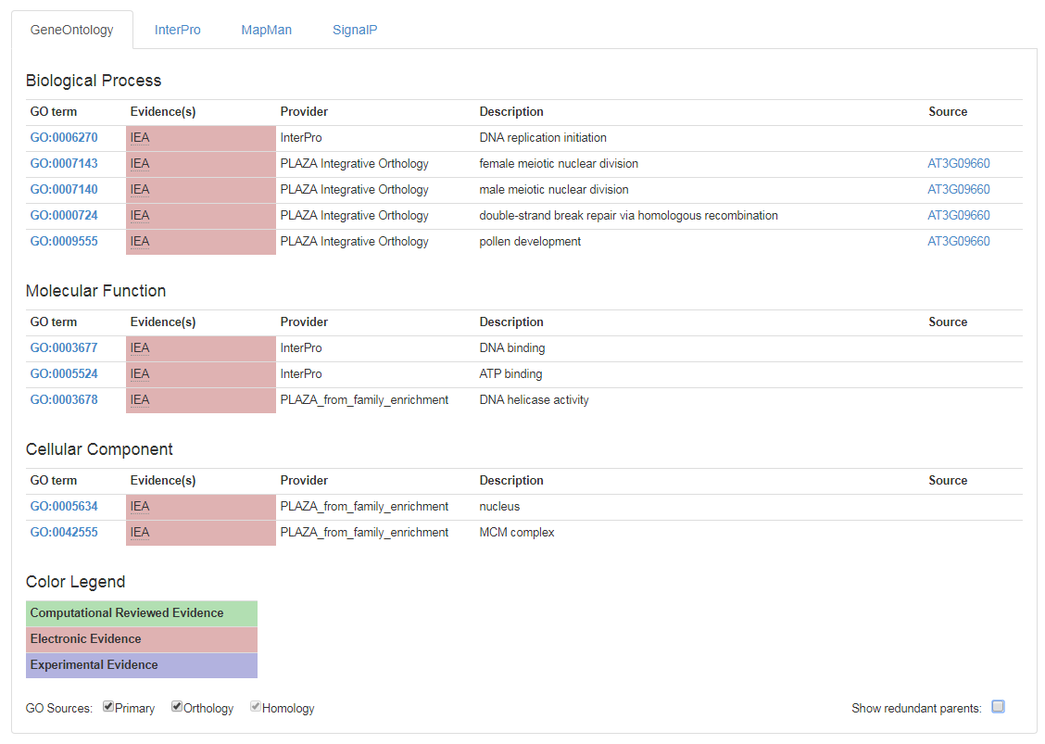
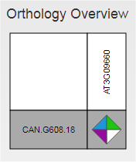
Gene Page: projected GO annotations

