Slide 1
Functional Plant Bioinformatics
Using PLAZA to get more out of your plant omics data
21-22 October, 2019
Klaas Vandepoele
Michiel Van Bel

Slide 2
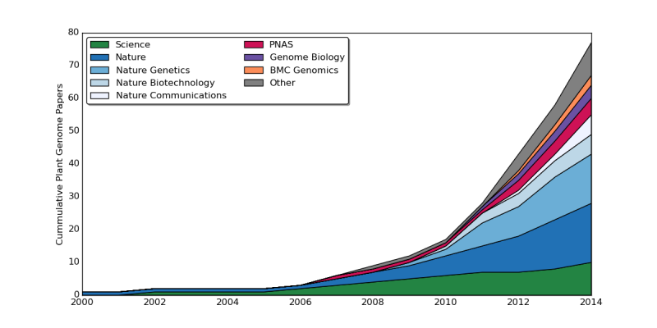
Plant genome sequencing is booming
New and faster sequencing technologies
Generating a draft genome sequence has become cheap
The number of published plant genomes grows rapidly
Currently >200 published plant genomes
Credit: CoGe
Michael & VanBuren, 2015
Notes:
Strong increase in plant genome sequences, but due to increasing performance of long molecule sequencing and mapping strategies, also more complex genomes are being sequenced. This complex genomes are sometimes plyploids and have genome size that easily are a few times larger than te human genome.
Michael & VanBuren: Progress, challenges and the future of crop genomes. Current Opinion in Plant Biology (2015)

Slide 3
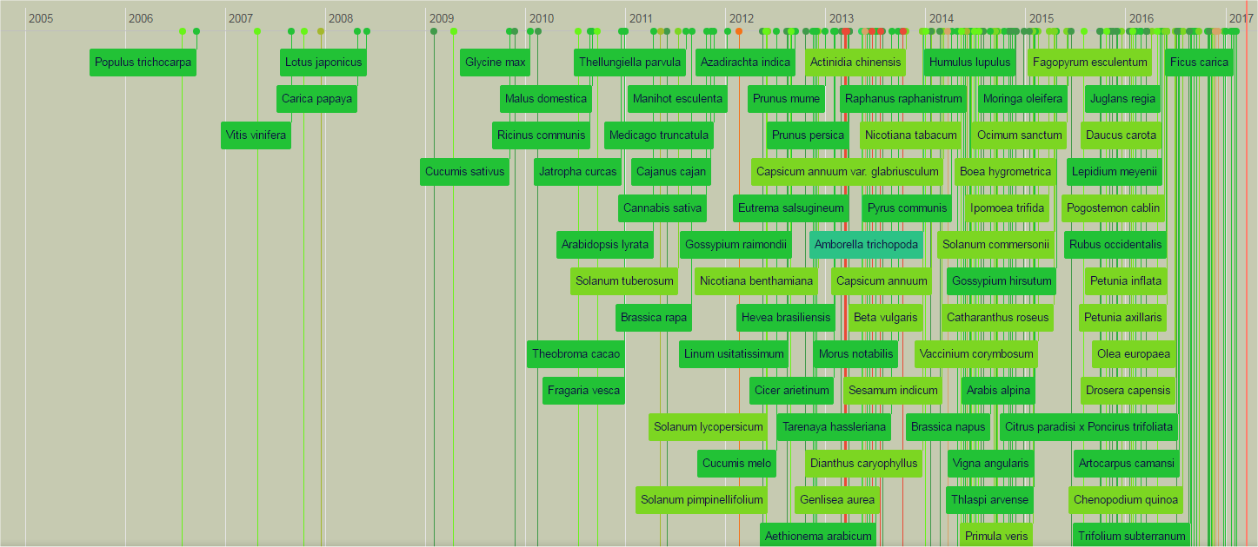
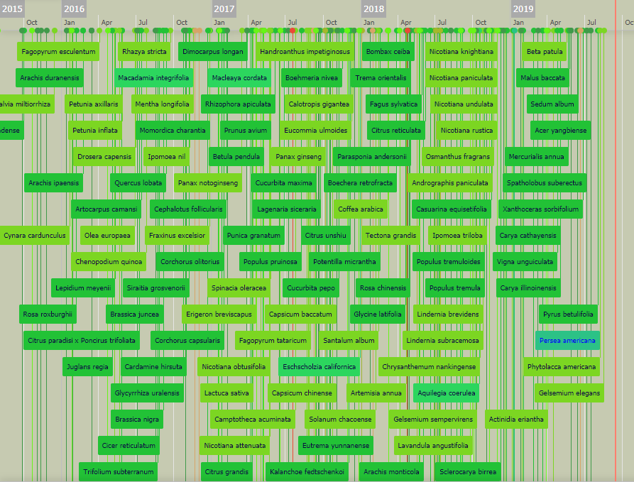
Plant genome sequencing is booming
Credit: Usadel lab
: https://www.plabipd.de/timeline_view.ep
Sequencing & publication rate keeps increasing!
Notes:
Source: https://www.plabipd.de/timeline_view.ep and https://www.plabipd.de/plant_genomes_pa.ep

Slide 4
Plant genome sequencing is booming
Single sequenced genome no longer guarantee for publication in high impact factor journal
  Interest: crop species and species of particular interest
    A reference genome for pea provides insight into legume genome evolution (Nature Genetics 2019)
  Quality: pseudomolecule assembly is required
    Shifting the limits in wheat research and breeding using a fully annotated reference genome (Science 2018)
  Quantity: multiple species are sequenced and published in the same study
    The genome sequences of Arachis duranensis and Arachis ipaensis, the diploid ancestors of cultivated peanut (Nature Genetics 2016)
  Coverage: sequence reference and resequence multiple genomes to publish in the same study
    Allele-defined genome of the autopolyploid sugarcane Saccharum spontaneum L. (Nature Genetics 2018) → 64 genomes resequenced

Slide 5
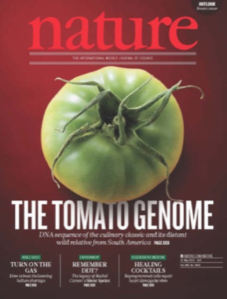
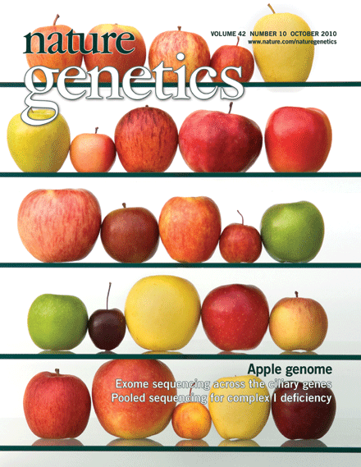
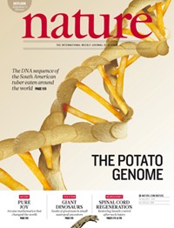
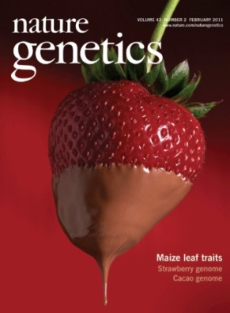

From data to knowledge
The basic genome analysis toolkit:
Genome assembly
Structural annotation shows where genes are
Functional annotation tells you what genes do
Data availability of genome sequence & gene annotation
Facilitate biological discovery
Notes:
A few basic steps are needed to transform read data in useful sequence data. Discovery? Identify pathways producing specific specific secondary metabolites responsible for great flavours / aroma’s, which genes responsible for disease resistance, or which genes control plant biomass.

Slide 6
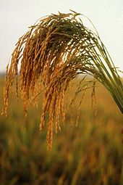
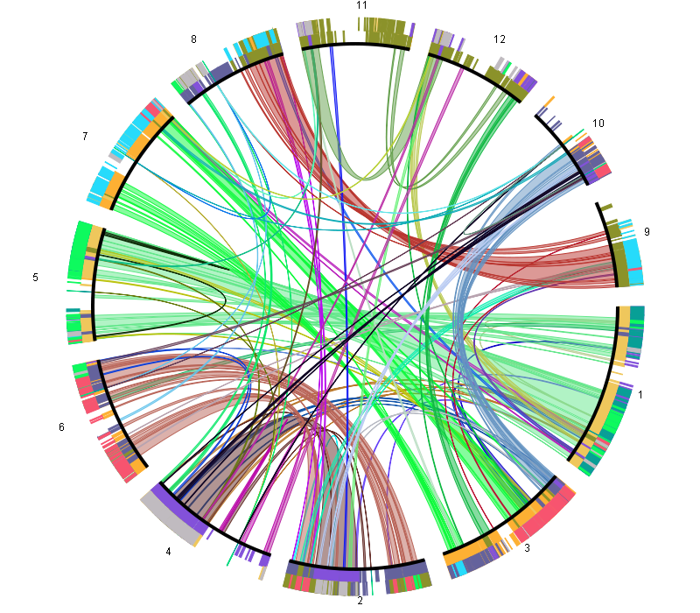
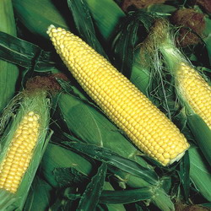
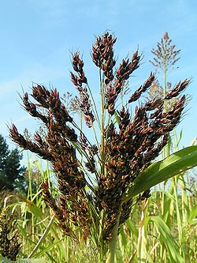
Cross-species genome analysis
Comparative genomics is a powerful tool
  to transfer knowledge from model species to crops
  to link genomic changes to environmental adaptation
  to trace structural changes within a genome or population
Notes:
Comparative genomics can be performed at different levels: genome level to study chromosome biology, at the gene level to study pathways or GFs, but also at the DNA level to for example identify CVs, SNPS. In all these cases, setting up CG workflows is not easy, as you need to handle a lot of data, combine several tools and also make sure the performance of your methods scales well with for example extra genomes.

Slide 7
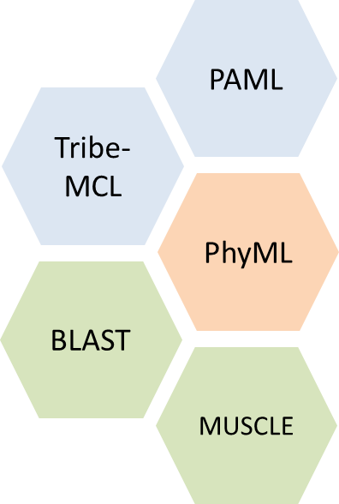
Cross-species genome analysis
Comparative genomics has a steep learning curve
  Gathering data in the same state incl. proper QC, ready for processing, is not effortlessly
  Knowledge of data processing tools is required
  Computer clusters and high memory machines are required
  User friendly visualizations are necessary to explore genomic features across multiple species
  Limited access to high quality comparative genomics information
Notes:
Comparative genomics can be performed at different levels: genome level to study chromosome biology, at the gene level to study pathways or GFs, but also at the DNA level to for example identify CVs, SNPS. In all these cases, setting up CG workflows is not easy, as you need to handle a lot of data, combine several tools and also make sure the performance of your methods scales well with for example extra genomes.

Slide 8
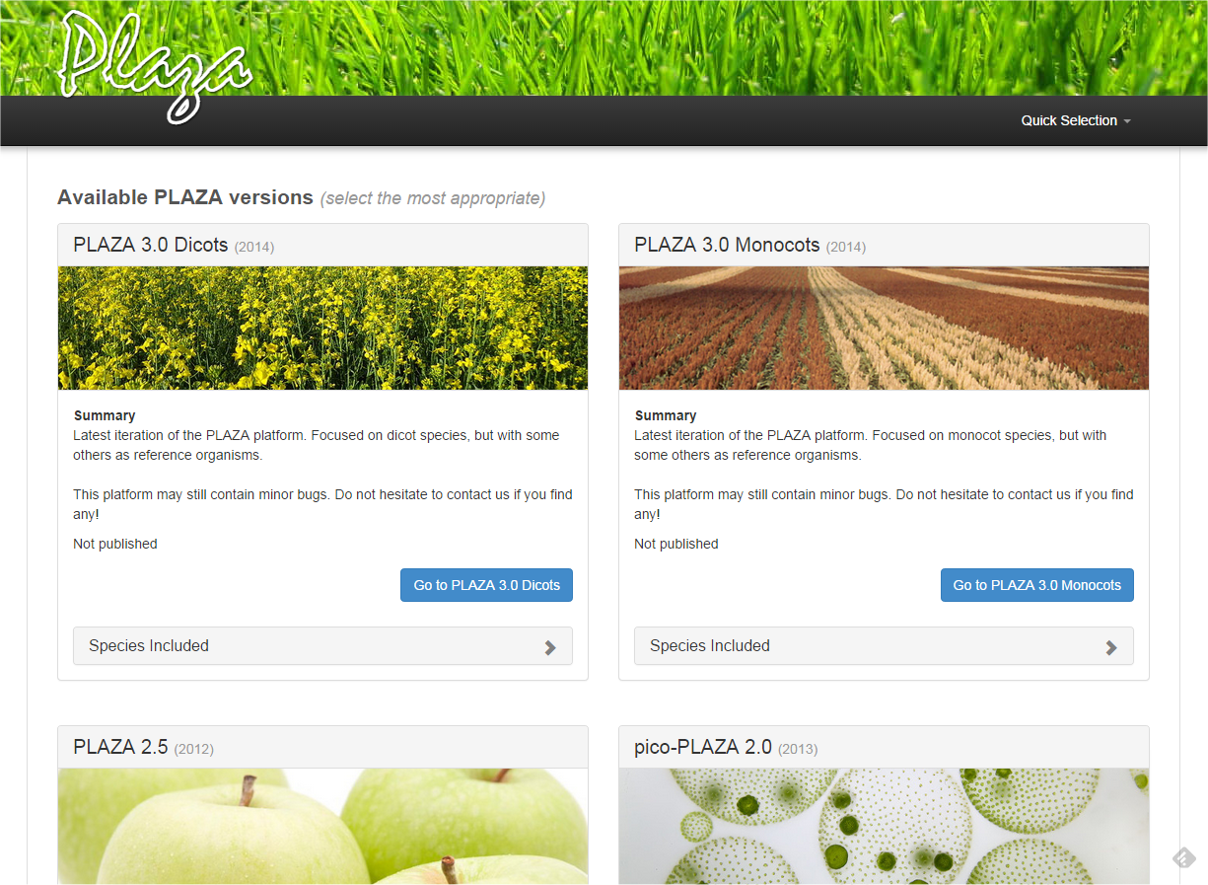
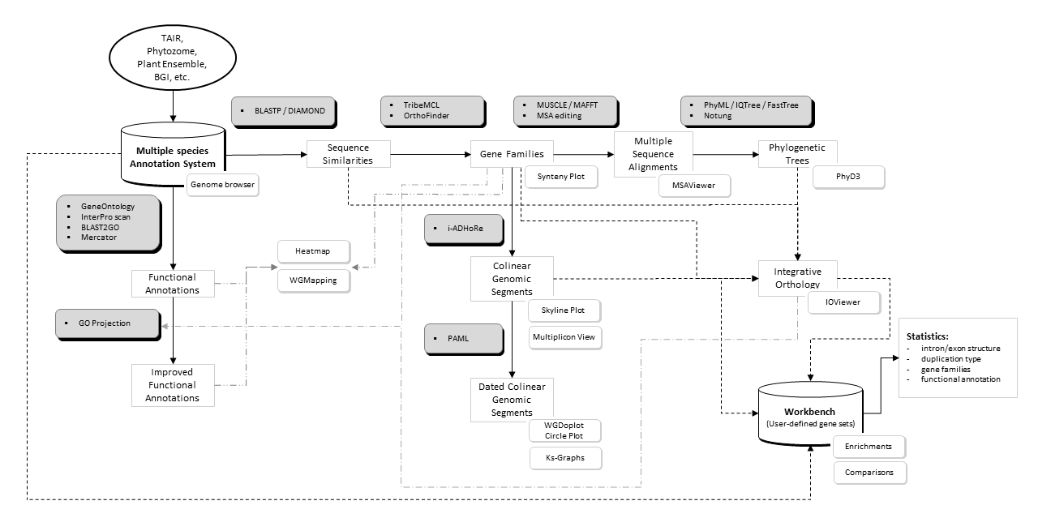
Exploiting cross-species genome information
>20 tools available!

Slide 9
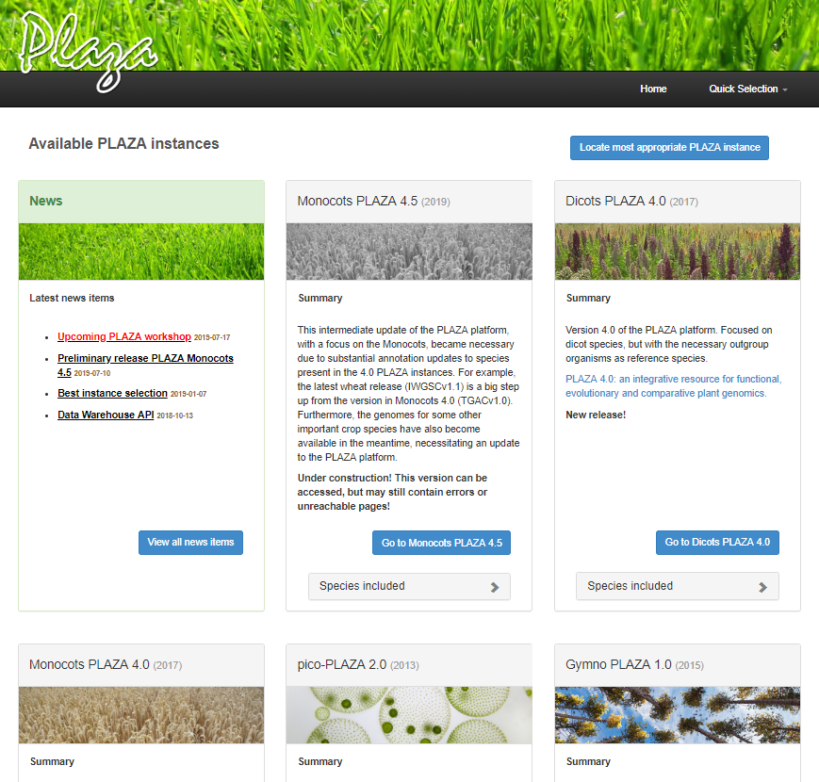
http://bioinformatics.psb.ugent.be/plaza/
Notes:
10 years ago, we started developing PLAZA. Integrative resource for plant genomics, with a focus on comp. genomics. Different PLAZA dbs have been developed, depending on which species with the green plant lineage you like best.

Slide 10
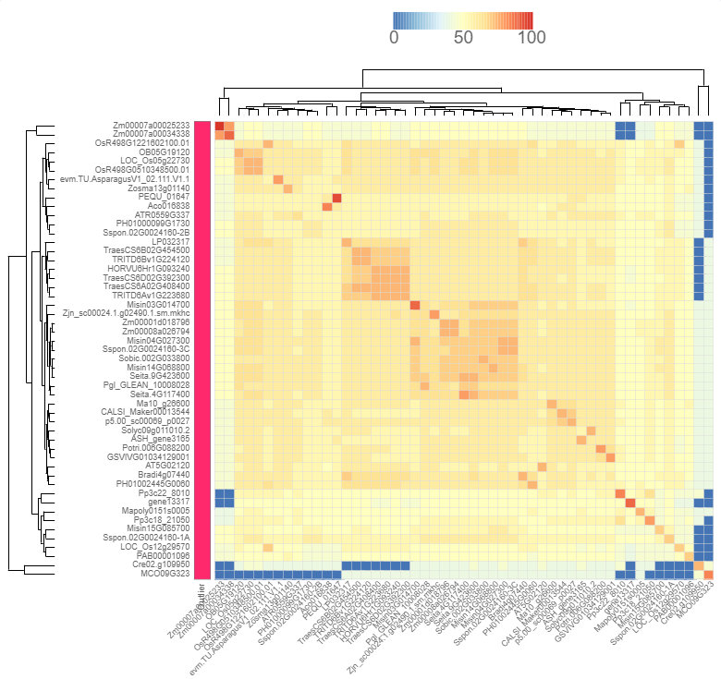
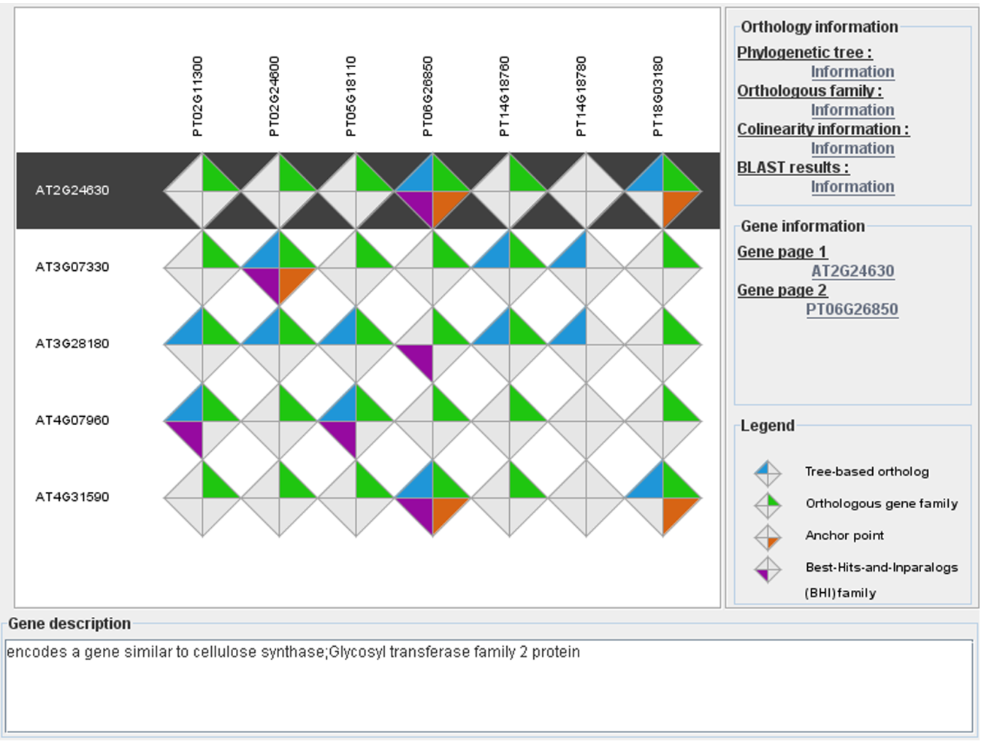
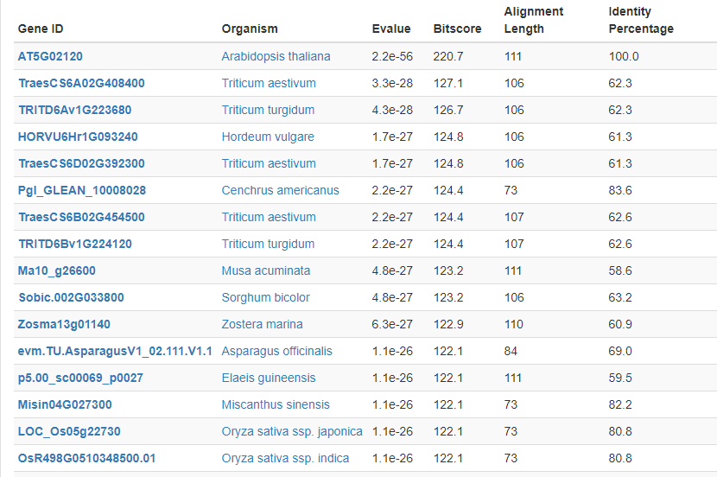
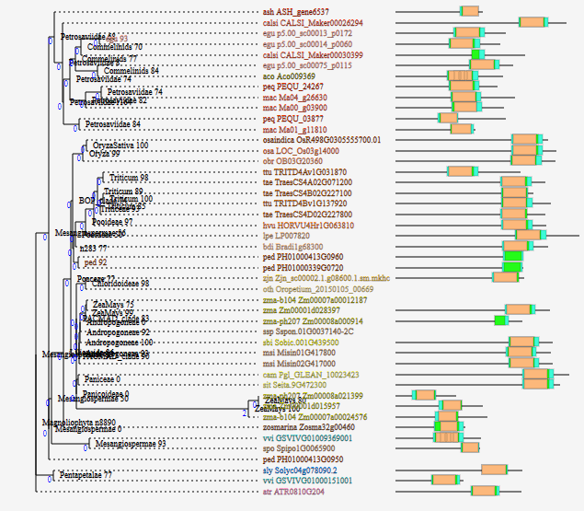
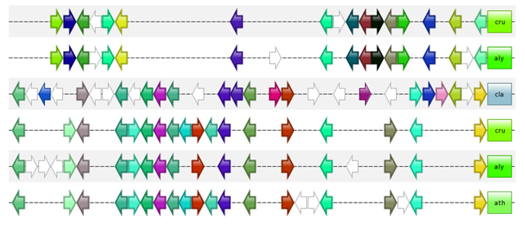
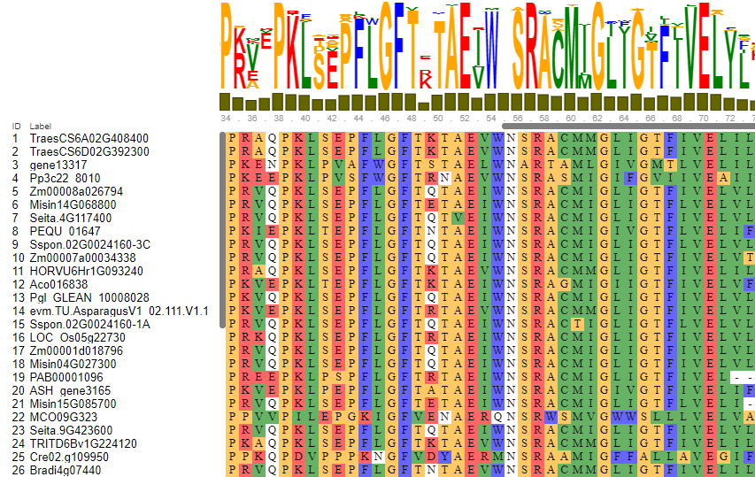
http://bioinformatics.psb.ugent.be/plaza/
> 100 species/genomes
  → dicots, monocots, gymnosperms, algae, diatoms, etc.
Highly scalable design
  → Web-based mobile user interface
Integrated Workbench for analysis of sets of genes
APIs & FTP dumps for large scale custom analyses
Gene family annotation and phylogenetic trees
Traceable functional annotation (GO/InterPro/MapMan)
Colinearity and synteny
Integrative gene orthology inference
Highly integrative platform to translate knowledge from model to crop
Notes:
PLAZA starts from plant genomes, or better structural and functional annotations, produced by a variety of data providers. It focusses on gene-based comp. sequence analysis, with an emphasis on gene families, pathways and genome organization.
Scalable: version1: 9 genomes 250K proteins, now integrate genomes of >80 species, >1M proteins

Slide 11
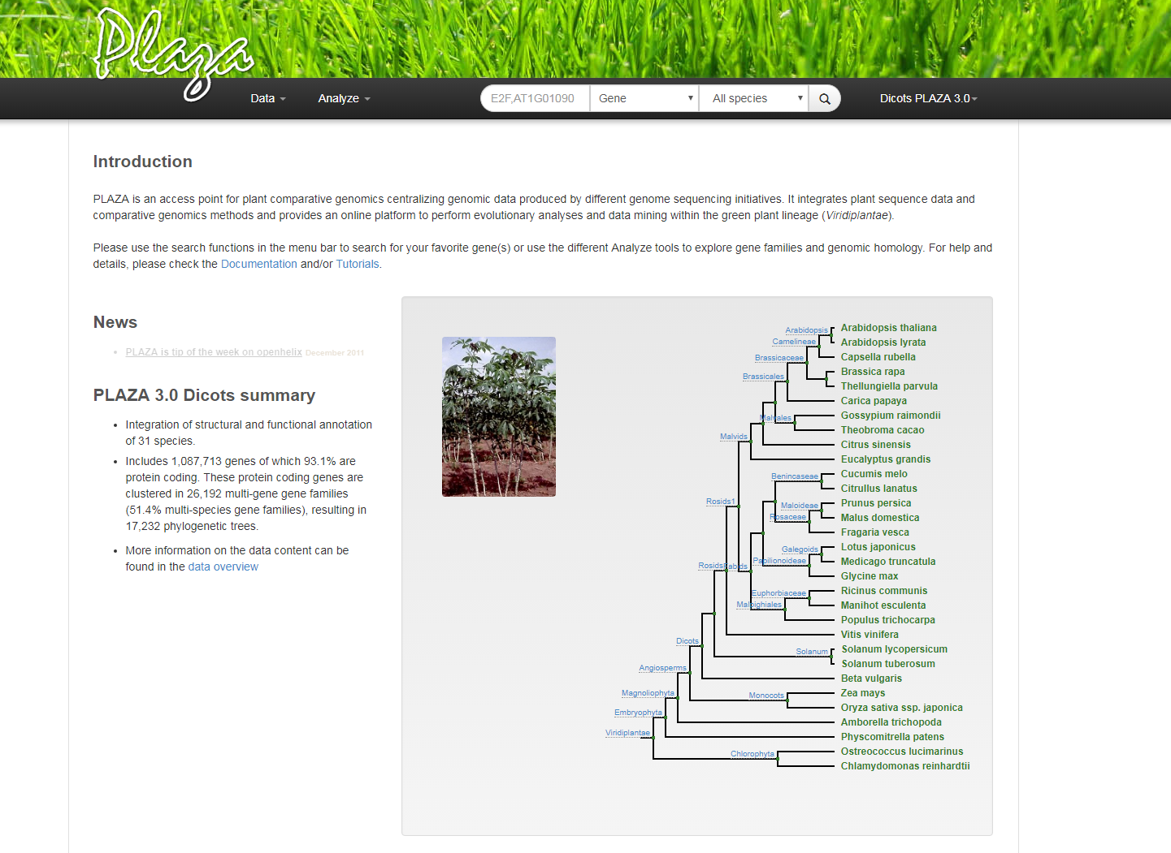
PLAZA Instance Main Page
Search bar
Data overview and downloads
Other PLAZA Instances
Tools and Visualizations
Available Species

Slide 12
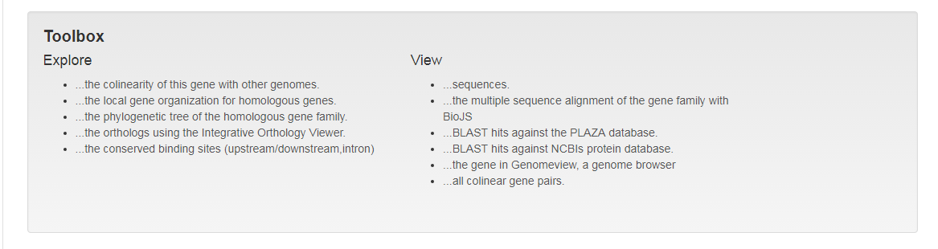
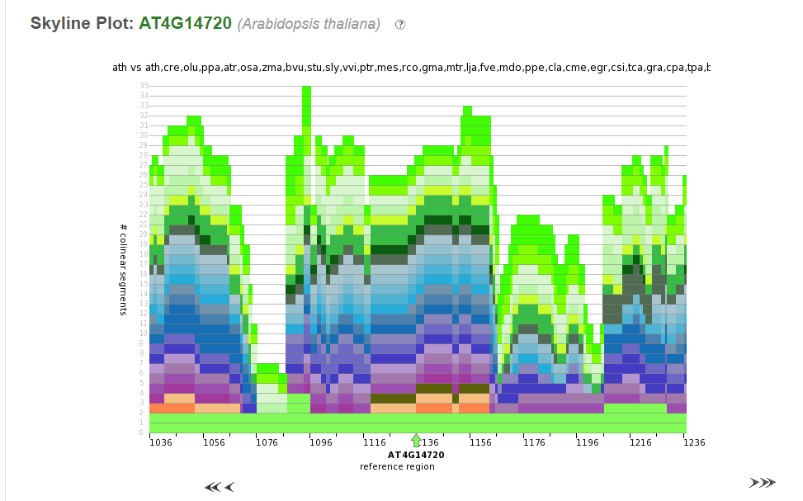
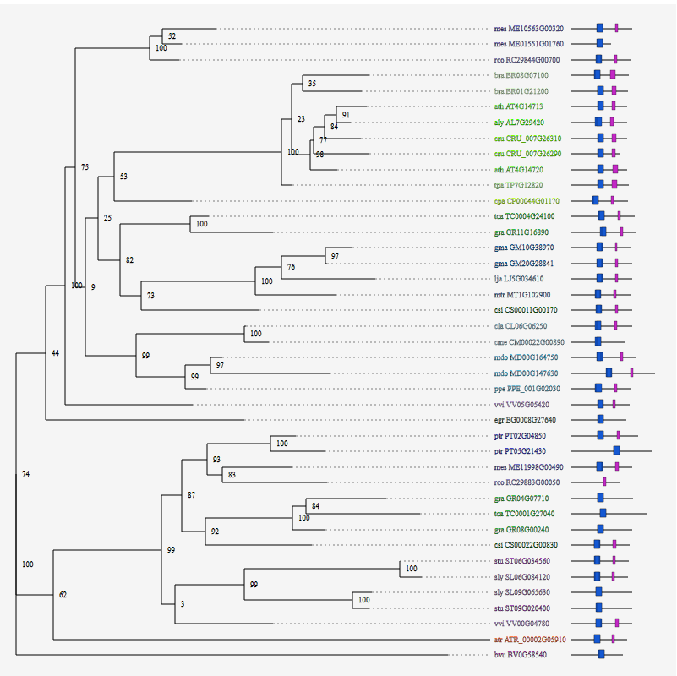
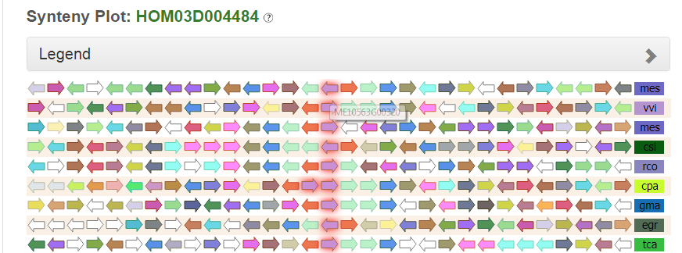
Gene Page: ToolBox

Slide 13
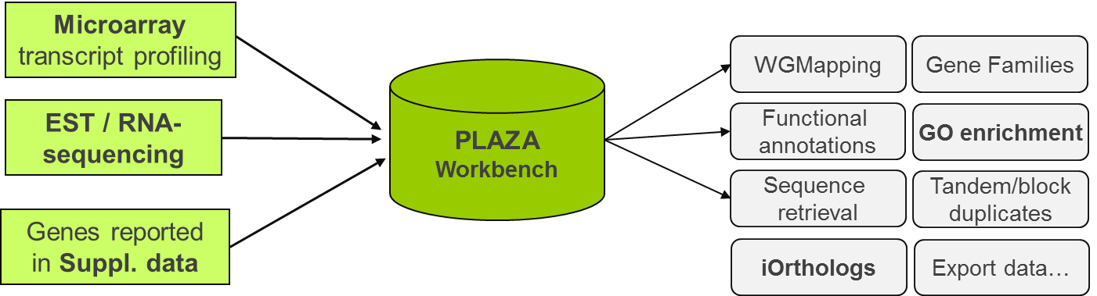
PLAZA Workbench
Create a custom gene set (~experiment) using gene identifiers or BLAST
  External/internal gene IDs (e.g. AN3, AT5G28640, GRMZM2G180246_T01)
  BLAST interface can be used to map sequence data from a non-model species to a reference species present in PLAZA
A toolbox is available to analyze user-defined gene sets (~experiment)

Slide 14
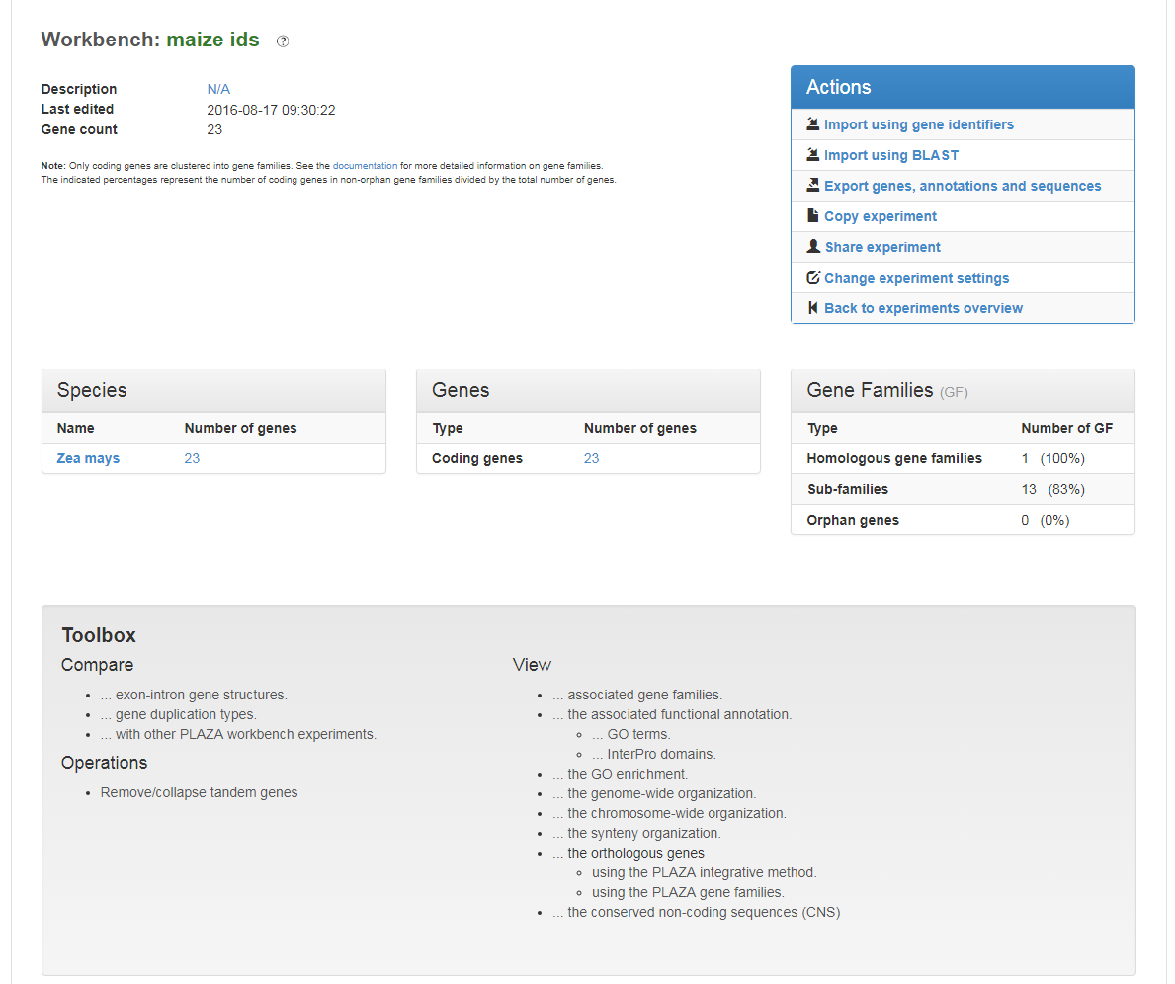
PLAZA Workbench

Slide 15
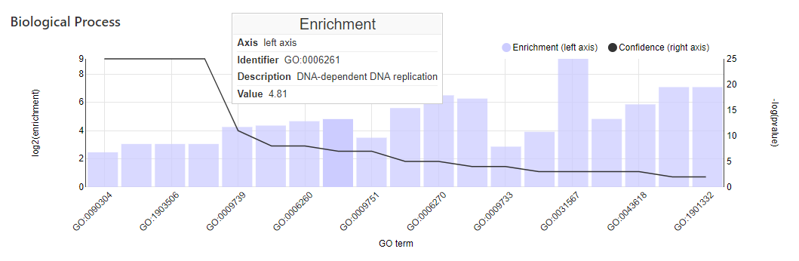
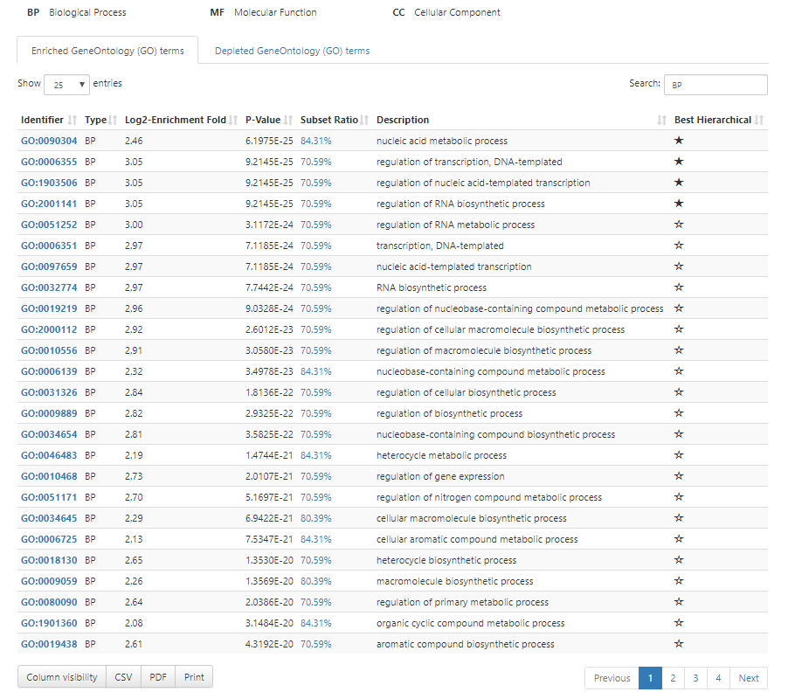
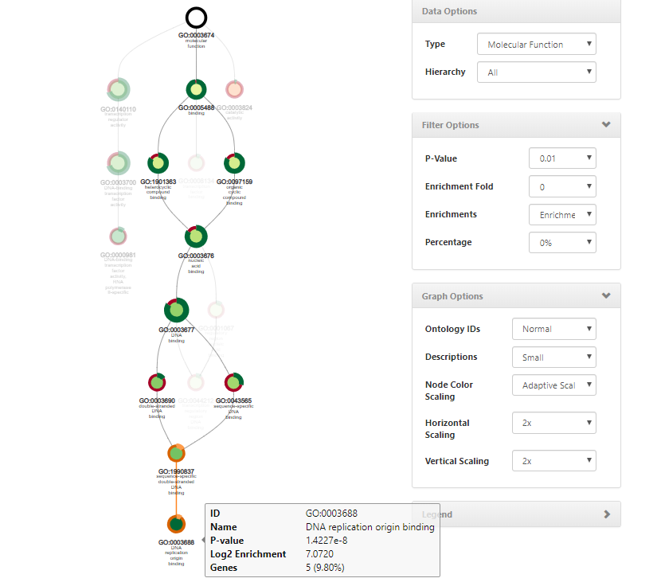
Enrichment analysis: GO/InterPro/MapMan

Slide 16
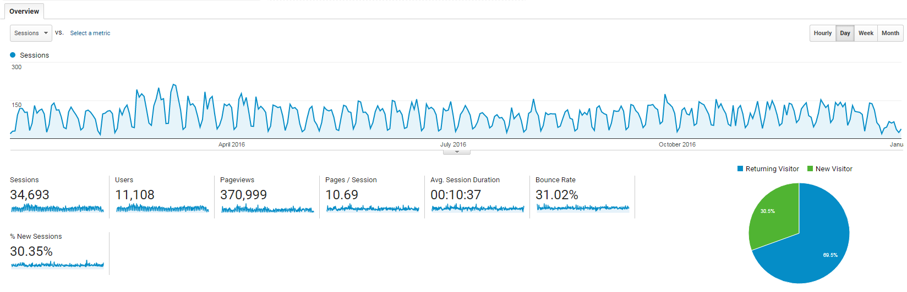
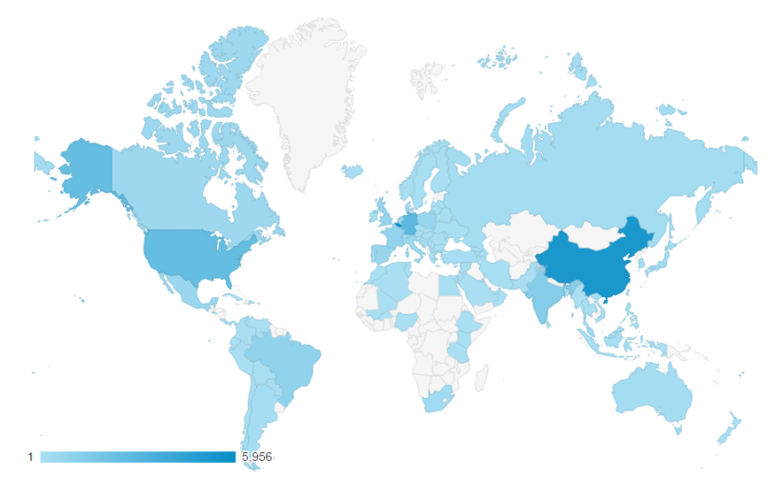
PLAZA 3.0 user statistics (2016)
>11,000 users (+13%), 370K page views (+30%)
Users from >95 countries
Intensively used by
  academia (>400 citations)
  industry

Slide 17
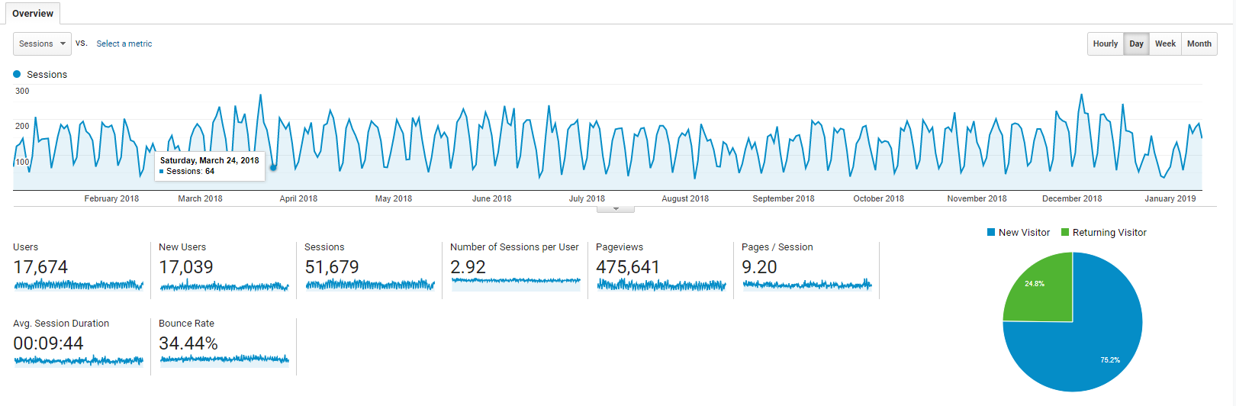
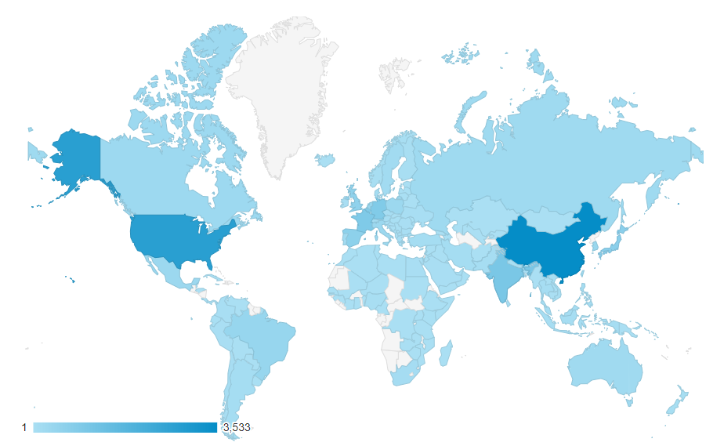
PLAZA 4.0 user statistics (2018)
>17,000 users
Users from >140 countries
Intensively used by
  academia (>750 citations)
  industry

Slide 18
How to find what you are looking for?
http://bioinformatics.psb.ugent.be/plaza/documentation
Glossary
Documentation
  Data content
  Construction
  Tools
Tutorials & FAQ
Publications

Slide 19
Further reading
Core Publications
  Van Bel, M., Diels, T., Vancaester, E., Kreft, L., Botzki, A., Van de Peer, Y., Coppens, F., Vandepoele, K. (2017) PLAZA 4.0: an integrative resource for functional, evolutionary, and comparative plant genomics Nucleic Acids Res. 46 (Database issue): D1190-1196
  * Proost, S., * Van Bel, M., Vaneechoutte, D., Van de Peer, Y., Inzé, D., Mueller-Roeber, B., Vandepoele, K. (2014) PLAZA 3.0: an access point for plant comparative genomics. Nucleic Acids Res. 43(Database issue):D974-81
  * Van Bel, M., * Proost, S., Wischnitzki, E., Movahedi, S., Scheerlinck, C., Van de Peer, Y., Vandepoele, K. (2012) Dissecting plant genomes with the PLAZA comparative genomics platform. Plant Physiol. 158(2):590-600
  * Proost, S., * Van Bel, M., Sterk, L., Billiau, K., Van Parys, T., Van de Peer, Y., Vandepoele, K. (2009) PLAZA: a comparative genomics resource to study gene and genome evolution in plants. Plant Cell. 21(12):3718-31
Training Material
  * Vandepoele, K. (2016) A Guide to the PLAZA 3.0 Plant Comparative Genomic Database. Methods Mol Biol. 1533:183-200.

Slide 20
Conclusions
PLAZA provides a versatile toolbox for plant genomics
Integration of complementary data sources describing gene functions
Improved algorithms to transfer functional annotation from well-characterized plant genomes to other species
Technical improvements
  database design
  comparative genomics toolbox
  speed
  interactive visualizations

