Slide 1
Functional Plant Bioinformatics
Genes, gene families and genome organization
21-22 October, 2019
Klaas Vandepoele
Michiel Van Bel

Slide 2
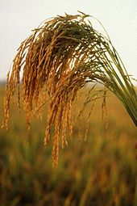
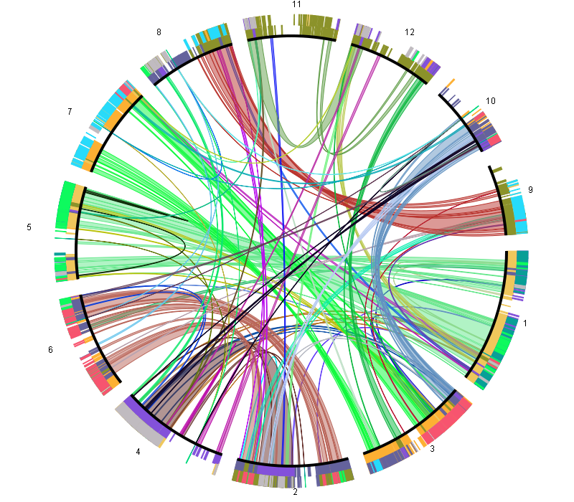
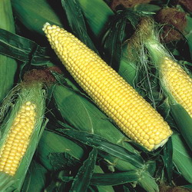
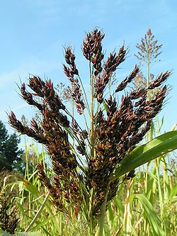
Cross-species genome analysis
Comparative genomics is a powerful tool
  to transfer knowledge from model species to crops
  to trace structural changes within a genome or population
  Level of resolution
    Population or species level (DNA-based)
    Cross-species (protein-based)
Notes:
Comparative genomics can be performed at different levels: genome level to study chromosome biology, at the gene level to study pathways or GFs, but also at the DNA level to for example identify CVs, SNPS. In all these cases, setting up CG workflows is not easy, as you need to handle a lot of data, combine several tools and also make sure the performance of your methods scales well with for example extra genomes.

Slide 3
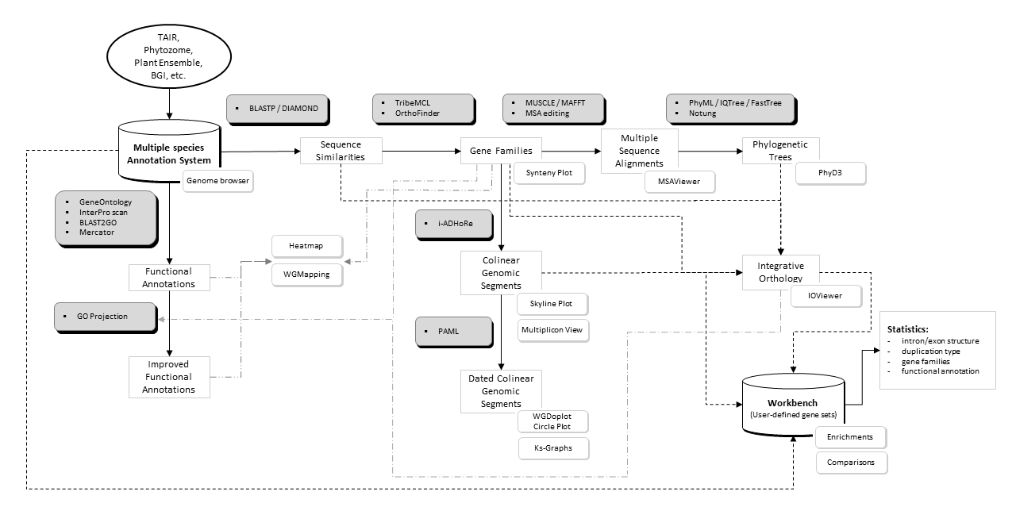
Exploiting cross-species genome information
>20 tools available!

Slide 4
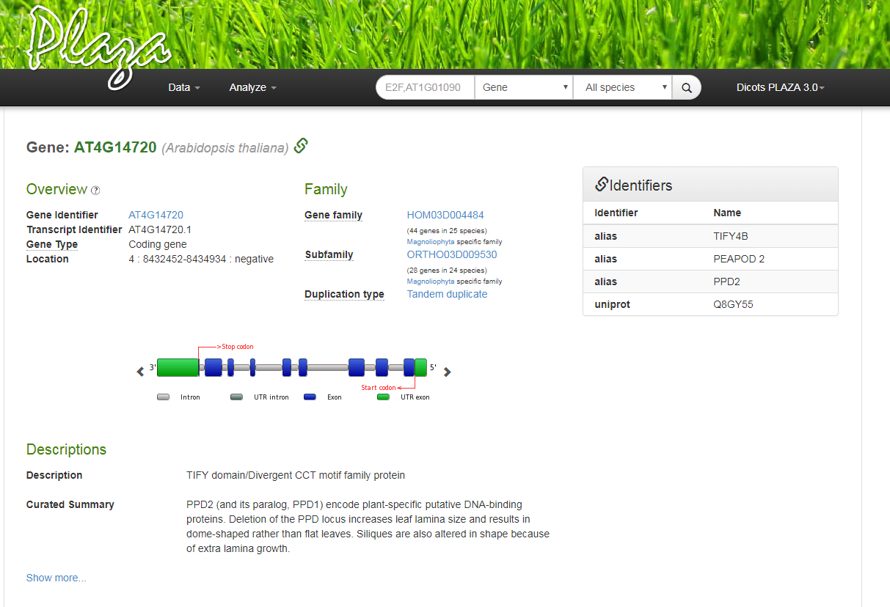
Gene Page: a. structural information

Slide 5
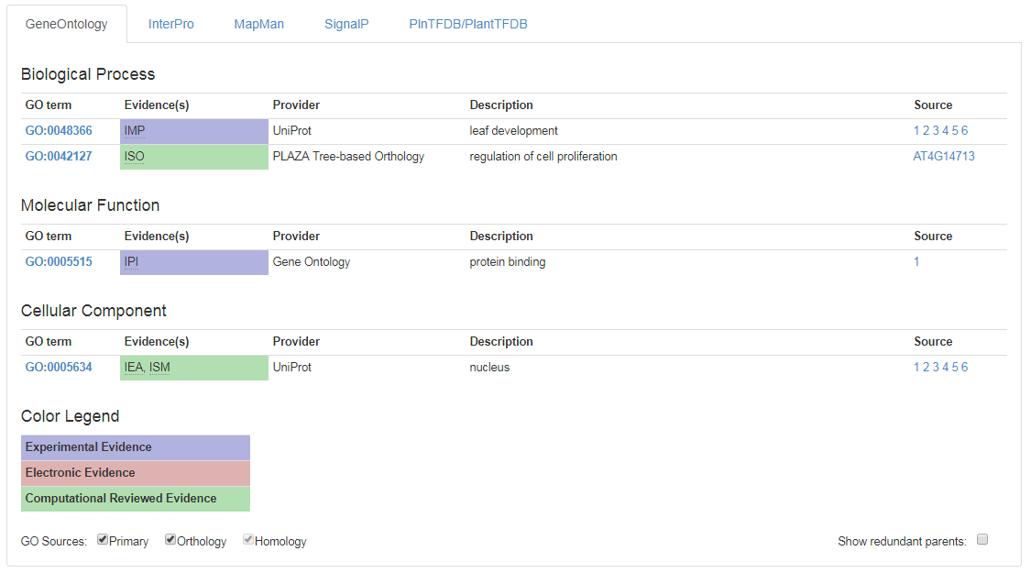
Gene Page: b. functional information

Slide 6
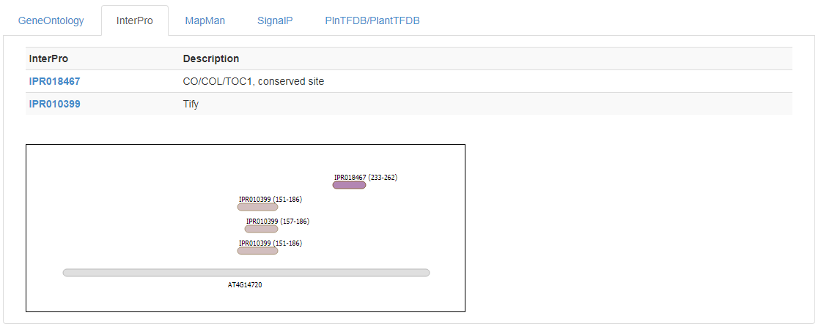
Gene Page: b. functional information

Slide 7
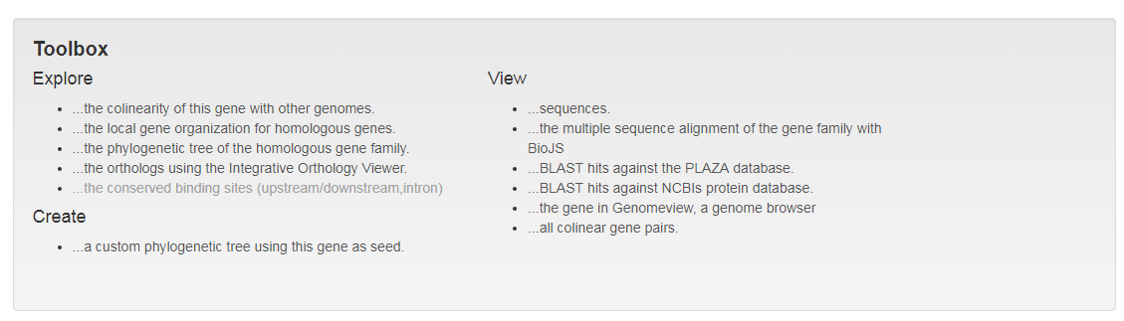
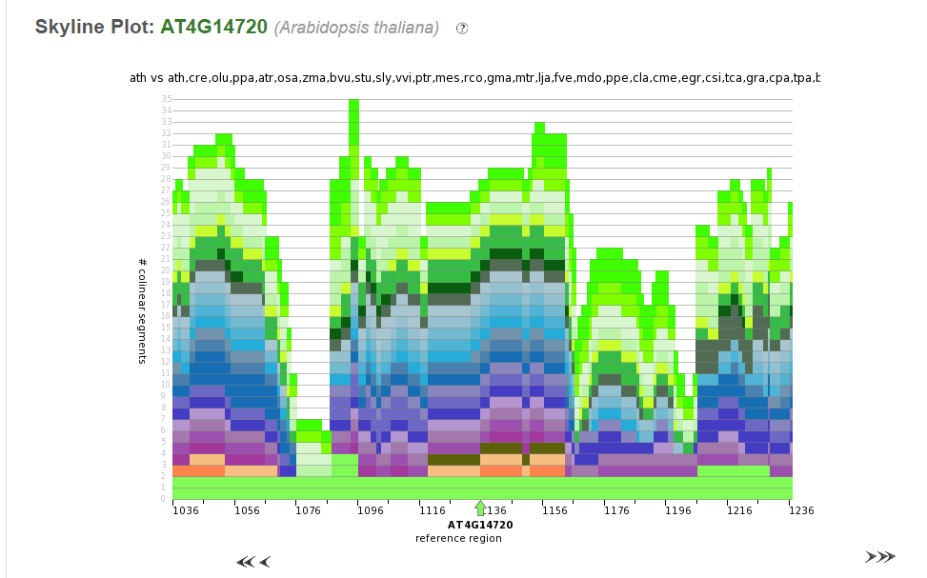
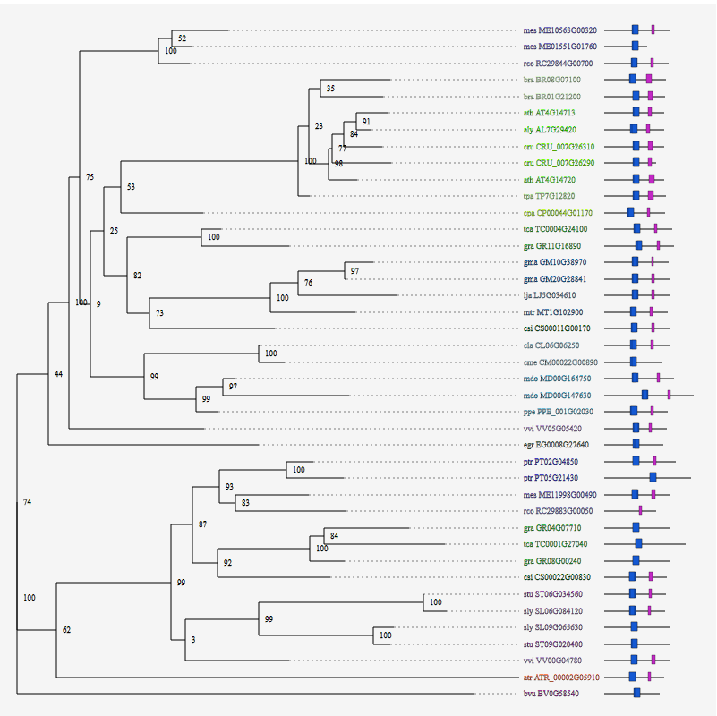
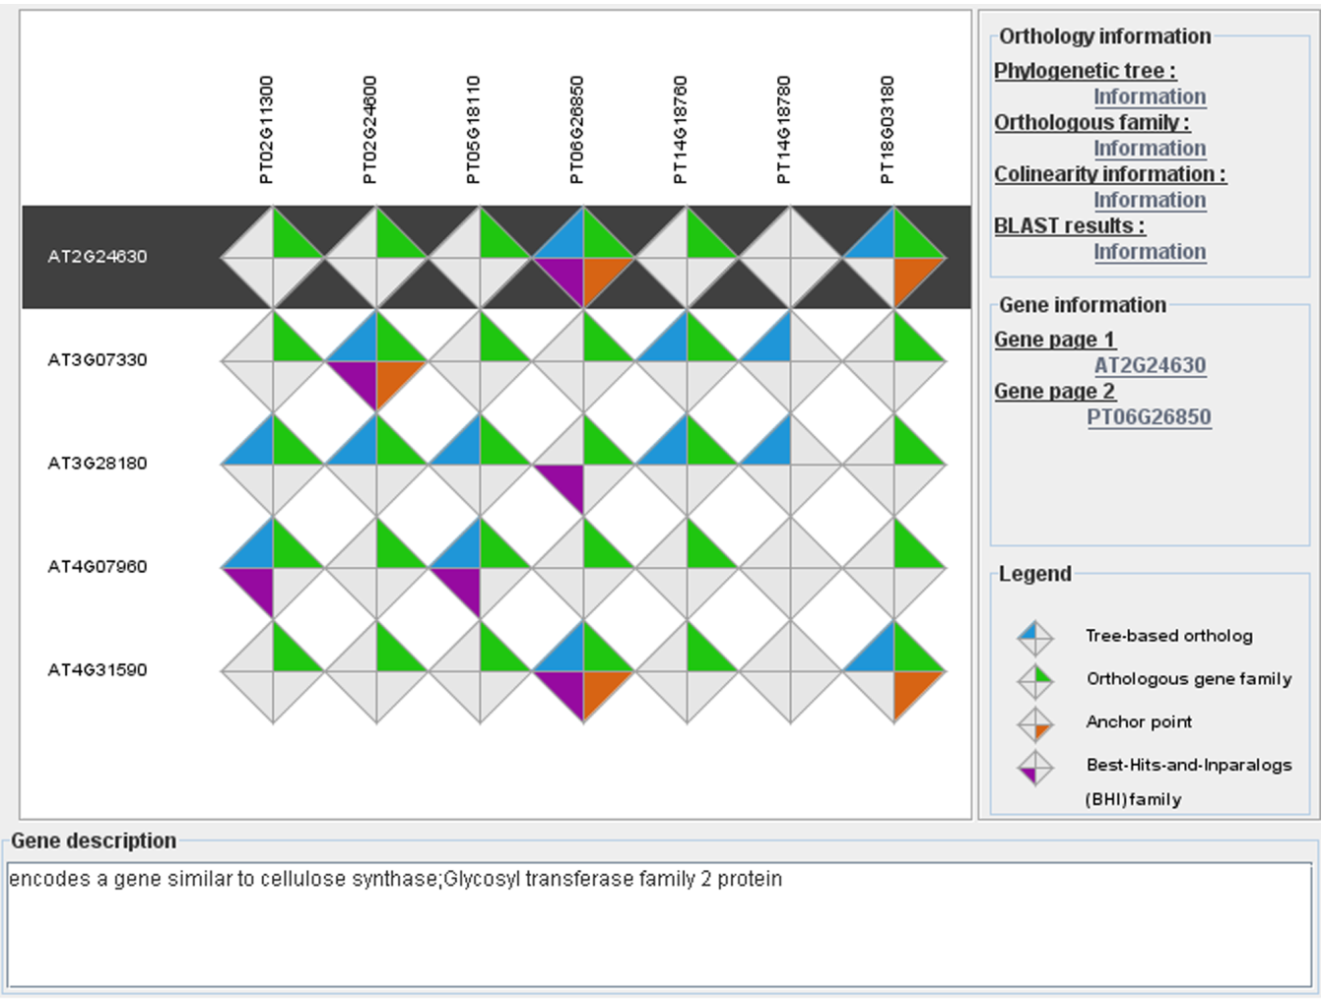
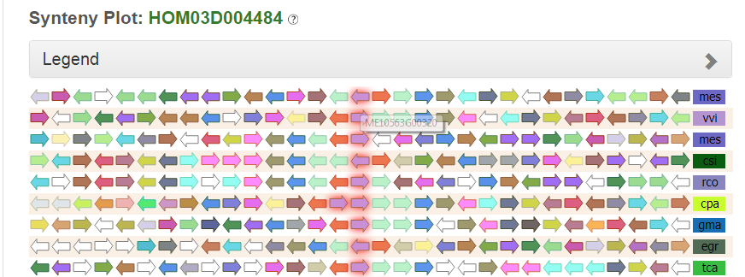
Gene Page: c. Toolbox

Slide 8
Search function & gene identifiers
DEMO
Different search functions available
  Keyword (gene description, gene symbol)
    Try to filter based on (model) species of interest
    BUT caveats due to missing gene descriptions
    Use “View associated gene families” to summarize results
  Gene Ontology or InterPro
  Accession number or gene identifier
    Both original as PLAZA gene identifier are supported

Slide 9
Homology & gene families
Homology = shared ancestral common origin
Inferred based on:
  Sequence similarity
  Similar (multi-) protein domain composition and organization
So sequence similarity means homology?
  No, it depends!

Slide 10
Homology is NOT a measure
Sequence analysis aims at finding important sequence similarities that would allow one to infer homology. The latter term is extensively used in scientific literature, often without a clear understanding of its meaning, which is simply common origin. Since the mid-19th century, zoologists and botanists have learned to make a distinction between homologous organs (e.g. bat's wing and human's hand) and similar (analogous) organs (e.g. bat's wing and butterfly's wing). Homologous organs are not necessarily similar (at least the similarity may not be obvious); similar organs are not necessarily homologous. For some reason, this simple concept tends to get extremely muddled when applied to protein and DNA sequences. Phrases like “sequence (structural) homology”, “high homology”, “significant homology”, or even “35% homology” are as common, even in top scientific journals, as they are absurd, considering the definition.
Koonin 2005, Orthologs, paralogs, and evolutionary genomics.

Slide 11
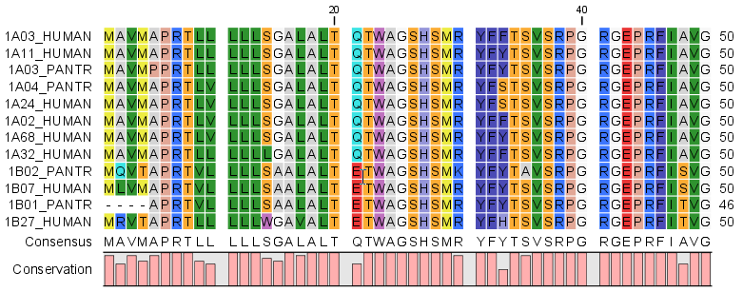
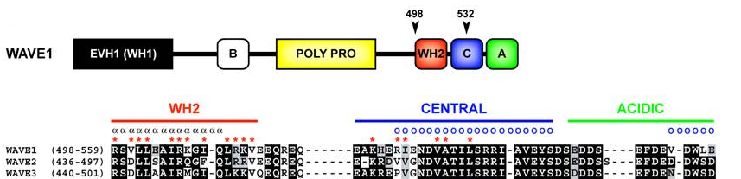
How to define gene homology using similarity?
Columns (~positions) in the alignment
Sequences (~taxa)

Slide 12
Homologous genes in PLAZA
Sequence similarity searches
  BLAST / DIAMOND
  Protein clustering
    Gene families (TribeMCL)
    Sub-families (OrthoFinder)
Similarity heatmap
Gene family page
Functional annotation gene family

Slide 13
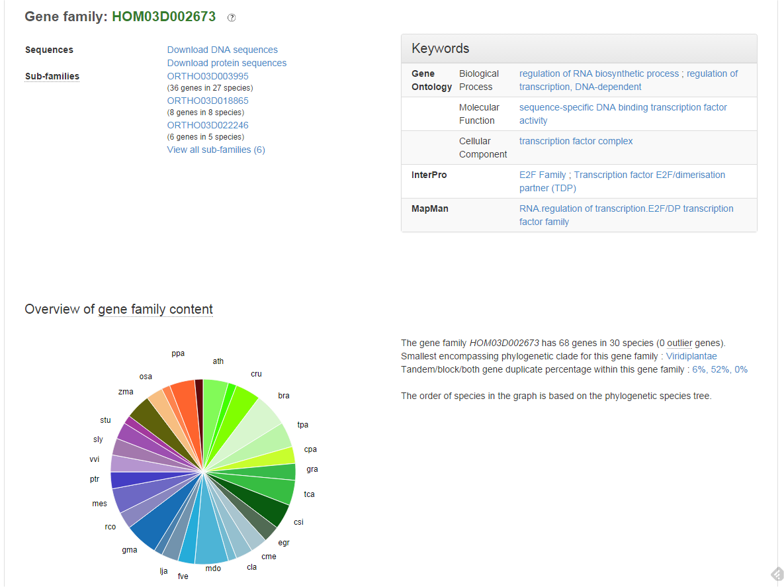
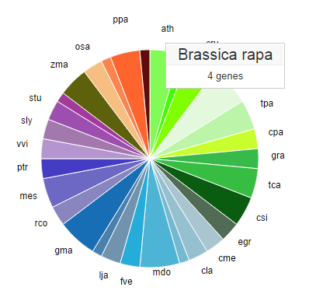
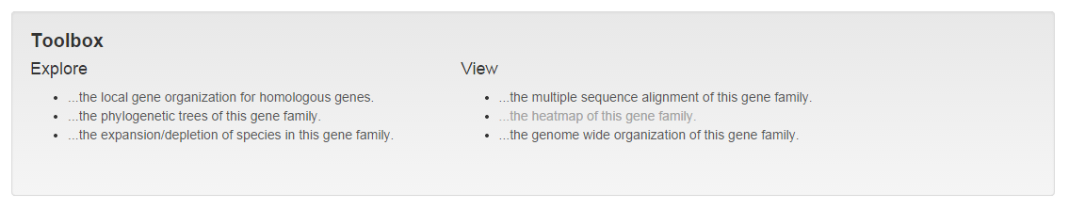
Gene family page

Slide 14
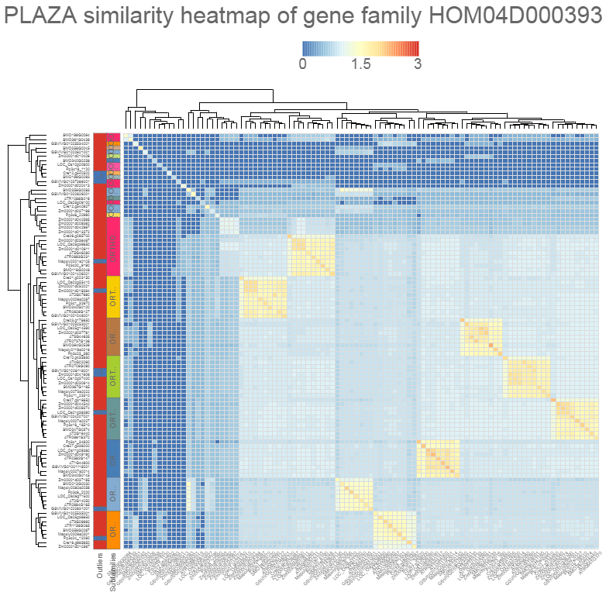
Gene family similarity heatmap
Mini-chromosome maintenance (MCM) protein

Slide 15
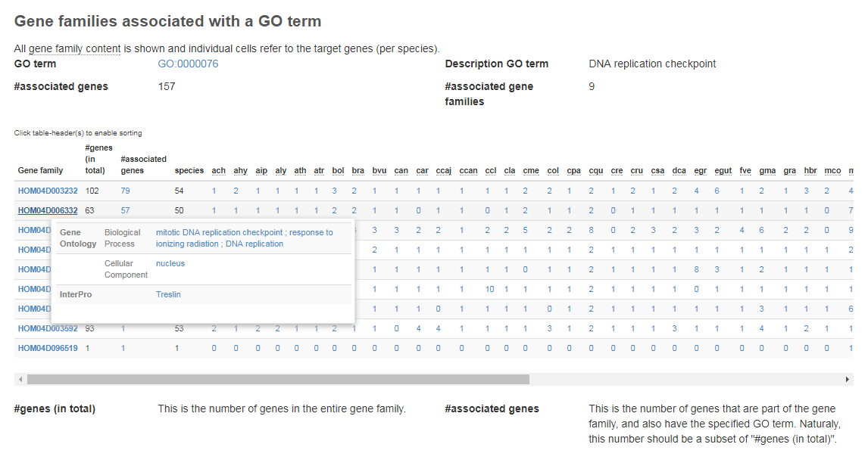
Associated gene families & phylogenetic profiles

Slide 16
Exploiting cross-species genome information
>20 tools available!

Slide 17
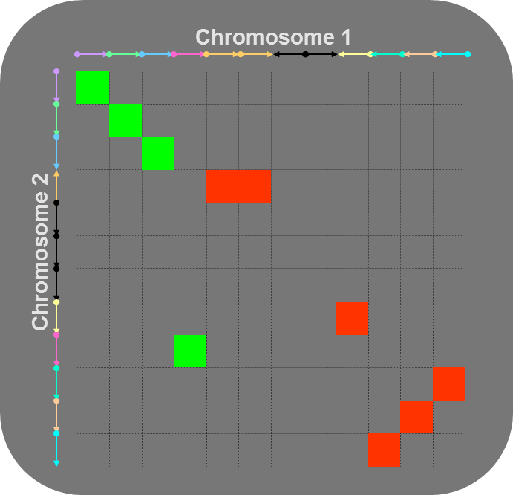
Gene colinearity & genome organization
  Colinearity
  Conservation of gene content and order
  Synteny
  Conservation of gene content
  Detection gene colinearity using i-ADHoRe 3.0
  Represent chromosomes as sorted gene lists
  Identify all homologous gene pairs between chromosomes (all-against-all BLASTP or use homologous gene families).
  Score pairs of homologous genes in matrix
1
2

Slide 18
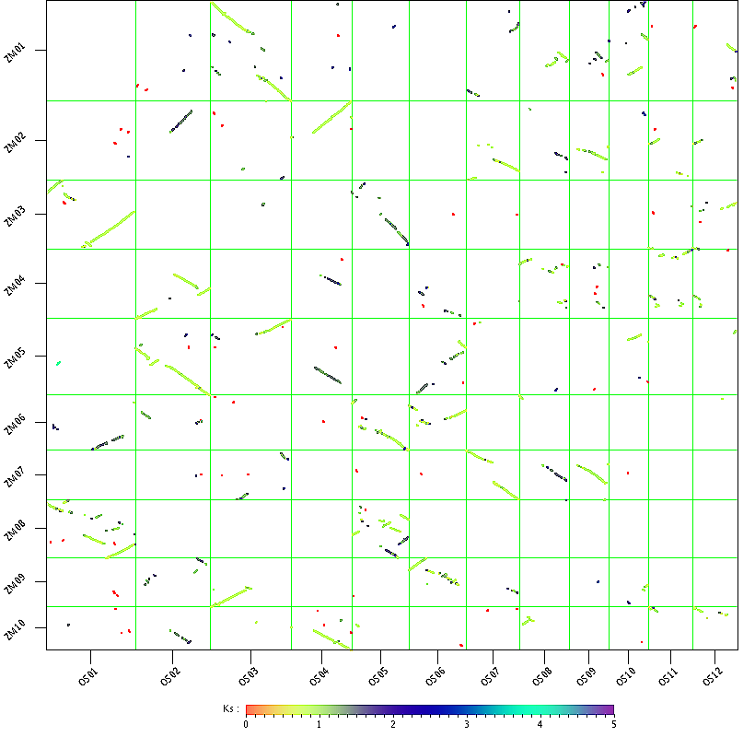
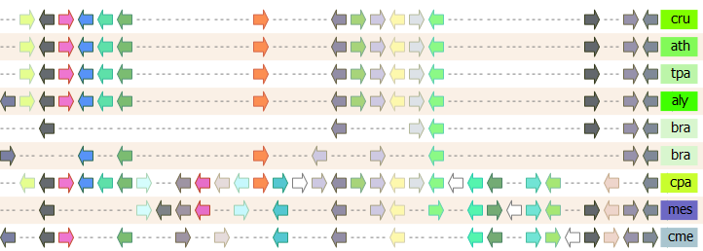
Gene colinearity & genome organization
WGDotplot
Multiplicon Viewer

Slide 19
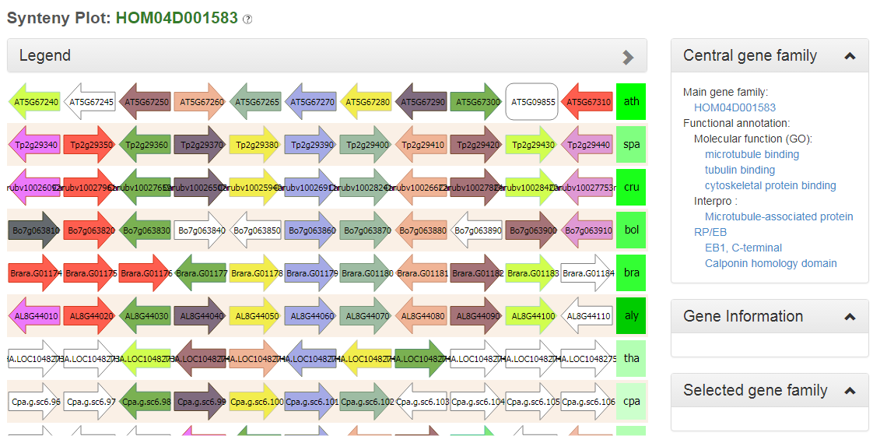
Gene colinearity & genome organization
Synteny Plot

Slide 20
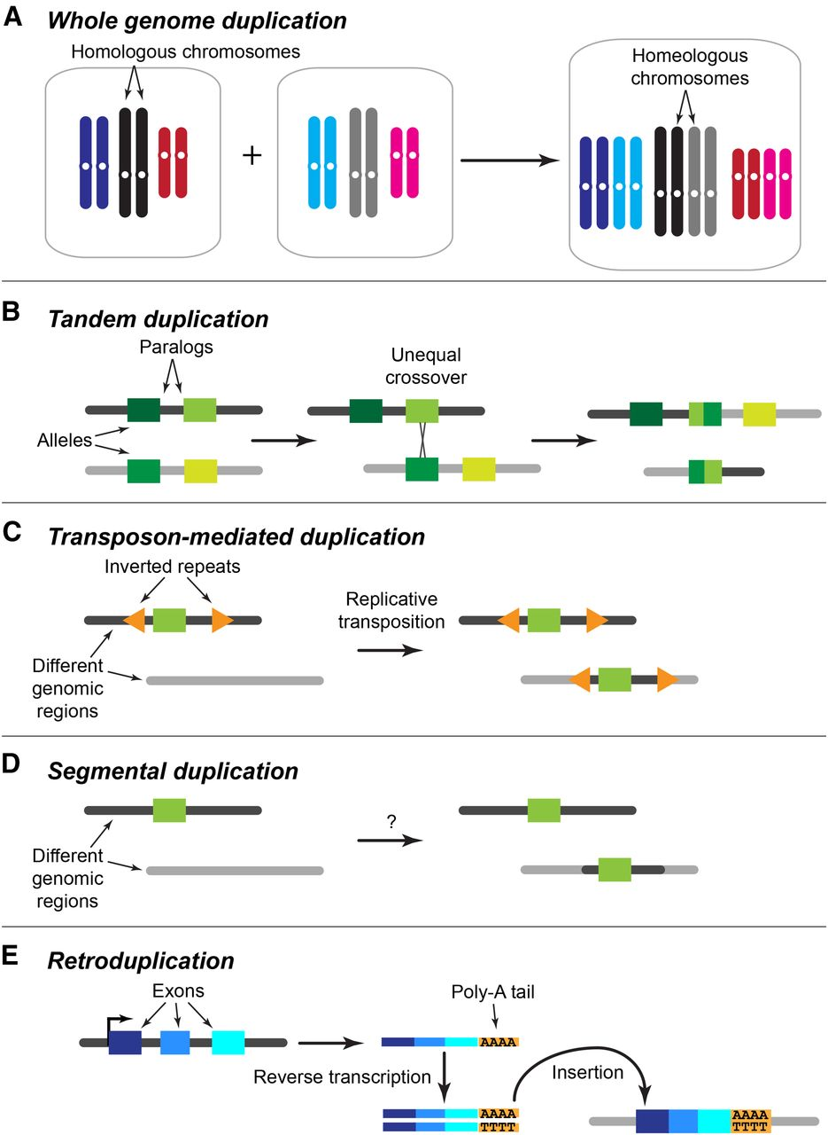
Gene duplication types
Large-scale
  Whole genome
  Chromosome
Small-scale
  Tandem
  TE-mediated
  Retroduplication

Slide 21
Tandem gene organization Zm00001d017741

