Slide 1
Functional Plant Bioinformatics
Functional annotation + concept GO projection
25-26 October, 2021
Klaas Vandepoele
Michiel Van Bel

Slide 2
Overview
Basic information about the Functional Ontologies used in the PLAZA platform for annotating genes
Functional Enrichment of sets of genes
Mapping of GO annotations between genes
Annotating gene families in the PLAZA platform

Slide 3
Overview
Basic information about the Functional Ontologies used in the PLAZA platform for annotating genes
  GO (Gene Ontology)
  InterPro (Protein domains)
  MapMan
Functional Enrichment of sets of genes
Mapping of GO annotations between genes
Annotating gene families in the PLAZA platform

Slide 4
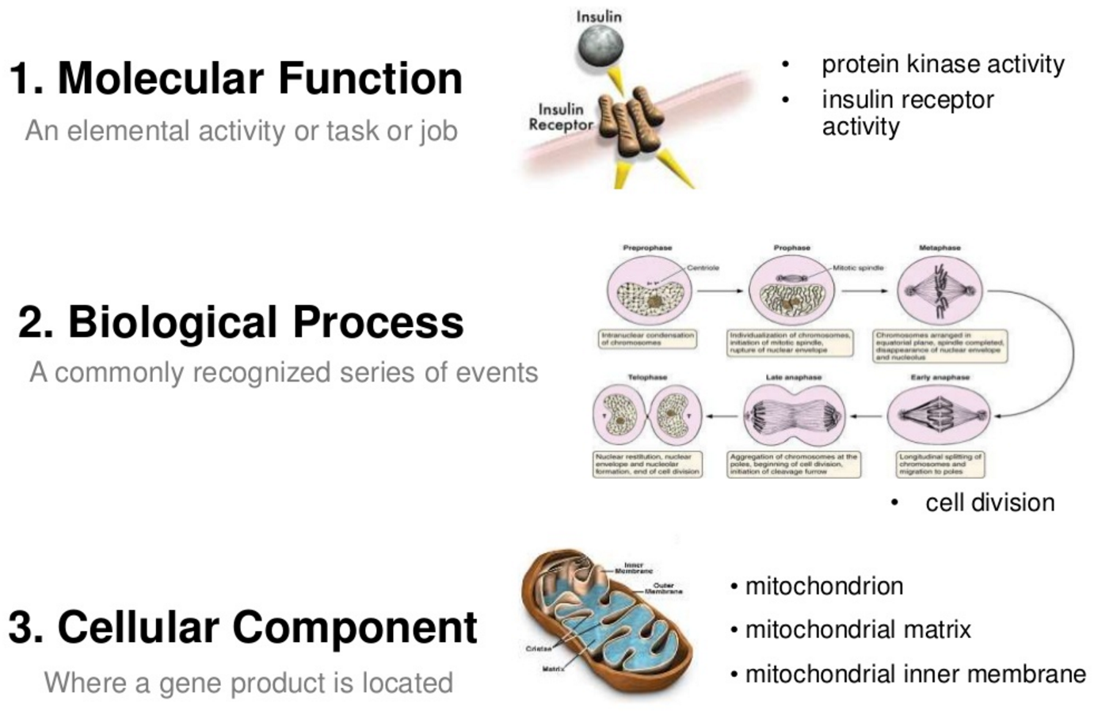
Gene Ontology (GO)
A collaborative effort to address the need for consistent descriptions of gene products across databases
The GO project has developed three structured ontologies that describe gene products in a species-independent manner
An ontology is a formal representation of a body of knowledge, within a given domain. Ontologies usually consist of a set of classes or terms with relations that operate between them.

Slide 5
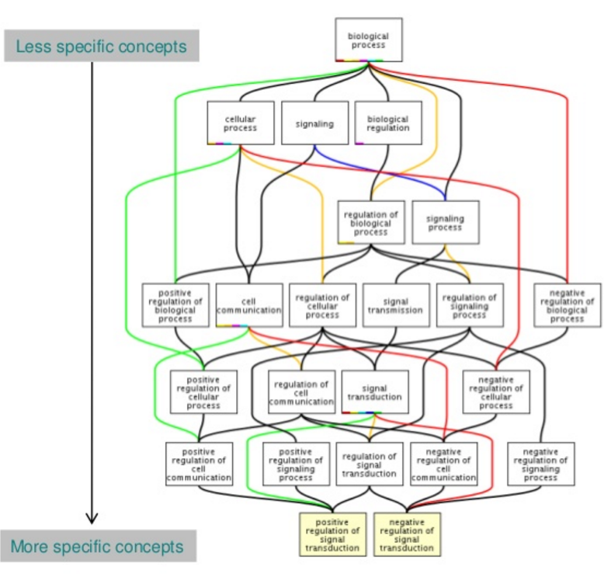
Sample GO term
id: GO:0016049
name: cell growth
namespace: biological_process
def: "The process in which a cell irreversibly increases in size over time by accretion and biosynthetic production of matter similar to that already present." [GOC:ai]
subset: goslim_generic
subset: goslim_plant
subset: gosubset_prok
synonym: "cell expansion" RELATED []
synonym: "cellular growth" EXACT []
synonym: "growth of cell" EXACT []
is_a: GO:0009987 ! cellular process
is_a: GO:0040007 ! growth
relationship: part_of GO:0008361 ! regulation of cell size
GO annotation is the process of assigning GO terms to gene products.

Slide 6
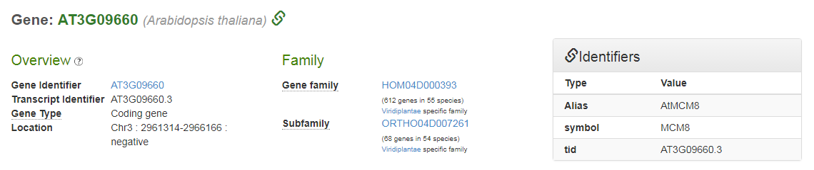
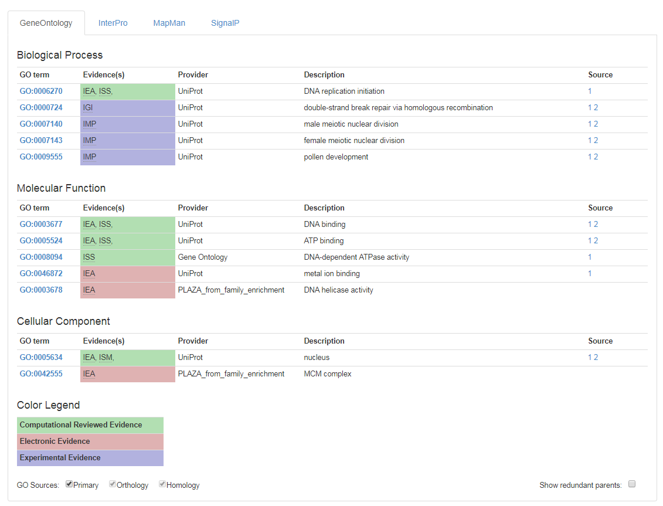
Gene Page: functional GO information

Slide 7
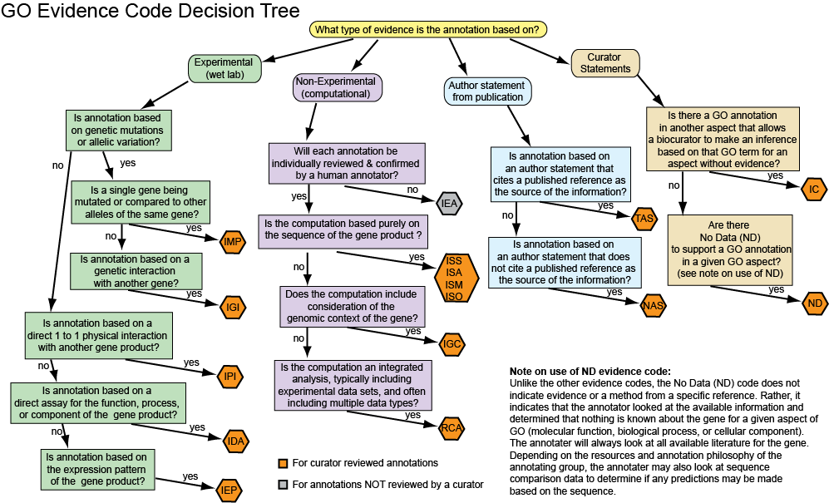
GO evidence codes

Slide 8
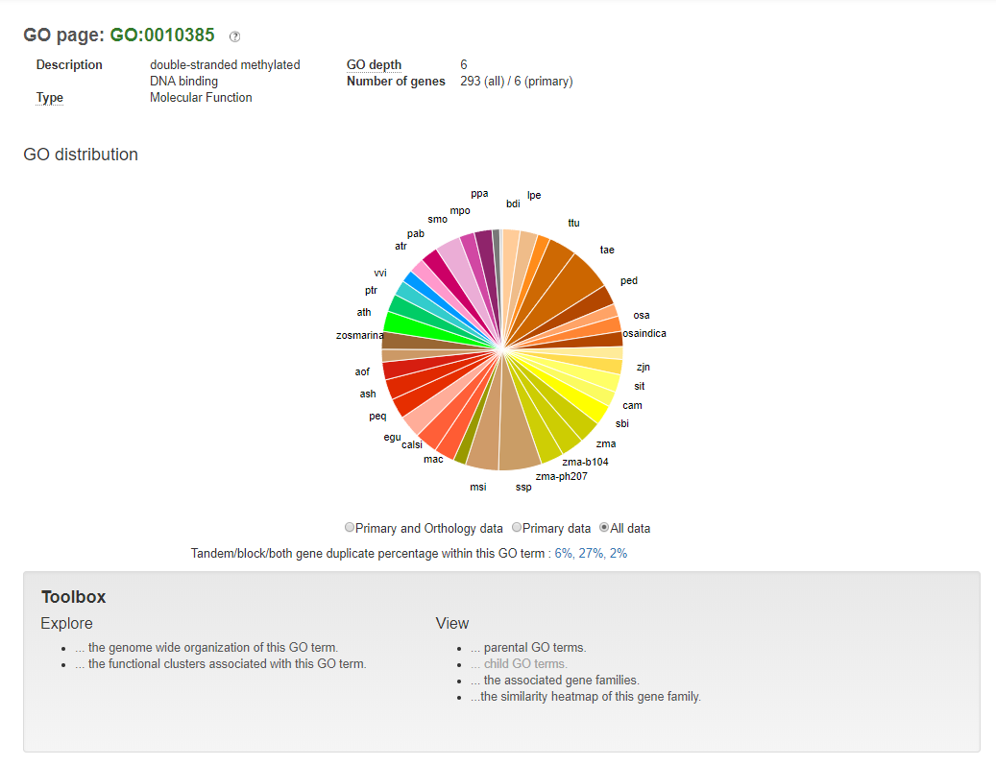
GO page

Slide 9
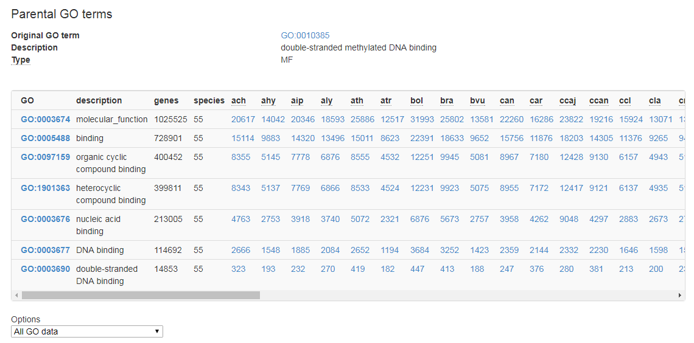
Navigating parental/child GO terms

Slide 10
Common usage of the GO hierarchy
Return all the genes that are annotated with GO-term A
  Include also all the genes that have been annotated with the children of GO-term A
  For example:
    Return all the genes annotated with ‘Response to stress’ (GO:0006950)
    Include genes that are annotated with the children (‘Response to biotic stress’, ‘Response to abiotic stress’) but not with ‘Response to stress’ directly.
Return all the GO terms that have been annotated with gene B
  Include also all the GO terms that are the parents of the explicitly annotated GO terms.
  For example:
    Return all the GO terms that are associated with AT1G21850
    Standard answer (within Molecular Function) is ‘copper ion binding’ (GO:0005507)
    This implies that the gene is also annotated with the parental terms ‘transition metal ion binding’, ‘metal ion binding’, ‘cation binding’, ‘ion binding’, ‘binding’, and ‘molecular function’

Slide 11
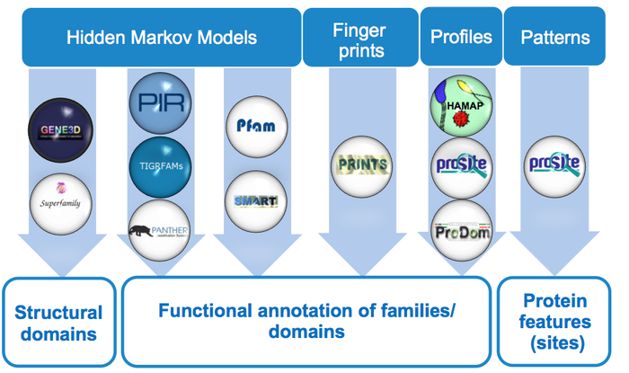
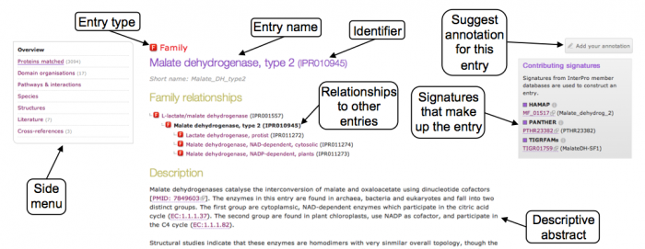
InterPro: protein sequence analysis & classification
Provides functional analysis of protein sequences by classifying them into families and predicting the presence of domains and important sites.
To classify proteins in this way, InterPro uses predictive
models, known as signatures, provided by several
different databases

Slide 12
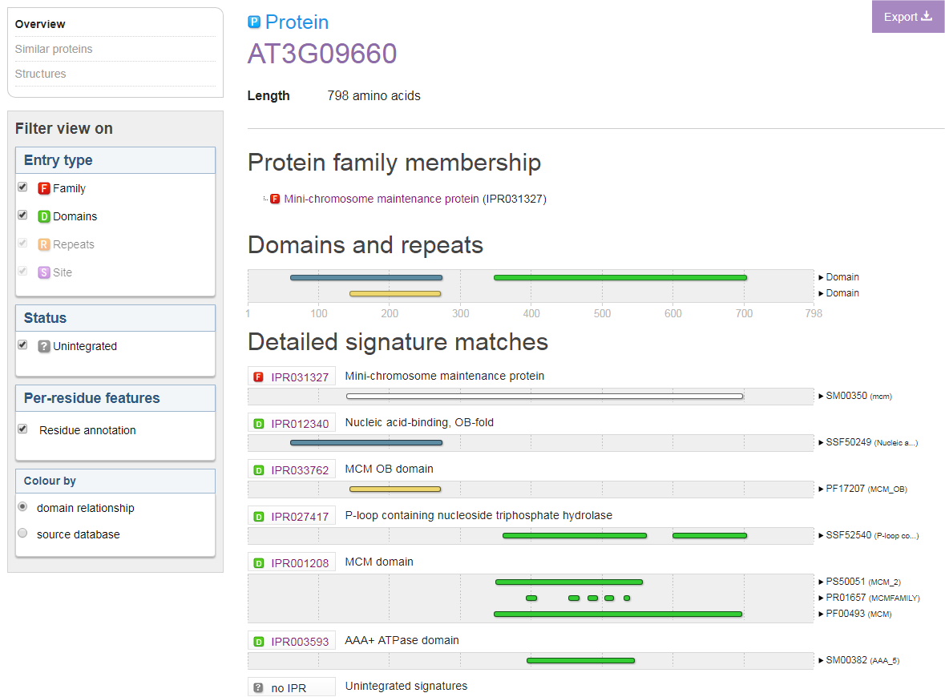
InterProScan sequence search
The InterPro protein view provides a graphical representation of the signatures that match a particular protein, with information about protein family membership, sequence features, structural features, and structural predictions for that protein.

Slide 13
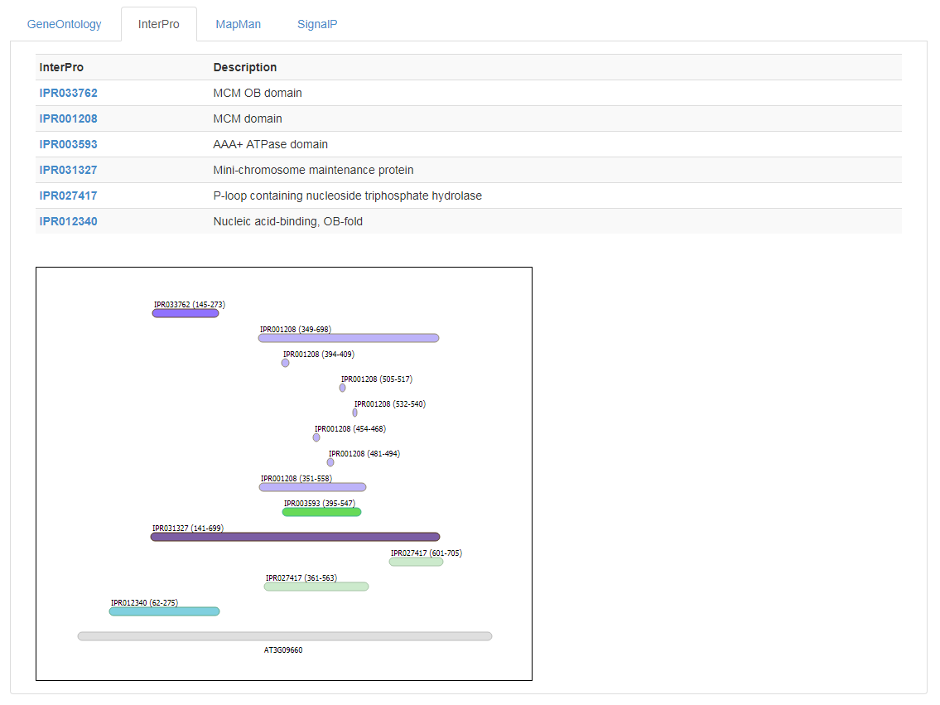
Gene Page: functional InterPro information

Slide 14
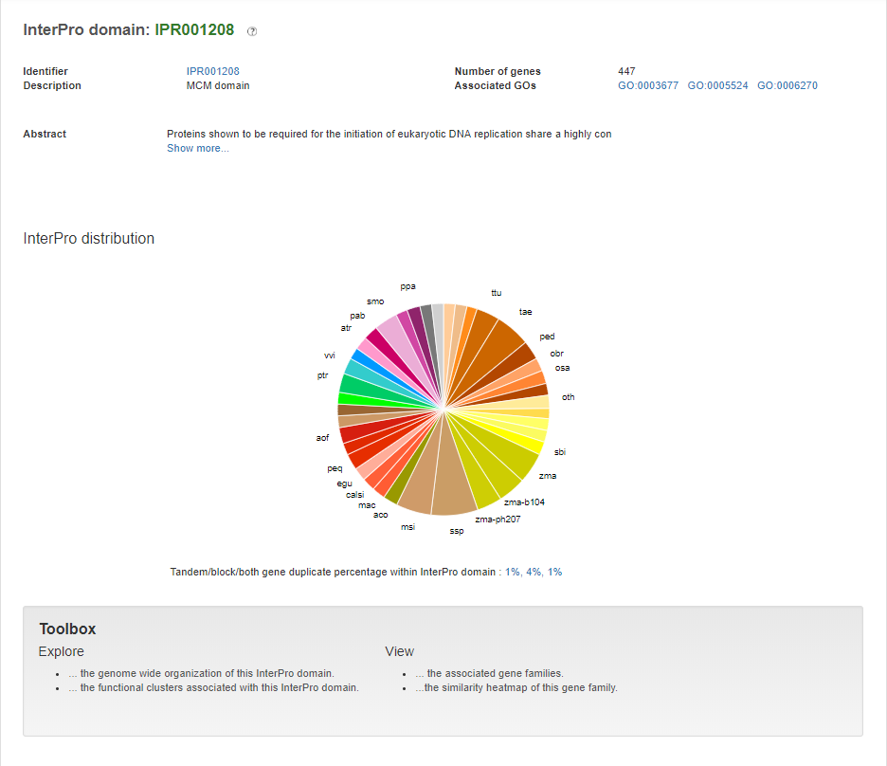
InterPro page

Slide 15
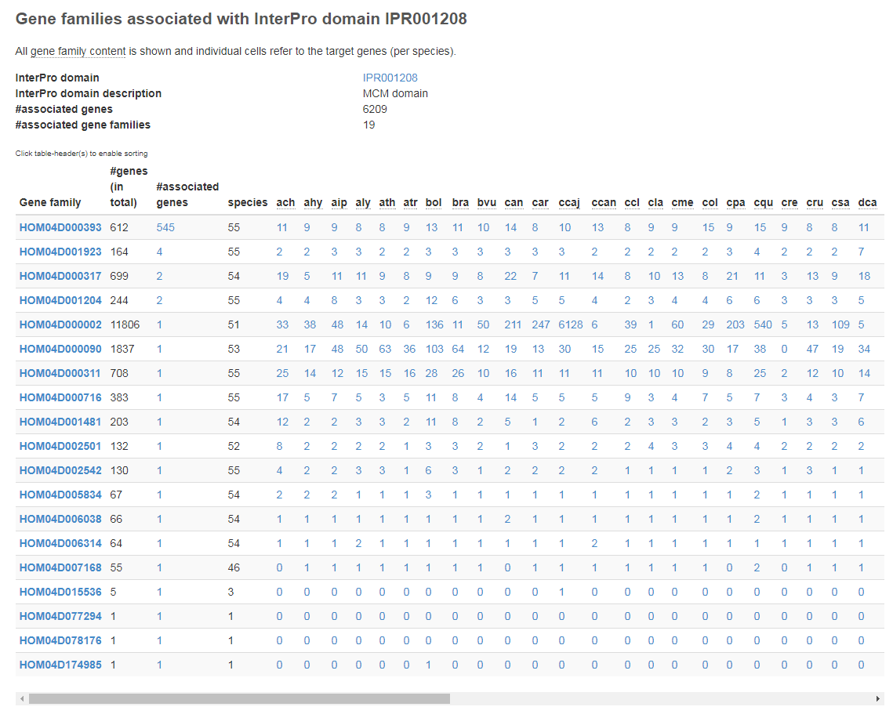
InterPro page: View the associated gene families

Slide 16
MapMan: Protein Classification and Annotation Framework
Plant-specific ontology designed to facilitate the visualization of omics data on plant pathways
Introduced as an alternative to Gene Ontology (GO)
Structure
  Hierarchical tree structure → easier than the graph structure of GO
  Multiple ‘bins’ at the top-level
  (e.g. 1 == Photosynthesis, 2 == Cellular respiration)
  The description of each term contains its parental terms description as well
    1 == Photosynthesis
    1.1 == Photosynthesis.photophosphorylation
    1.2 == Photosynthesis.calvin cycle
    1.1.1 == Photosynthesis.photophosphorylation.photosystem II

Slide 17
MapMan: Protein Classification and Annotation Framework
Annotation
  Most genes are annotated with only a single MapMan term
Effect : the most descriptive term of MapMan must confer more information than the most descriptive term of GO, in order to be equally useful
  GO (depth 12)
    GO:0044019 ➔histone acetyltransferase activity (H3-K72 specific)
  Mapman (depth 7)
    13.3.6.5.2.1.1.1 ➔ Cell cycle organisation.mitosis and meiosis.meiotic recombination.meiotic crossover.class II interference-insensitive crossover pathway.MUS81-dependent pathway.MUS81-EME1 Holliday junction cleavage heterodimer.component MUS81

Slide 18
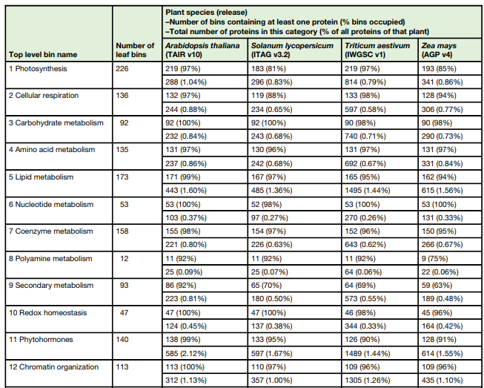
MapMan: Functional assignment comparison
Source:
MapMan4: A Refined Protein Classification and Annotation Framework Applicable to Multi-Omics Data Analysis
Molecular Plant 2019

Slide 19
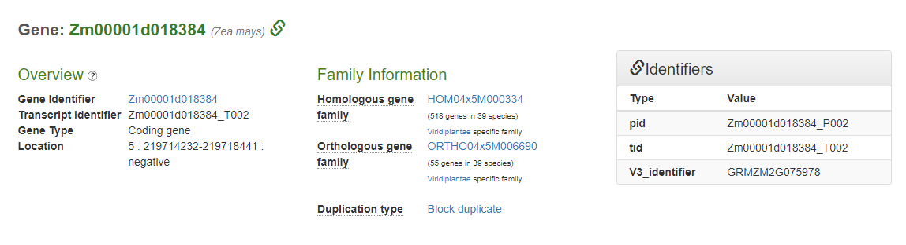
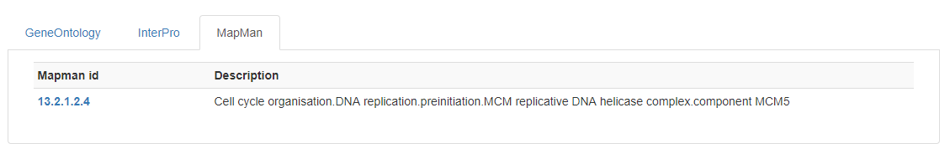
Gene Page: functional MapMan information

Slide 20
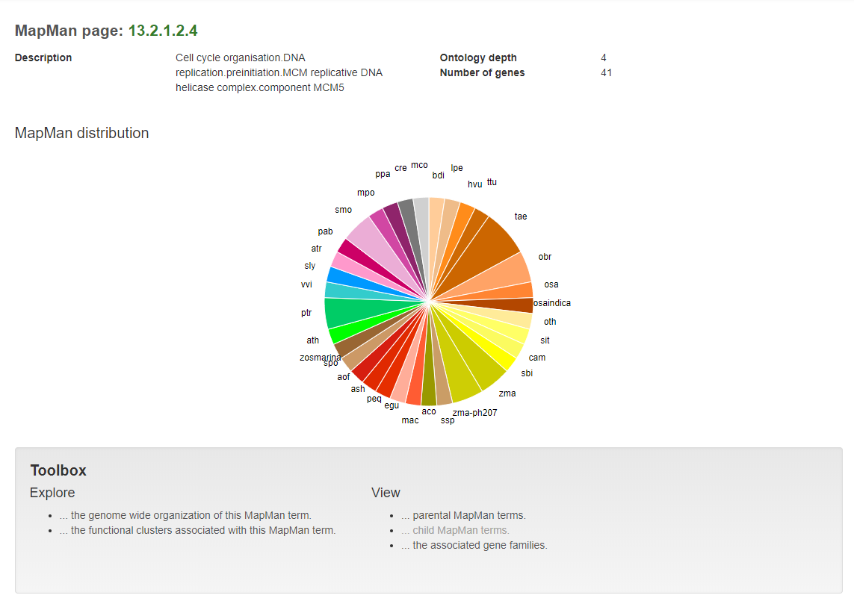
MapMan page

Slide 21
Overview
Basic information about the Functional Ontologies used in the PLAZA platform for annotating genes
Functional Enrichment of sets of genes
  Concepts
  PLAZA
Mapping of GO annotations between genes
Annotating gene families in the PLAZA platform

Slide 22
Enrichment analysis of gene sets
For a set of genes:
  What are there associated GO terms?
  Are there GO terms that are overrepresented (compared to ….)? Are there GO terms that are underrepresented?
  How can we find these overrepresented GO terms?
  How can we test whether the overrepresentation could occur by chance?
  GO Enrichment analysis of get sets
  Can be extended to InterPro/MapMan/…
More information:The Gene Ontology Handbook
http://gohandbook.org/doku.php

Slide 23
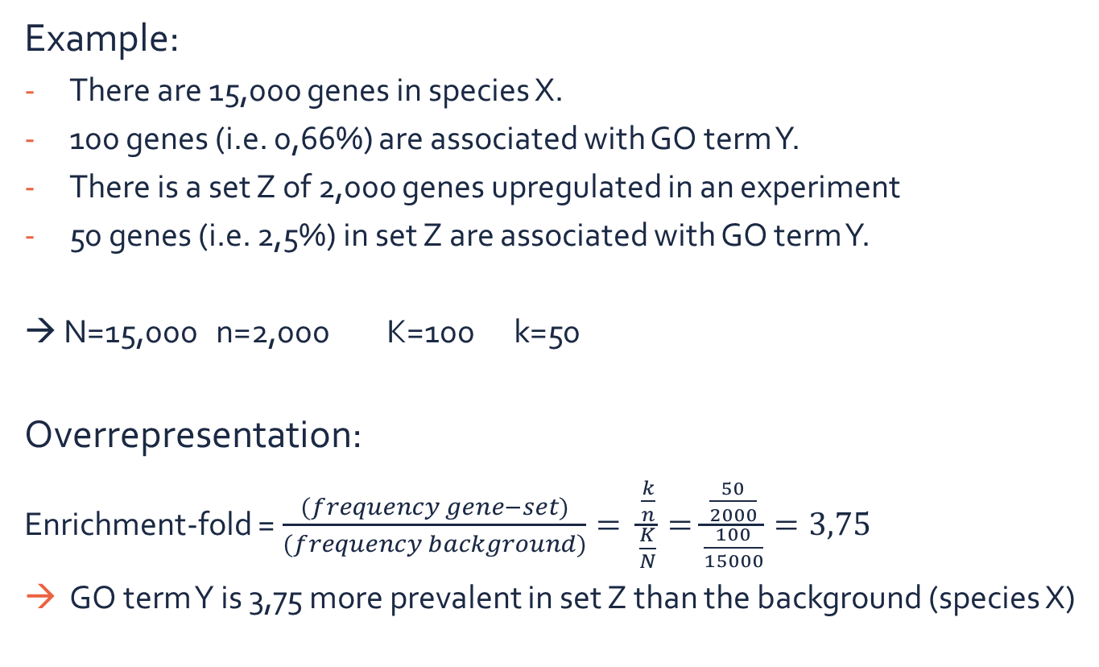
Enrichment analysis of gene sets
Example:
There are 15,000 genes in species X.
100 genes (i.e. 0,66%) are associated with GO term Y.
There is a set Z of 2,000 genes upregulated in an experiment
50 genes (i.e. 2,5%) in set Z are associated with GO term Y.
→ N=15,000 n=2,000 K=100 k=50
Overrepresentation:
Enrichment-fold =$\frac{(frequency gene−set)}{(frequency background)}= \frac{\frac{k}{n}}{\frac{K}{N}}=\frac{\frac{50}{2000}}{\frac{100}{15000}}=3,75$
GO term Y is 3,75 more prevalent in set Z than the background (species X)

Slide 24
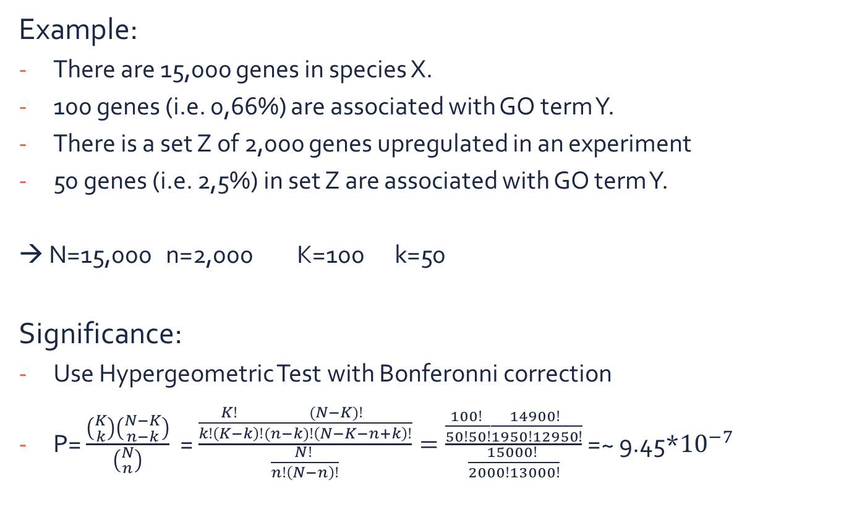
Enrichment analysis of gene sets
Example:
There are 15,000 genes in species X.
100 genes (i.e. 0,66%) are associated with GO term Y.
There is a set Z of 2,000 genes upregulated in an experiment
50 genes (i.e. 2,5%) in set Z are associated with GO term Y.
→ N=15,000 n=2,000 K=100 k=50
Significance:
Use Hypergeometric Test with Bonferonni correction
P= $\frac{\left({K \atop k}\right)\left({N−K \atop n−k}\right)}{\left({N \atop n}\right)}$ = $\frac{\frac{K! }{k!\left(K−k\right)!}\frac{(N−K)! }{(n−k)!\left(N−K−n+k\right)!}}{\frac{N! }{n!\left(N−n\right)!}}=\frac{\frac{100! }{50!50!}\frac{14900! }{1950!12950!}}{\frac{15000! }{2000!13000!}}$ =~ 9.45*${10}^{−7}$

Slide 25
Overview
Basic information about the Functional Ontologies used in the PLAZA platform for annotating genes
Functional Enrichment of sets of genes
Mapping of GO annotations between genes
  Main concept and rational
  Implementation
Annotating gene families in the PLAZA platform

Slide 26
GO Projection: Concept and Rational
InterPro-scan provides GO annotation for many genes, but is limited
  Not all protein domains are known
  Mapping between InterPro and GO isn’t always easily done
  Knowledge-generation is restricted:
    E.g. Knowing a gene has a DNA-binding domain doesn’t indicate in which tissues or in what conditions the DNA-binding occurs

Slide 27
GO Projection: Concept and Rational
Experimentally validated GO information
  Available for many genes of model-species (e.g. based on knockout, expression analysis, etc.),
  Not available for species of interest
  Indicated using different GO evidence codes
→ Solution: transfer knowledge from model species to crop species!

Slide 28
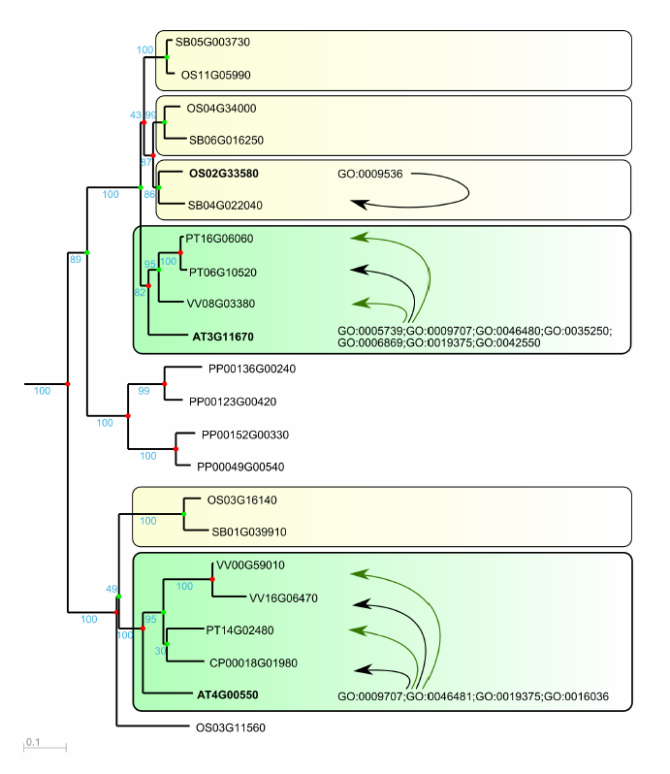
Functional annotation through GO projection
Orthology-based
1. Tree-based orthology
2. Integrative orthology
Homology-based
Enrichment + 50% rule
Orthology-based
Homology-based
Transfer of experimentally confirmed GO information to orthologs and homologs

Slide 29
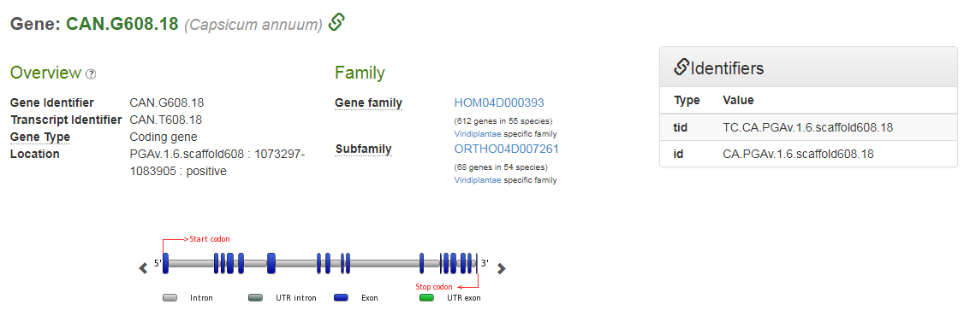
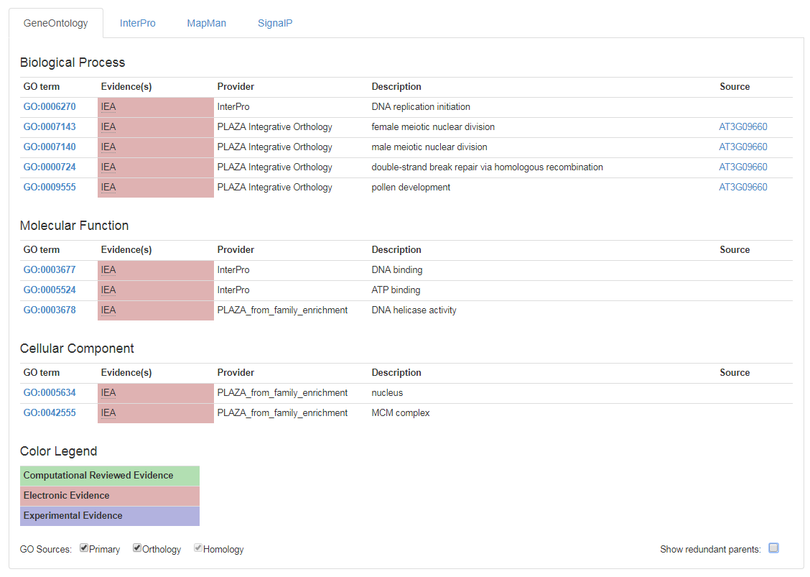
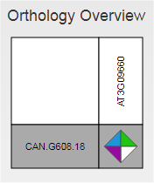
Gene Page: projected GO annotations

Slide 30
Overview
Basic information about the Functional Ontologies used in the PLAZA platform for annotating genes
Functional Enrichment of sets of genes
Mapping of GO annotations between genes
Functionally annotating gene families in the PLAZA platform

Slide 31
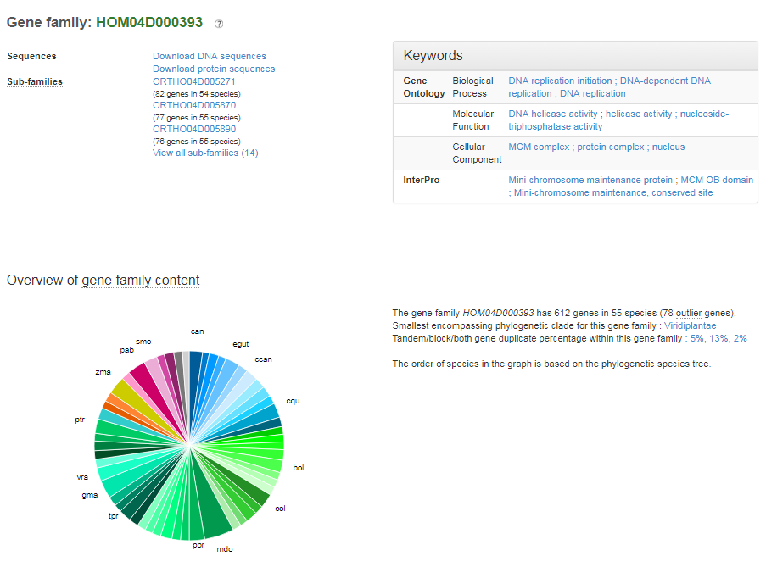
Functional annotation of gene families
Consider a gene family to be a set of genes
  We can perform enrichment analysis!
  Use non-projected GOs to prevent circular reasoning!

