Slide 1
Functional Plant Bioinformatics
Colinearity, synteny, and polyploidy
September 15th, 2026
Klaas Vandepoele
Michiel Van Bel

Slide 2
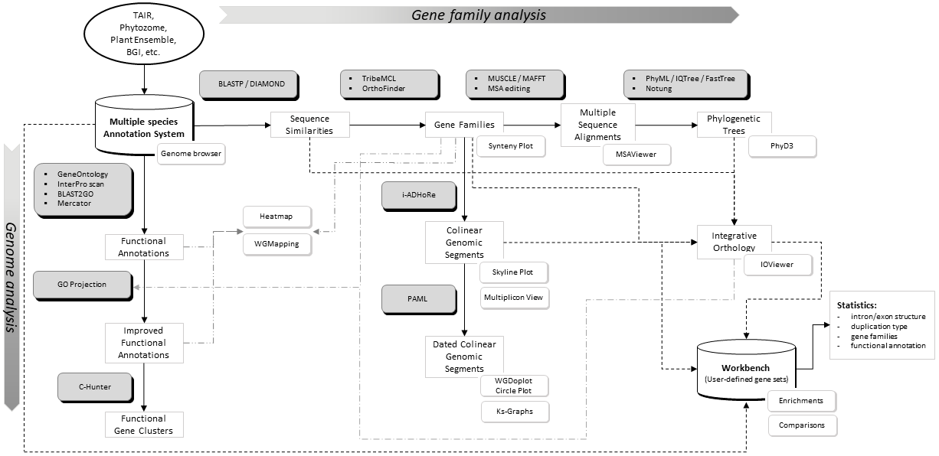
Exploiting cross-species genome information
>20 tools available!

Slide 3
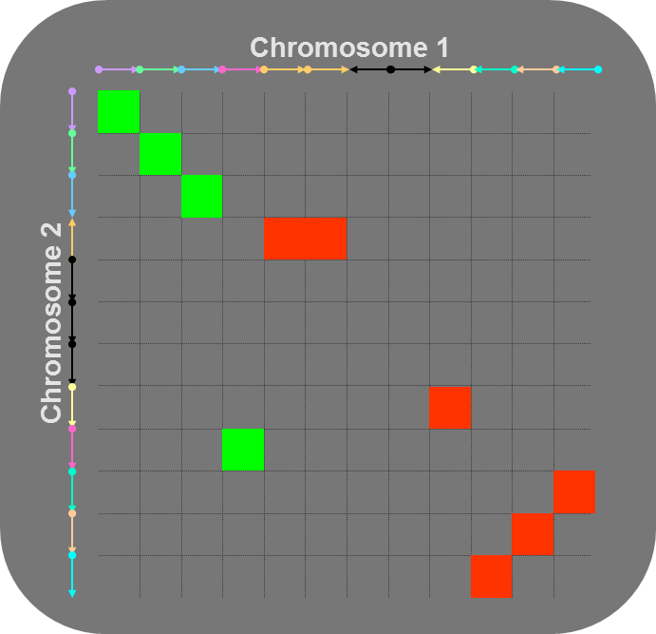
Gene colinearity & genome organization
  Colinearity
  Conservation of gene content and order
  Synteny
  Conservation of gene content
  Detection gene colinearity using i-ADHoRe 3.0
  Represent chromosomes as sorted gene lists
  Identify all homologous gene pairs between chromosomes (all-against-all BLASTP or use homologous gene families).
  Score pairs of homologous genes in matrix
1
2

Slide 4
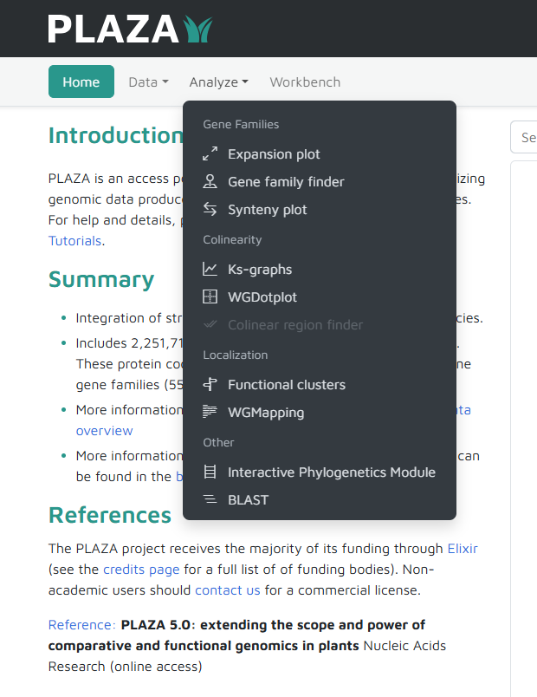
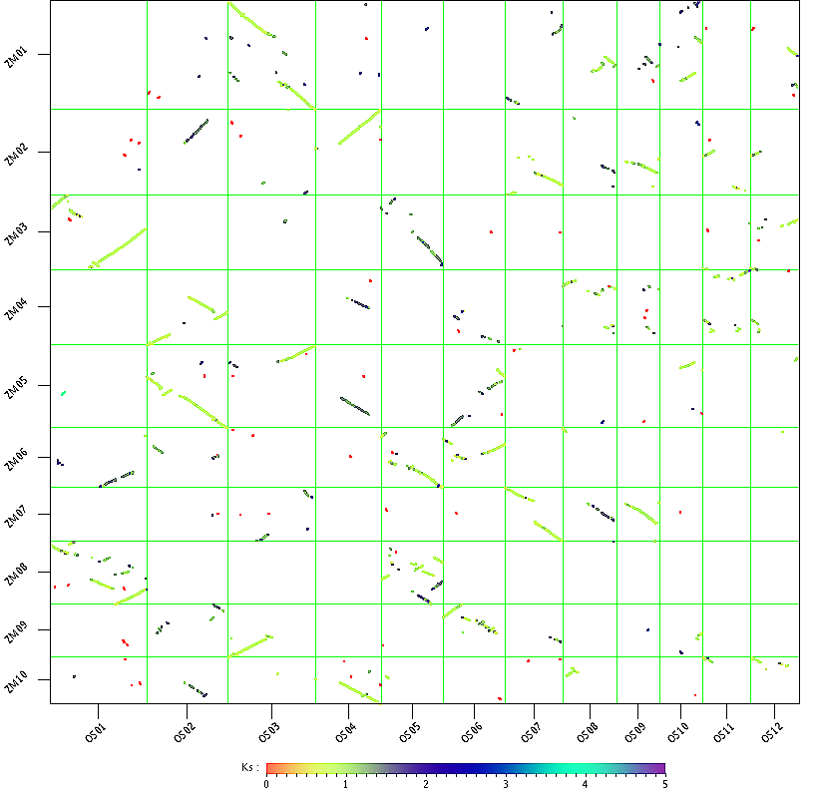
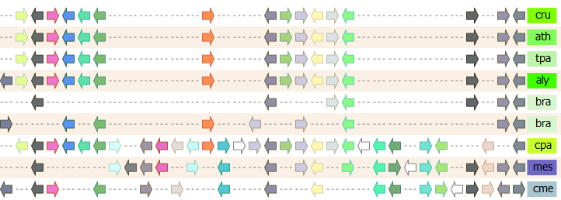
Gene colinearity & genome organization
WGDotplot
Multiplicon Viewer

Slide 5
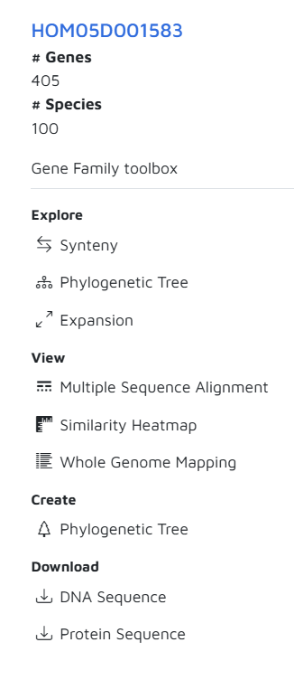
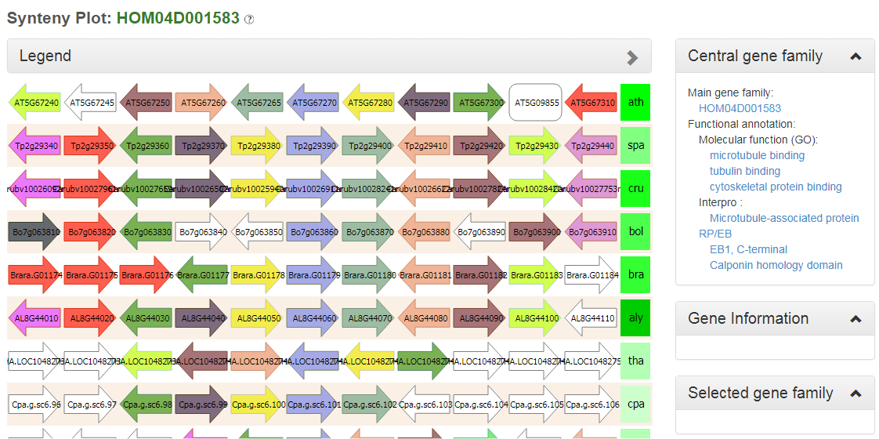
Gene colinearity & genome organization
Synteny Plot

Slide 6
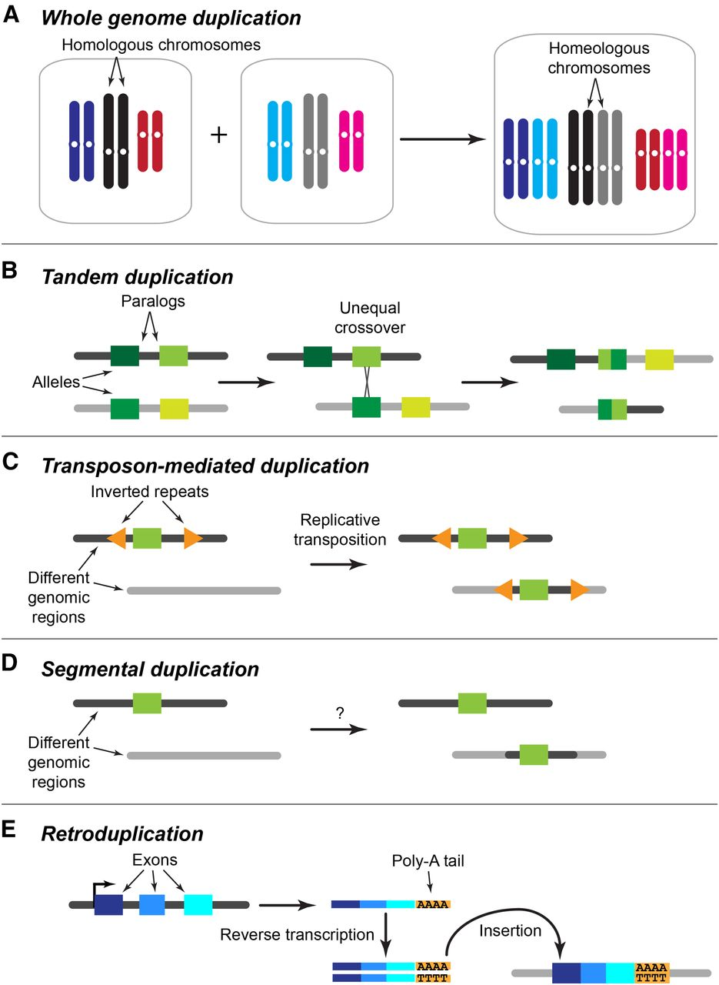
Gene duplication types
Large-scale
  Whole genome
  Chromosome
Small-scale
  Tandem
  TE-mediated
  Retroduplication

Slide 7
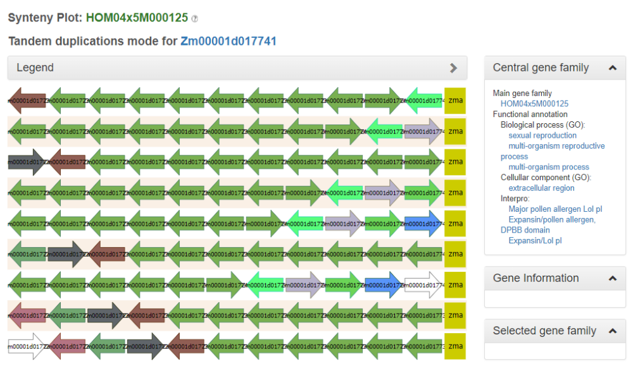
Tandem gene organization Zm00001d017741

