Slide 1
Functional Plant Bioinformatics
ChIP-Seq data analysis & co-expression analysis
14-15 September, 2017
Klaas Vandepoele

Slide 2
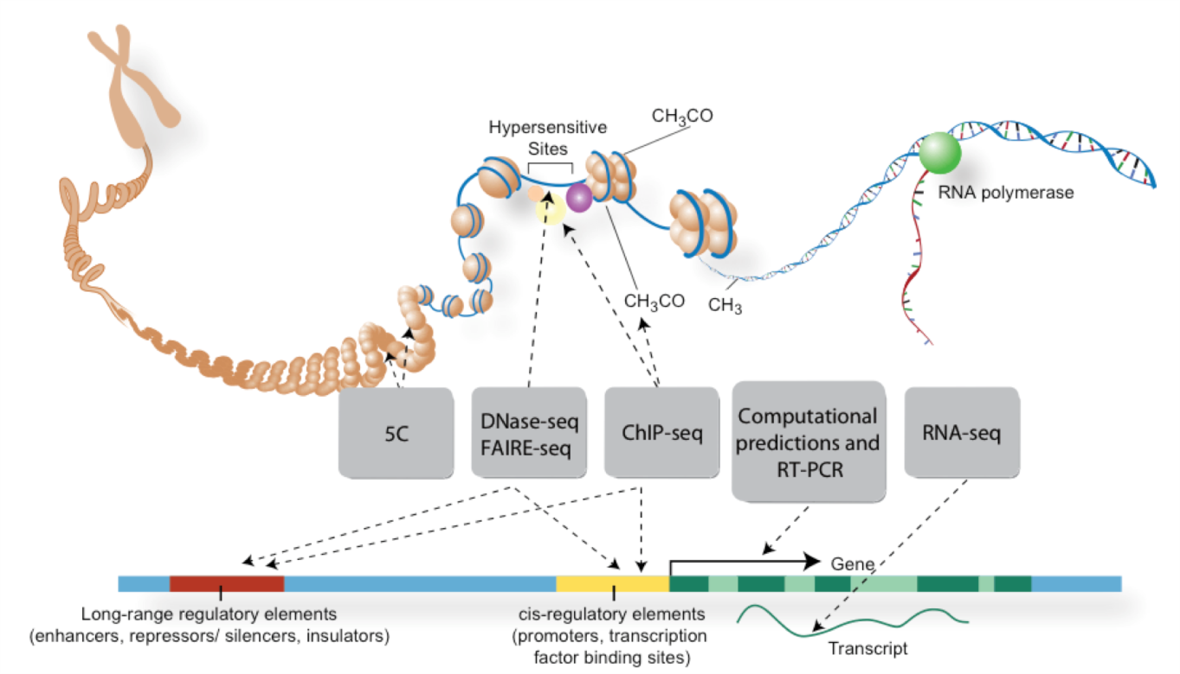
Experimental analysis of gene expression & regulatory interactions
ENCODE; Sullivan et al., 2015
Notes:
In the next slides, I will introduce different experimental and computational methods are available to map GRNs, which will be discussed, compared and integrated in the rest of my talk.

Slide 3
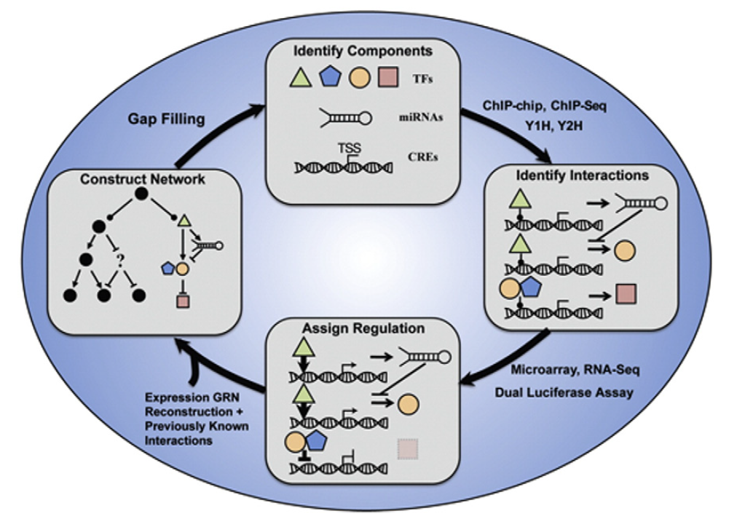
Mapping of Gene Regulatory Networks (GRNs)
Mejia-Guerra et al., 2012
Notes:
Fig. 1. General scheme for the continuous analysis of GRNs. GRNs can be explored in a recurring loop from their basic building blocks (Identify Components) to their most global scale properties (Construct Network). Identify Components: The most basic level is the inventory of all probable components of the grid. In plants, GRNs are composed of transcription factors (TFs) and microRNAs (miRNAs). Identify Interactions: A set of well-established techniques including ChIP-chip, Y1H and Y2H test for binary interactions between components. Assign Regulation: Once connections are identified, genome-wide expression analyses or dual luciferase assays can be used to determine which interactions generate a transcriptional response. Interactions with regulatory consequences are represented by arrows (positive regulation) or T-bars (negative regulation). Construct Network: Integrate information from all identified interactions and their regulation to construct a network representing the GRN. Gaps in the network can be a starting point to generate hypothesis and expand through experimentation.

Slide 4
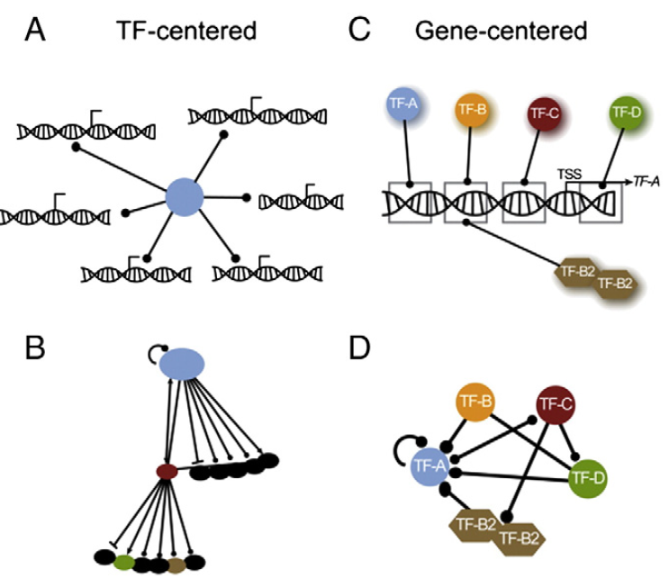
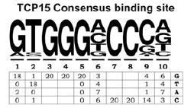
Experimental characterization of regulatory interactions between Transcription Factors (TFs) and target genes
SELEX
PBM
ChIP-Seq
EMSA
Y1H
Mejia-Guerra et al., 2012
Notes:
GRN mapping approaches. (A) The TF-centered approach to map GRNs focuses on the identification of target genes for a particular TF. (B) In the example TF-centered network, a target from a first ChIP-chip (or ChIP-Seq) experiment was used for a subsequent ChIP-chip (or ChIP-Seq) in order to identify downstream targets. Resulting networks are extensive but tend to show low interconnectivity. (C) The gene-centered approach to mapping GRNs focuses on the identification of TF–promoter interactions among a predefined group of TFs. (D) Resulting gene-centered networks tend to show more interconnectivity but do not identify new targets as they are limited by the interactions tested.

Slide 5
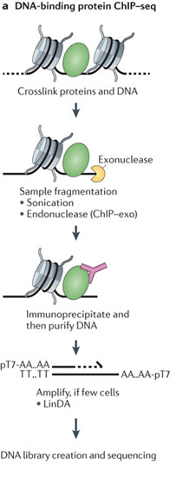
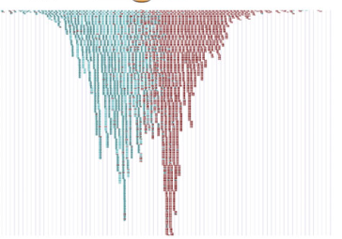

ChIP-Seq: measuring TF protein-DNA interactions
ChIP
in vivo method to measure protein-DNA interactions using chromatin immuno-precipitation
Different cellular conditions can be profiled
Requires TF-specific antibody*
* Tagged TF protein can also be used
TF ChIP-Seq
Furey et al., 2012

Slide 6
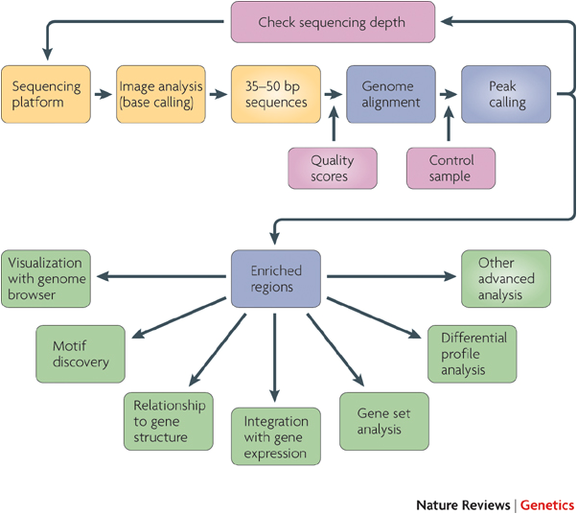
TF ChIP-Seq processing
Reliable peak calling
Modelling TF binding site
Farnham, 2009

Slide 7
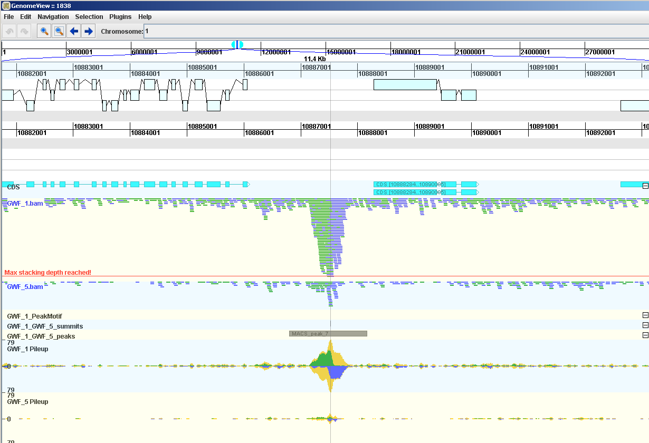
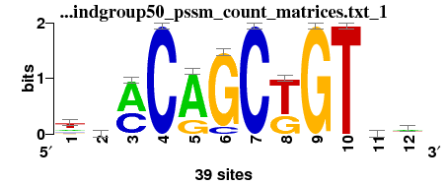
Output ChIP-Seq peak calling procedure displayed in genome browser
Gene annotation
Reads sample
Position Weight Matrix (PWM)
Control
Peak / Motif
Read pileup

Slide 8
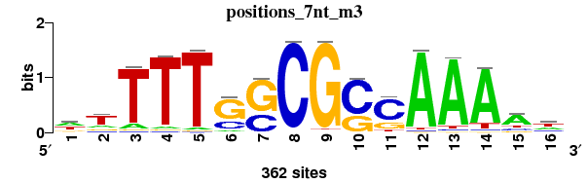
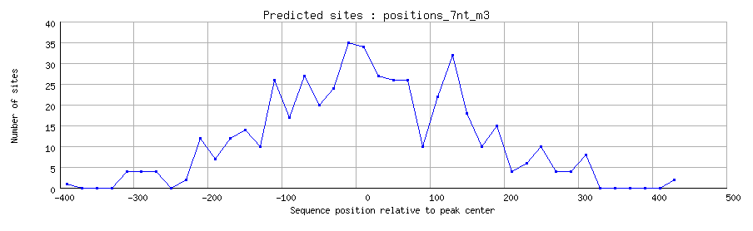
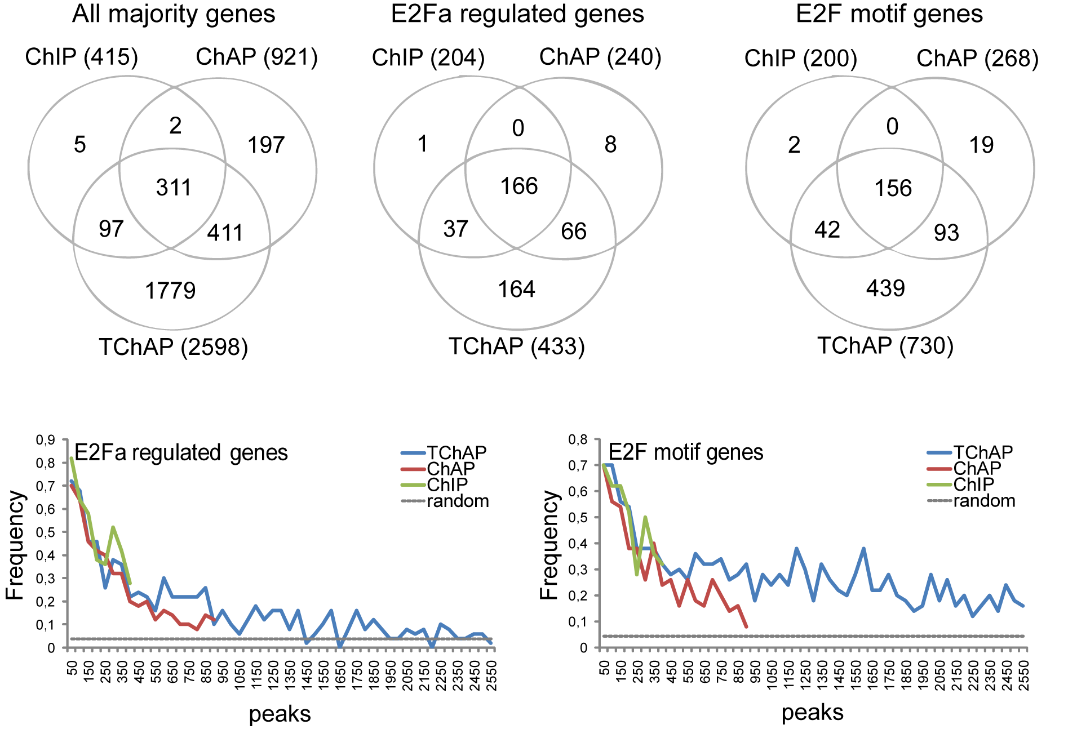
Detection binding site profiled TF
de novo motif finding– RSAT PeakMotifs
Identifies overrepresented motifs in peak sequences
motif composition (PWM) - 6
localization relative to peak center
compares discovered motifs with reference motifs
E2F motif mapping (WTTSSCSS / TTTSSCGC)
E2F motif peaks
 | TChAP
peaks | 2598
peaks with E2F motif (%) | 730 (28,1)
Random occurrence E2F motif genes = 4,34%
Notes:
(using peak regions)
Verify statistical significance (i.e. over-representation)
Compare discovered motifs with known motifs
Sorting the peaks based on their score (~significance), and determining the fraction of peaks that contains an E2F binding motif, we can verify a. if peaks with high scores typically contain more motifs (compared to peaks with low score) b. if the low-scoring peaks still contain more DNA motifs than expected by chance (random line indicates expected frequency by chance)

Slide 9
ChIP-Seq peak annotation

Slide 10
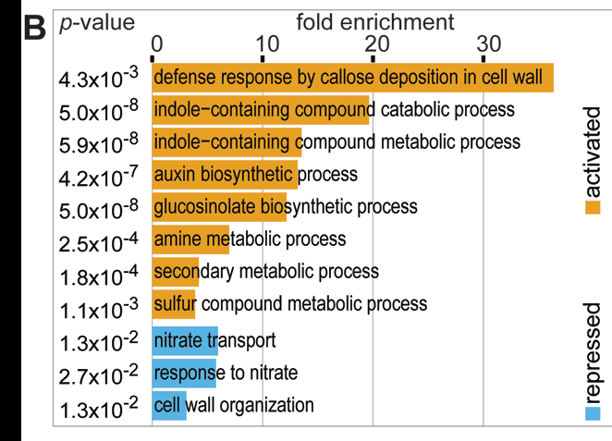
From binding to TF regulation (to biological discovery)
1.Perform a transcript profiling experiment where the TF of interest is perturbed
(inducible) overexpression
knock out (T-DNA, mutant, CRISPR)
2. Identify Up and Down-regulated genes (Differential Expression [DE])
Biological questions
Which genes, pathways or biological processes are regulated by TF of interest?
Which genes of a multi-gene family are (not) regulated by a specific TF?
Can we identify signaling cascades downstream of a specific TF?
Is there evidence for indirect regulation in the TF regulated genes?
Santuari et al., 2016
Notes:
Transcriptome analysis of plants with TF-overexpressing constructs can be used to determine which genes are (directly or indirectly!) regulated by that TF.
The TChAP provides a read out of which peak regions/genes were bound by TF.
20-50% regulated genes are found by one of the binding assays (ChIP, ChAP, TChAP).
Plot lower-right indicates how high/low peak scores are associated with E2F regulated genes (and if frequency is higher than expected by chance (random)).

Slide 11
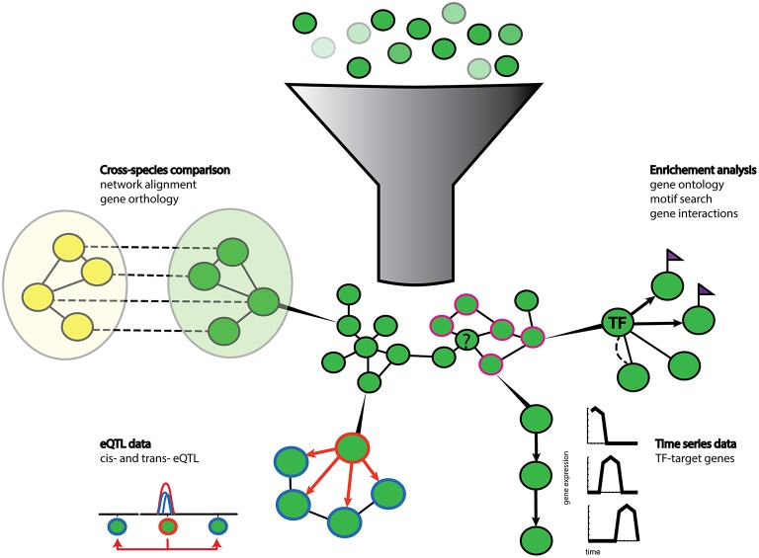
Co-expression as a gene prioritization strategy
Guilt-by-association (GBA): genes with similar gene expression profiles may share similarity in regulation & function
Identify candidate genes for follow-up experiments
Study differentially expressed genes or ChIP targets
  (co-)expression
  delineate functionally coherent clusters
  detect cis-regulatory elements
Learn more about the specific roles of genes
belonging to a certain GO category
Serin et al., 2016

Slide 12
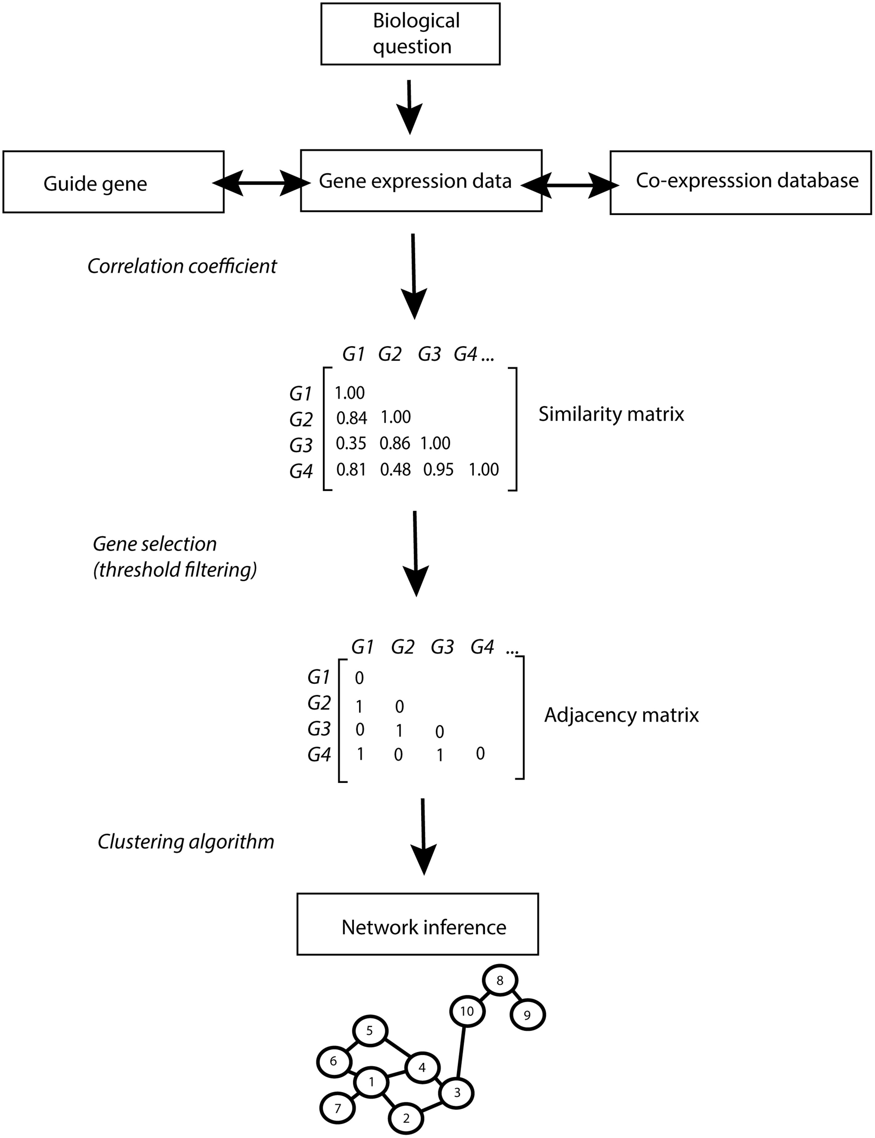
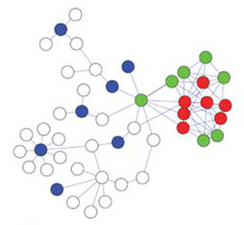
Co-expression Network Analysis
Features
  Integration heterogeneous data sources
    Different gene-gene associations with varying quality
  Exploit network-guided guilt-by-association principle
  Methodologies
      Simple un-weighted/weighted graphs
      Probabilistic models
Notes:
If bait genes are highly interconnected (red circles= unknown query genes), unlike random genes (blue circles), additional genes connected to the bait genes (green circles) are more likely to be involved in the same process.

Slide 13
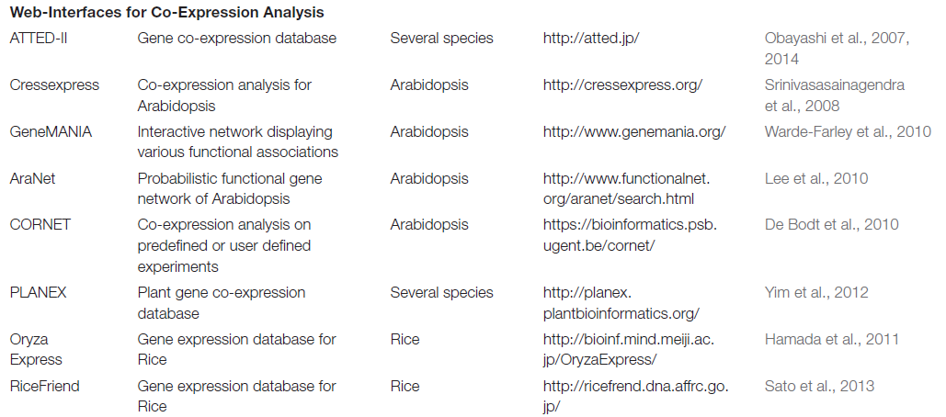
Plant co-expression analysis tools
Serin et al., 2016

Slide 14
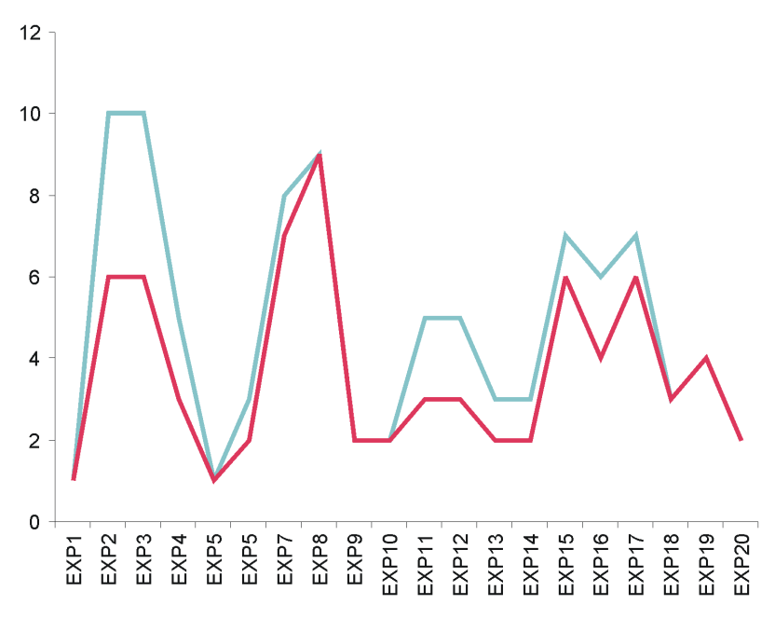
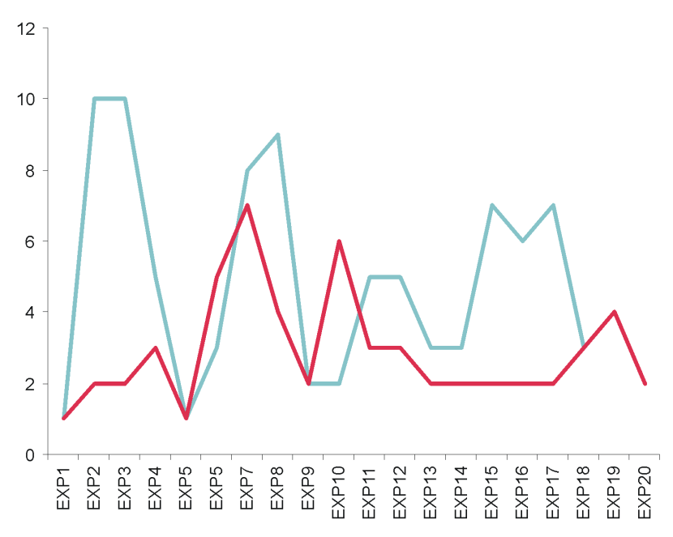
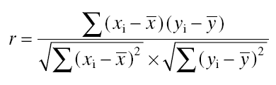
Measures of co-expression
Gene A
Gene B
Gene A
Gene C
Expression value
High correlation coefficient
Low correlation coefficient
Pearson correlation coefficient:
(range: -1,0,1)
Notes:
SSC is more robust to outliers

Slide 15
Other measures of co-expression
Pearson correlation coefficient (PCC):
measures similarity in shape of the expression profiles
Spearman correlation coefficient (SCC):
similar as PCC but on ranks instead of expression values
Highest Reciprocal Ranks (HRR):
Maximum of the two ranks (based on PCC) AB and BA
HRR(AB)=max(r(AB),r(BA))
Mutual rank:
geometric average of the two ranks (based on PCC) AB and BA
MR(AB) = √ (Rank(A→B) x Rank(B→A))
Notes:
SSC is more robust to outliers

Slide 16
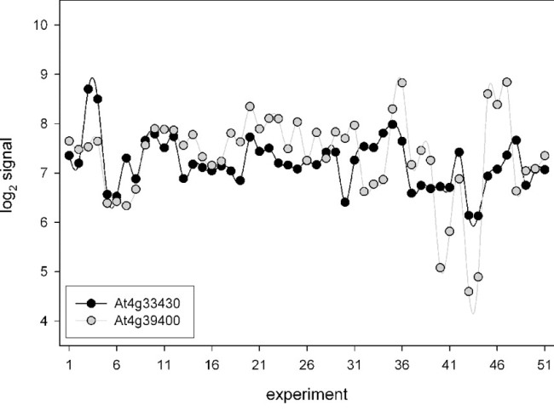
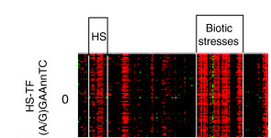
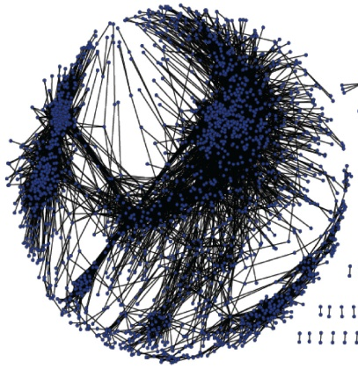
Examples of Plant Coexpression approaches
Persson et al., 2005
Guide-gene approach
Ma and Bohnert, 2007
Non-targeted approach
Integration stress cis-regulatory elements
Notes:
Cellulose synthase – cell wall biosynthesis

Slide 17

https://bioinformatics.psb.ugent.be/cornet/

Slide 18
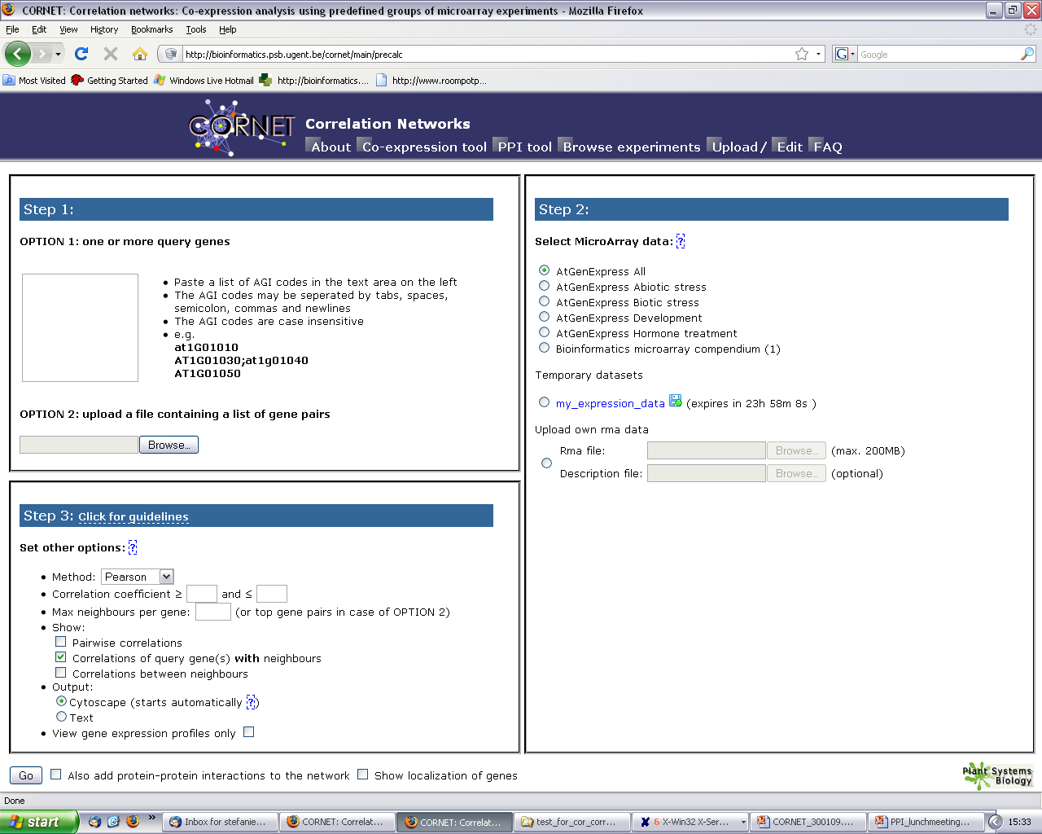
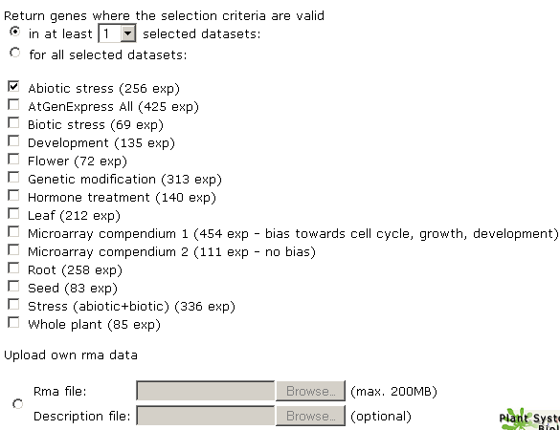

Slide 19
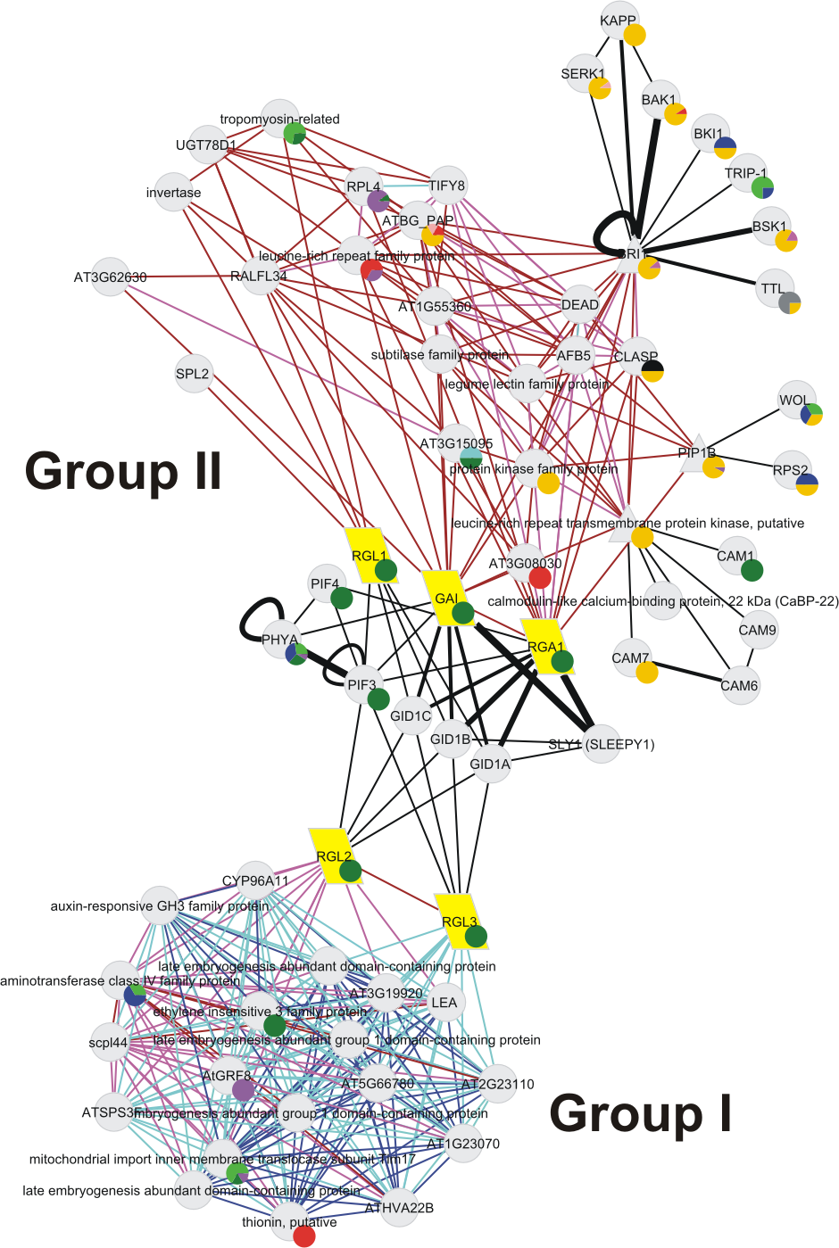
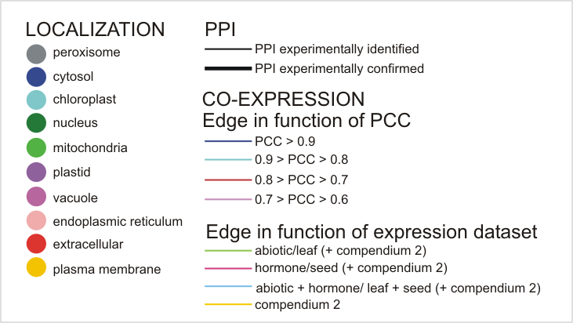
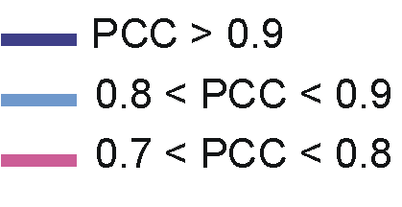
Co-expression and protein-protein interaction network

