Slide 1
Functional Plant Bioinformatics
Using PLAZA to get more out of your plant omics data
25-26 October, 2021
Klaas Vandepoele
Michiel Van Bel

Slide 2

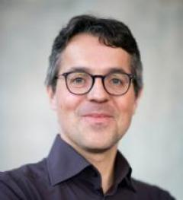
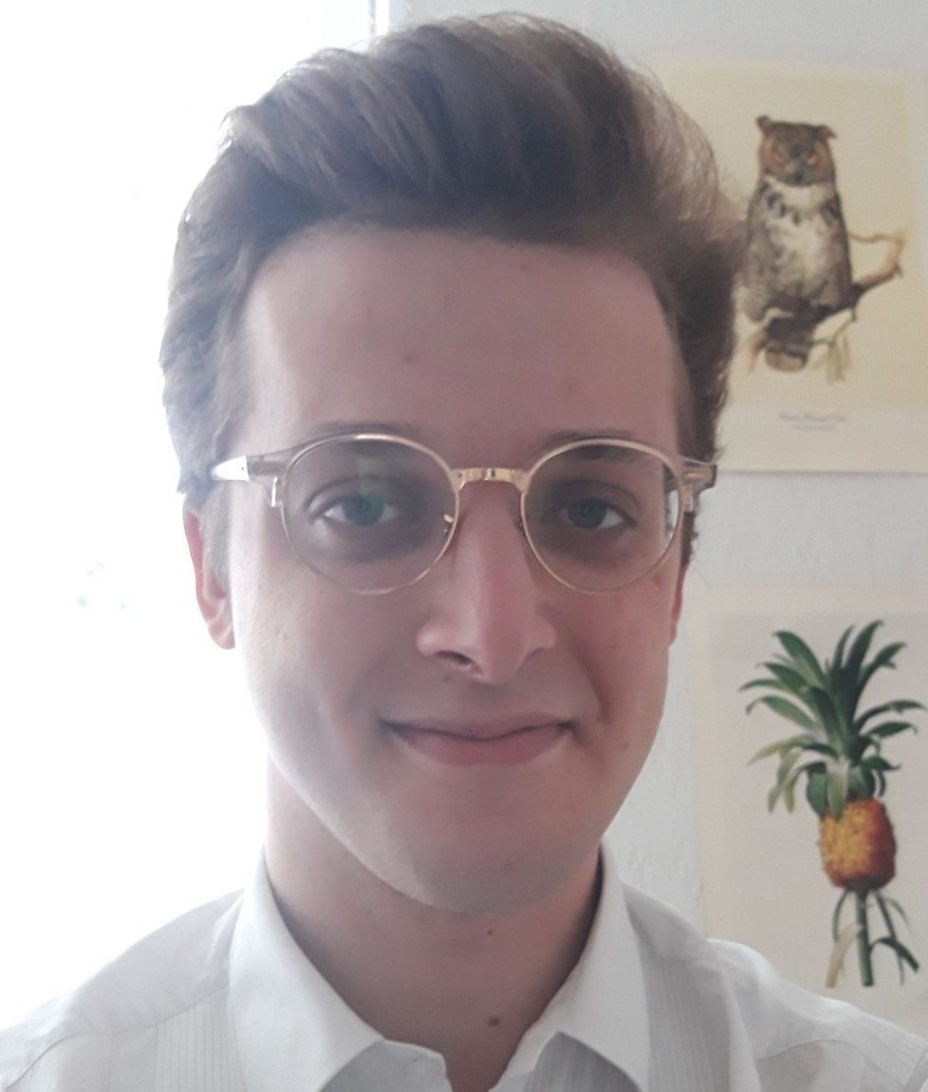
Trainers
Dr. Michiel Van Bel
Prof. Dr. Klaas Vandepoele
Workshop support Elixir/VIB
Alexander Halksworth

Slide 3
Workshop General Information
Virtual workshop via Zoom
  4 sessions: one link per ½ day session
  Fixed time slots for Theory and Hands-on
Questions / communication
  Zoom Chat function
  Zoom breakout room
Help
  PLAZA Documentation, Glossary
  E-mail Alexander: alexander.halksworth@psb.ugent.be

Slide 4
Workshop Schedule – day1
Monday 25 Oct |  |  | https://us02web.zoom.us/j/88929359996?pwd=Y01Yc3FPY1YxV0dKOHpJSnFoV29jUT09
 | 09:30-09:45 | 15 | Welcome: general info + sharing pointers to help channels (Documentation/glossary - breakout rooms) | Klaas
 | 09:45-10:00 | 15 | Short introduction participants (species/biological process of interest) | Klaas
 | 10:00-10:30 | 30 | PLAZA Introduction | Klaas
 | 10:30-11:00 | 30 | Coffee break
 | 11:00-11:30 | 30 | Theory I: genes, gene families, and genome organization | Klaas
 | 11:30-12:30 | 60 | Excercises I: genes, gene families, and genome organization | Michiel
 | 12:30-13:30 | 60 | Lunch
 |  |  | https://us02web.zoom.us/j/87472226602?pwd=SmJCdTVMV1BuRHpIb1hVK3JQWFpVQT09
 | 13:30-14:15 | 45 | Theory II: Orthologs, paralogs, and phylogenetic trees | Klaas
 | 14:15-15:15 | 60 | Excercises II: Orthologs, paralogs, and phylogenetic trees | Michiel
 | 15:15-15:45 | 30 | Coffee break
 | 15:45-16:15 | 30 | Theory III: Functional annotation & functional enrichments | Michiel
 | 16:15-17:00 | 45 | Excercises III: Functional annotation | Michiel

Slide 5
Workshop Schedule – day2
Tuesday 26 Oct |  |  | https://us02web.zoom.us/j/87810202901?pwd=aDQ1bUdOTzFqZmFLZDBmbWJONjZ1UT09
 | 09:30-10:15 | 45 | Theory IV: PLAZA Workbench | Michiel
 | 10:15-10:45 | 30 | Excercises IVa: PLAZA Workbench registration + upload gene set(s) | Michiel
 | 10:45-11:15 | 30 | Coffee break
 | 11:15-12:00 | 45 | Excercises IVb: PLAZA Workbench functional data analysis | Michiel
 | 12:00-13:00 | 60 | Lunch
 |  |  | https://us02web.zoom.us/j/84543936236?pwd=V3EyTDlmL2VNcWF1Ump3T1YrNFNFQT09
 | 13:00-13:45 | 45 | Theory V: Advanced orthology, synteny, and expression analysis in cereals | Klaas
 | 13:45-14:45 | 60 | Excercises Va: Advanced orthology, synteny, and expression analysis in cereals | Klaas
 | 14:45-15:15 | 30 | Coffee break
 | 15:15-16:00 | 45 | Excercises Vb: Advanced orthology/synteny using PLAZA workbench | Klaas
 | 16:00-16:30 | 30 | Feedback + closing workshop

