Slide 1
Functional Plant Bioinformatics
Using PLAZA to get more out of your plant omics data
22-23 April, 2024
Klaas Vandepoele
Michiel Van Bel Sander Thierens

Slide 2
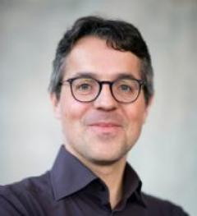
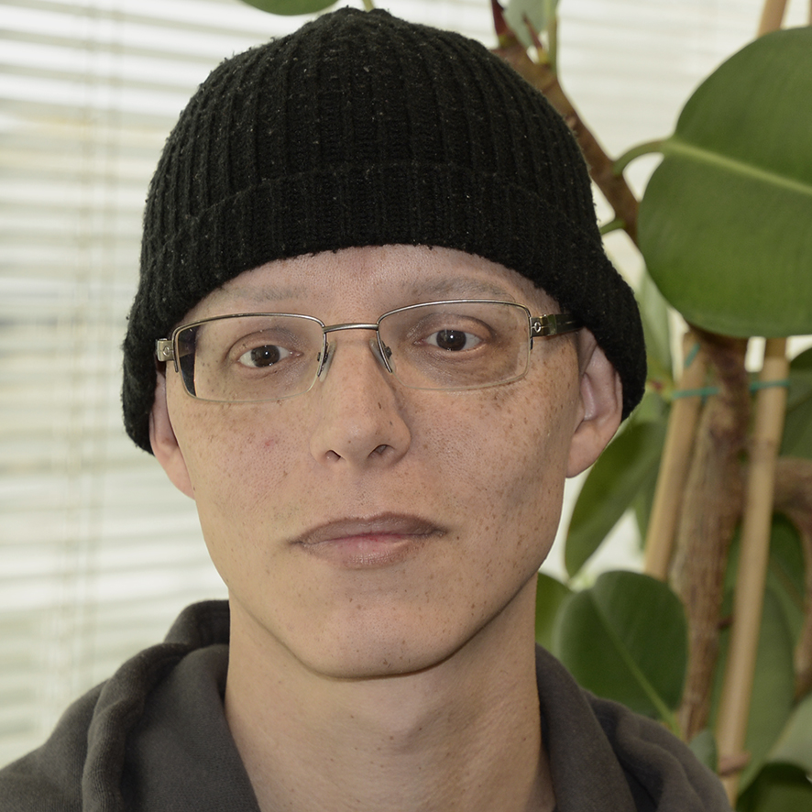
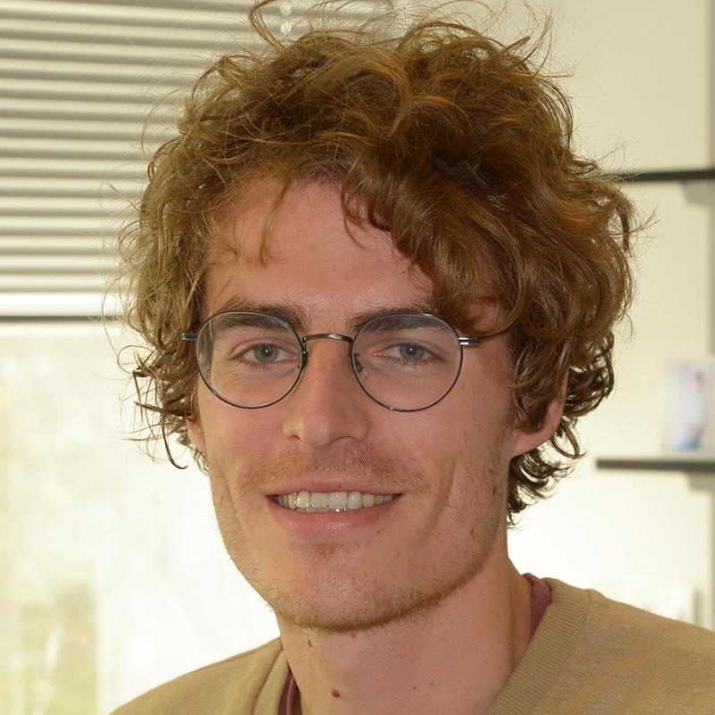
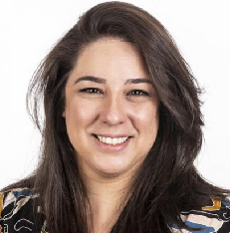
People
Trainers
Prof. Dr. Klaas Vandepoele
Dr. Michiel Van Bel
Sander Thierens
Workshop Support VIB/ELIXIR
Bruna Piereck
Yasmine Maes

Slide 3
Workshop General Information
One-site Workshop
4 sessions: one link per ½ day session
Fixed time slots for Theory and Hands-on
Questions / communication
Always feel free to ask questions
Use post-it notes to indicate exercises are finished
Help
PLAZA Documentation, Glossary

Slide 4
Workshop Schedule – day1
Monday April 22nd | Time | Duration |  | Trainer
 | 09:30-09:45 | 15 | Welcome | Klaas
 | 10:00-10:30 | 15 | Short introduction participants (reason to join workshop) | Klaas
 | 10:00-10:30 | 30 | PLAZA Introduction | Klaas
 | 10:30-11:00 | 30 | Coffee break
 | 11:00-11:30 | 30 | Theory I: genes, gene families, and genome organization | Klaas
 | 11:30-12:30 | 60 | Excercises I: genes, gene families, and genome organization | Michiel Sander
 | 12:30-13:30 | 60 | Lunch
 | 13:30-14:15 | 45 | Theory II: Orthologs, paralogs, and phylogenetic trees | Klaas
 | 14:15-15:15 | 60 | Excercises II: Orthologs, paralogs, and phylogenetic trees | Michiel Sander
 | 15:15-15:45 | 30 | Coffee break
 | 15:45-16:15 | 30 | Theory III: Functional annotation & functional enrichments | Michiel
 | 16:15-17:00 | 45 | Excercises III: Functional annotation | Michiel Sander

Slide 5
Workshop Schedule – day2
Tuesday April 23rd | Time | Duration |  | Trainer
 | 09:30-10:00 | 30 | Theory IV: PLAZA Workbench | Michiel
 | 10:00-10:30 | 30 | Excercises IVa: PLAZA Workbench registration + upload gene set(s) | Michiel Sander
 | 10:30-11:00 | 30 | Coffee break
 | 11:00-11:30 | 30 | Excercises IVb: PLAZA Workbench functional data analysis | Michiel
 | 11:30-12:30 | 60 | Lunch
 | 12:30-13:30 | 60 | Theory V: Advanced orthology, synteny, and expression analysis in cereals | Klaas
 | 13:30-14:15 | 45 | Excercises Va: Advanced orthology, synteny, and expression analysis in cereals | Klaas
 | 14:15-15:15 | 30 | Coffee break
 | 15:15-16:00 | 45 | Excercises Vb: Advanced orthology/synteny using PLAZA workbench | Klaas
 | 16:00-16:30 | 30 | Feedback + closing workshop

