Slide 1
Functional Plant Bioinformatics
Advanced orthology, synteny, and expression analysis in cereals
22-23 April, 2024
Klaas Vandepoele
Michiel Van Bel
Sander Thierens

Slide 2
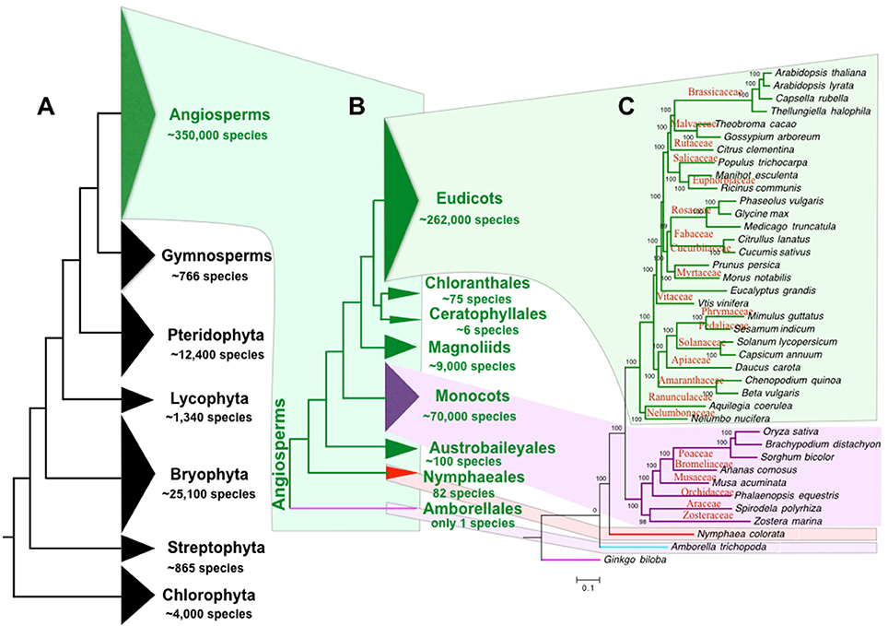
Plant genomes
Notes:
Source: https://www.plabipd.de/timeline_view.ep and https://www.plabipd.de/plant_genomes_pa.ep

Slide 3
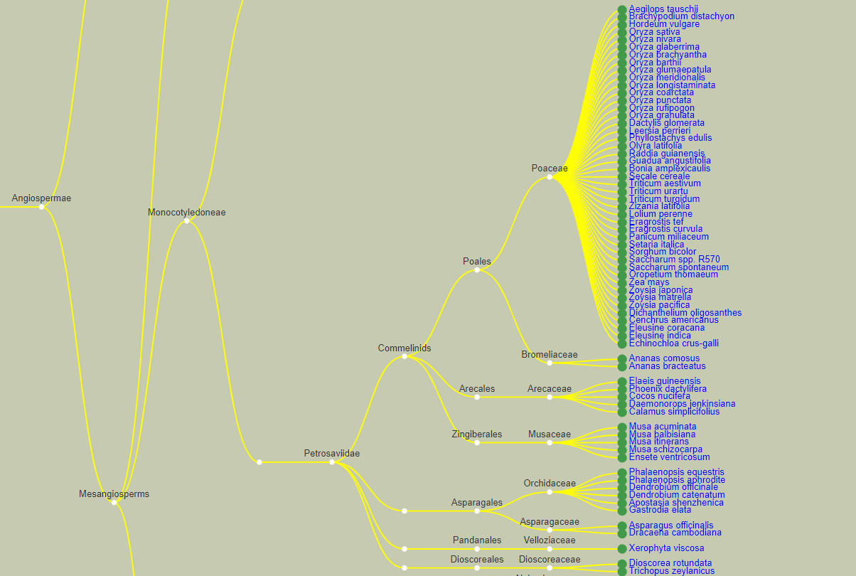
Cereal genomes
Notes:
Source: https://www.plabipd.de/timeline_view.ep and https://www.plabipd.de/plant_genomes_pa.ep

Slide 4
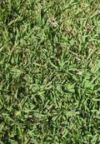
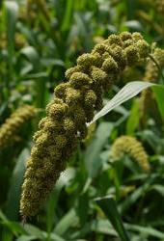
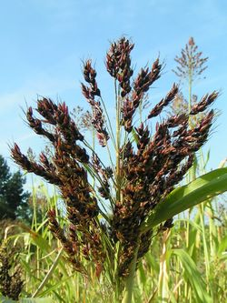
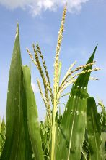
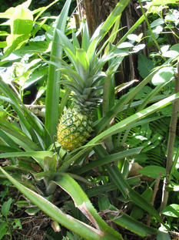
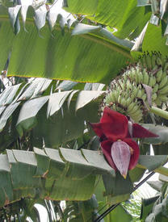
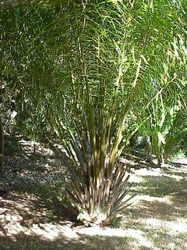


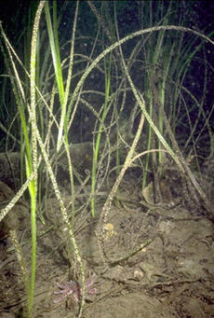
37 Liliopsida genomes in PLAZA 5.0 Monocots
Notes:
Source: https://www.plabipd.de/timeline_view.ep and https://www.plabipd.de/plant_genomes_pa.ep

Slide 5
Genomic approaches for studying crop evolution. Schreiber et al., 2018

Slide 6
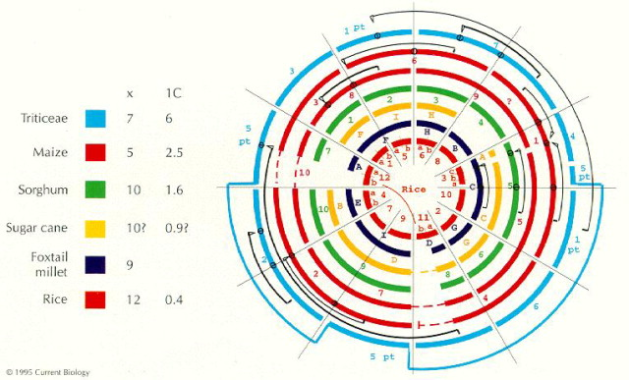
Cereal Genome Evolution: Grasses, line up and form a circle
Moore, Devos and Gale, 1995
Notes:
Comparative genomics can be performed at different levels: genome level to study chromosome biology, at the gene level to study pathways or GFs, but also at the DNA level to for example identify CVs, SNPS. In all these cases, setting up CG workflows is not easy, as you need to handle a lot of data, combine several tools and also make sure the performance of your methods scales well with for example extra genomes.

Slide 7
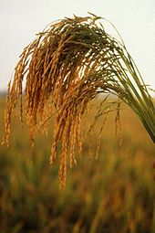
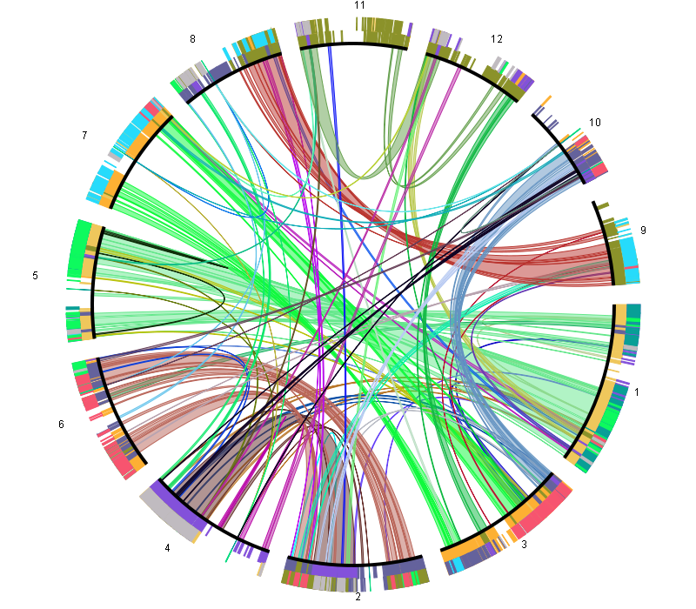
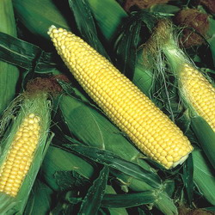

Cross-species genome analysis
Comparative genomics is a powerful tool
  to transfer knowledge from model species to crops
  to link genomic changes to environmental adaptation
  to trace structural changes within a genome or population
Notes:
Comparative genomics can be performed at different levels: genome level to study chromosome biology, at the gene level to study pathways or GFs, but also at the DNA level to for example identify CVs, SNPS. In all these cases, setting up CG workflows is not easy, as you need to handle a lot of data, combine several tools and also make sure the performance of your methods scales well with for example extra genomes.

Slide 8
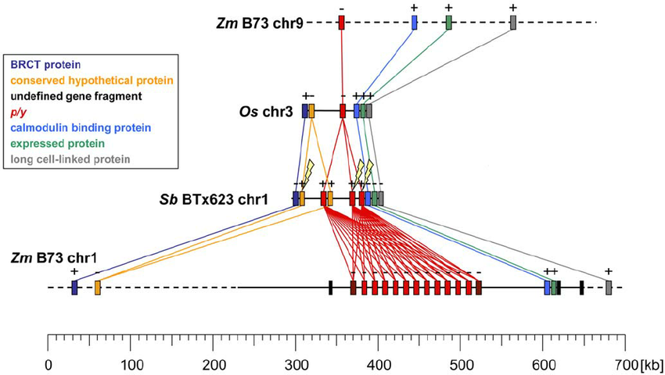
Conserved synteny in grasses
Goettel and Messing, 2009

Slide 9
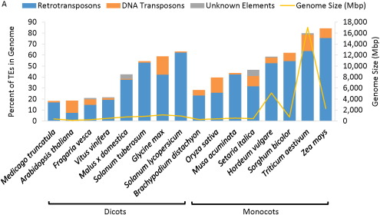
Transposable elements and genome size variation
Hirsh and Springer, 2017

Slide 10
Gene annotation is challenging in complex plant genomes
Zea mays
Van Bel, Bucchini and Vandepoele, 2018
2008
2010
2013
2016

Slide 11
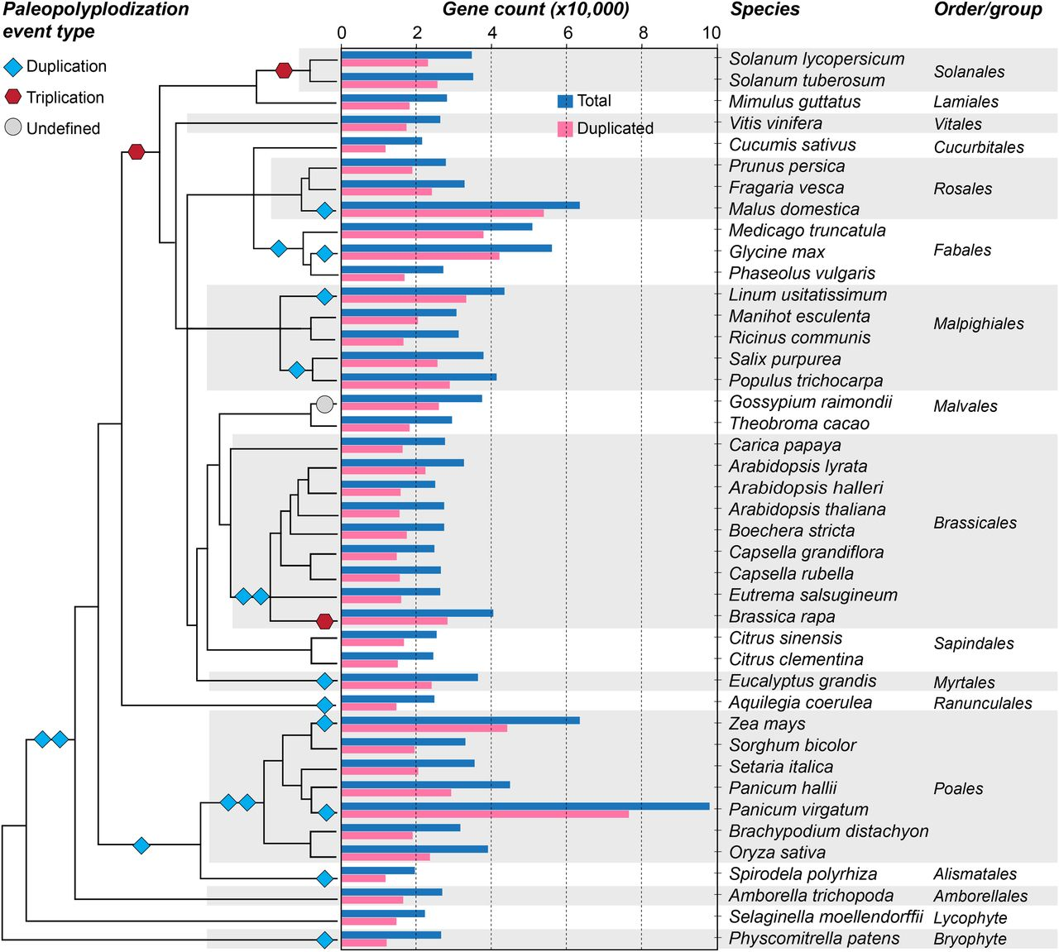
Polyploidy
Panchy et al., 2016
Notes:
Comparative genomics can be performed at different levels: genome level to study chromosome biology, at the gene level to study pathways or GFs, but also at the DNA level to for example identify CVs, SNPS. In all these cases, setting up CG workflows is not easy, as you need to handle a lot of data, combine several tools and also make sure the performance of your methods scales well with for example extra genomes.

Slide 12
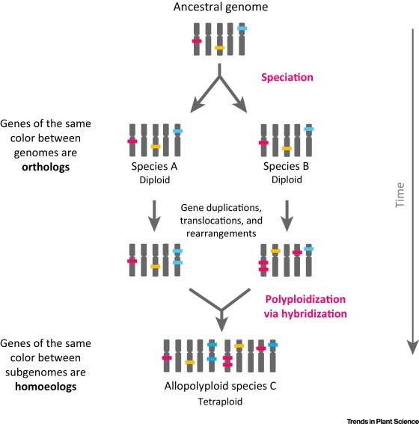
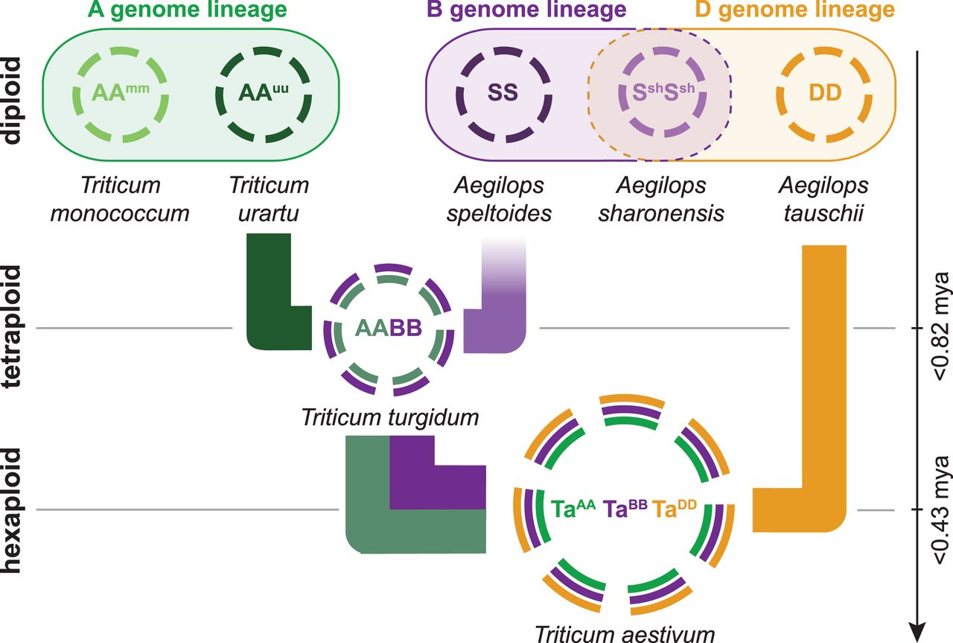
Homoeologs
Homoeologs are pairs of genes that originated by speciation and were brought back together in the same genome by allopolyploidization (~genome hybridization).
Glover et al., 2016; IWGSC, 2014

Slide 13
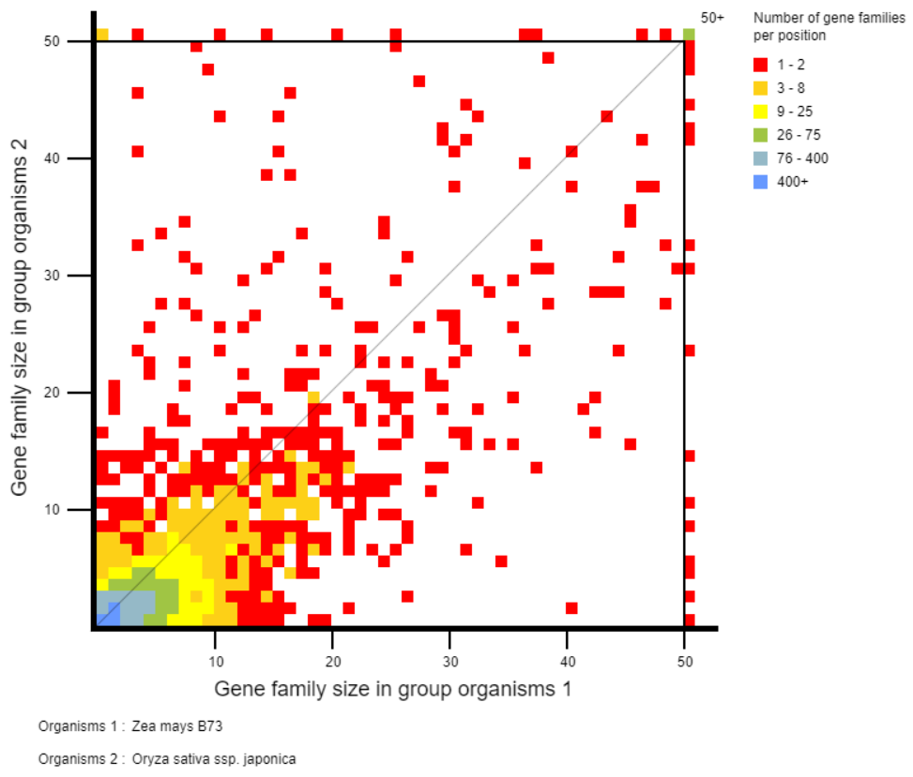
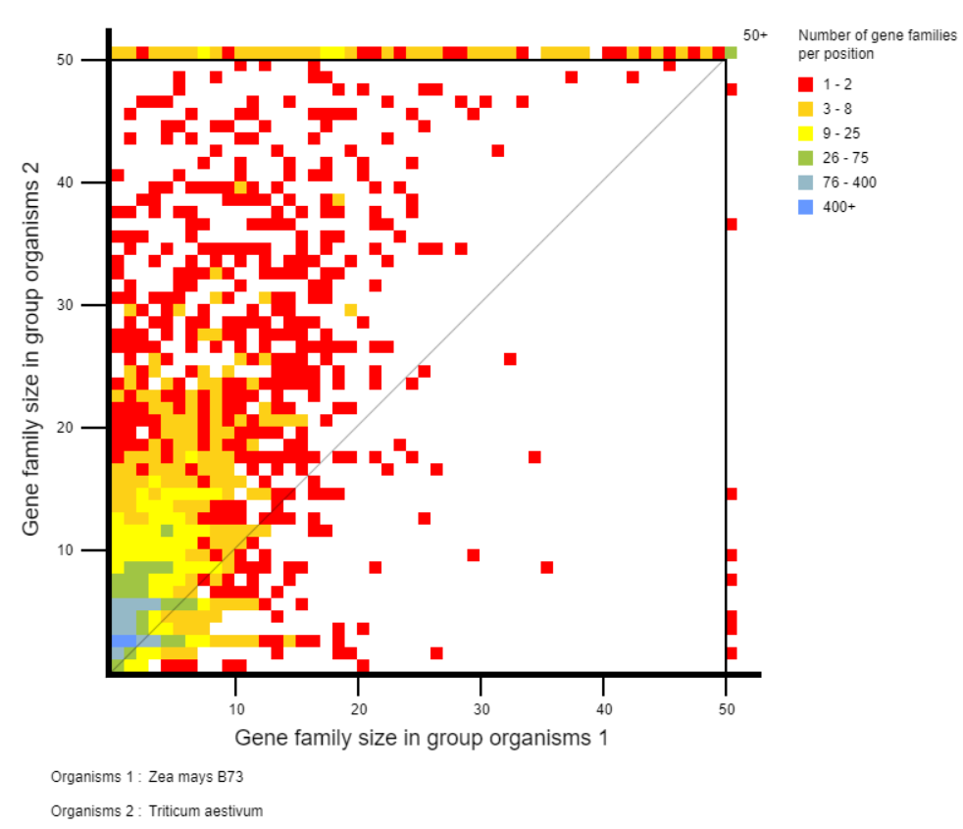
Gene family evolution
PLAZA Gene family expansion plot

Slide 14
Gene family expansions
Rice LOC_Os12g39620
disease resistance protein

Slide 15
Synteny analysis

Slide 16
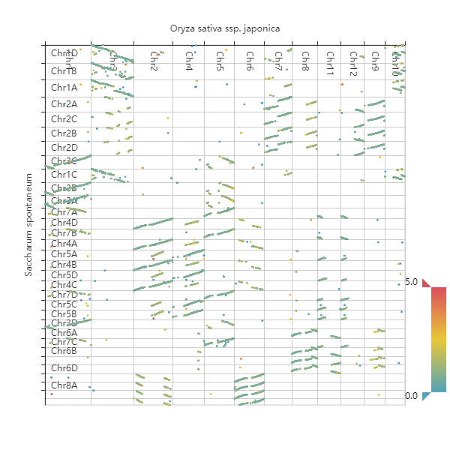
Oryza sativa - Saccharum spontaneum WGDotplot
The 32 pseudo-chromosomes comprise 8 homologous groups with 4 sets of monoploid chromosomes: A, B, C and D

Slide 17
Integrative Gene orthology
GRMZM2G017087 – KN1
Notes:
KN1 orthologs in Taes
TraesCS5A02G405900
TraesCS4D02G058000
TraesCS4B02G057900
TraesCS5B02G410600
TraesCS5D02G415900
TraesCS4A02G256700

Slide 18
Wheat genome

Slide 19
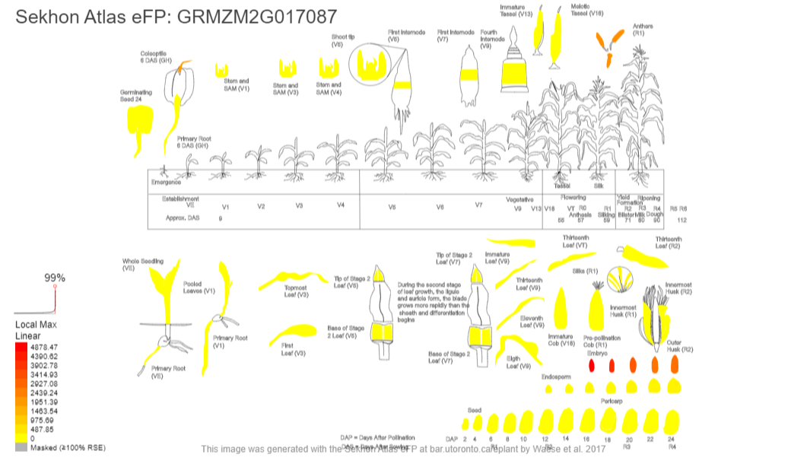
eFP gene expression browser: knotted1 (KN1)
eFP browser - BAR Toronto

Slide 20
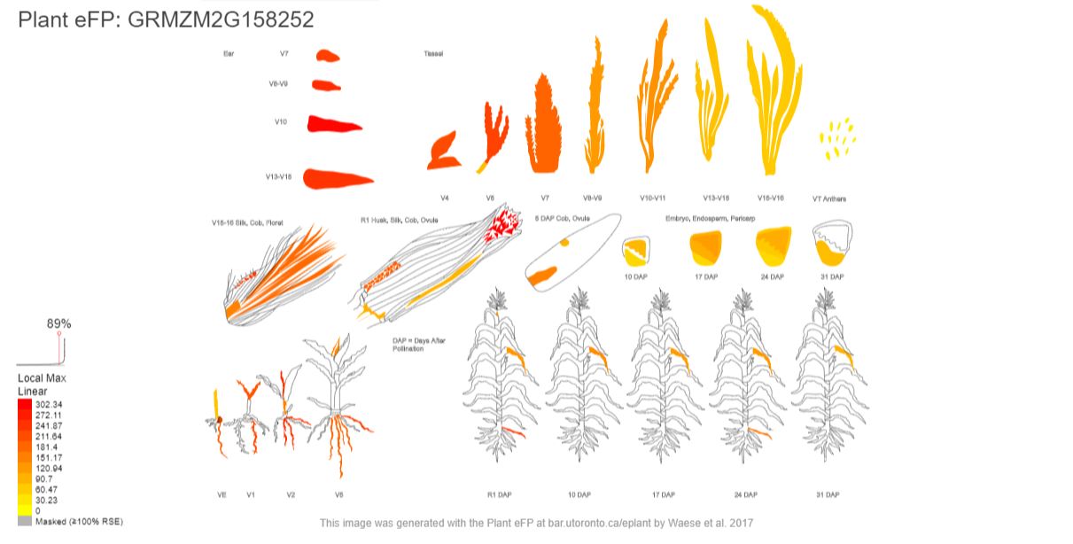
eFP gene expression browsers
eFP browser - BAR Toronto

Slide 21
Wheat transcriptional landscape
Ramirez-Gonzalez et al., 2018
Notes:
Ramírez-González

Slide 22
Gene triad expression analysis in hexaploid wheat
Ramirez-Gonzalez et al., 2018
Notes:
Ramírez-González

Slide 23
Wheat gene expression divergence
Ramirez-Gonzalez et al., 2018
Notes:
Ramírez-González

Slide 24
Wheat gene expression viewer: KN1 orthologs
http://www.wheat-expression.com/
Notes:
KN1 orthologs in Taes
TraesCS5A02G405900
TraesCS4D02G058000
TraesCS4B02G057900
TraesCS5B02G410600
TraesCS5D02G415900
TraesCS4A02G256700

